Slide 1

FY19 Annual Report and
FY20 planning report

Slide 2

Who We Are
Eight Academic Units
  Agriculture
  Criminal Justice Sciences
  Family and Consumer Sciences
  Health Sciences
  Information Technology
  Kinesiology and Recreation
  Military Science
  Technology
Five Affiliate Units
  Gamma Phi Circus
  University Farm at Lexington
  Horticulture Center
  Child Care Center
  Sports Medicine and Rehabilitation Therapy Clinic

Slide 3
college team
Todd McLoda – Dean
Cara Rabe-Hemp– Interim Associate Dean
Kara Snyder – Assistant Dean, Marketing & Constituent Relations
Lori Fox – Administrative Aide
Cindy Greskiwcz – Office Manager
Kate Jacobs – Director of Development
Marcus Alouan – Director of Gamma Phi Circus
Deb Wylie – Administrative Aide to Gamma Phi Circus
Chandra Smith, Kyle Campbell, Jim Hearn, Ben Hendrix, Todd Thomas, and Zeb Houle – IT Support Services

Slide 4
college team
Rob Rhykerd – Chair of AGR
Brent Teasdale – Chair of CJS
Jeff Clark – Interim Chair of FCS
Chris Grieshaber – Chair of HSC
Mary Elaine Califf – Director of IT
Dan Elkins – Director of KNR
LTC John Cross – Chair of MSC
Ted Branoff – Chair of TEC

Slide 5
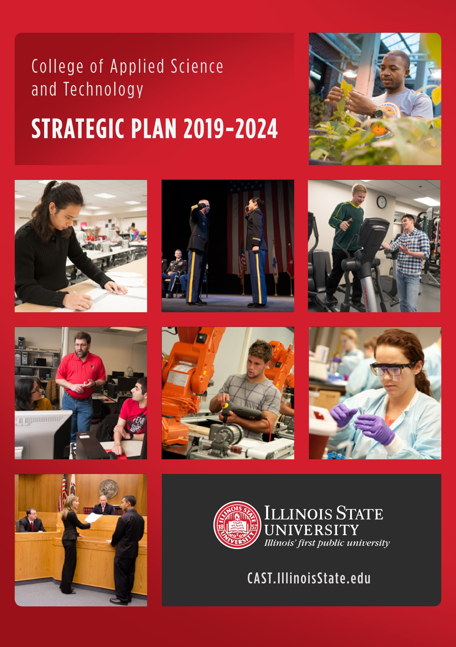
Strategic plan
(2019-2024)

Slide 6
mission and vision
Mission
Through applied learning, we prepare and empower students who will make lasting, positive contributions to their profession and the world. We leverage and celebrate the breadth of programs within the College of Applied Science and Technology that build upon a strong general education foundation.
Vision
CAST: Inspiring innovation, opportunity, and the discovery of knowledge through exceptional academic programs and experiential learning.

Slide 7
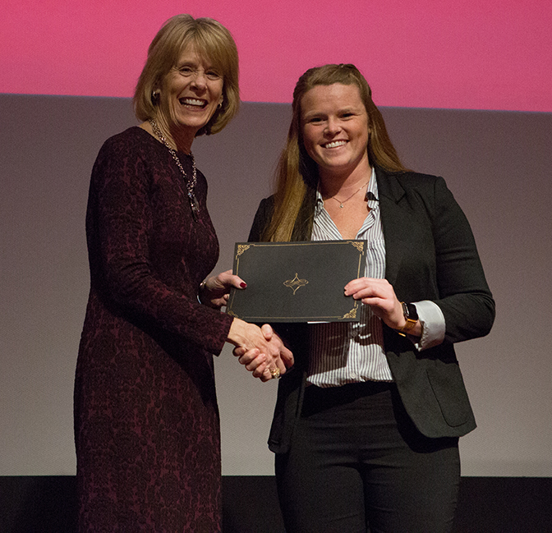
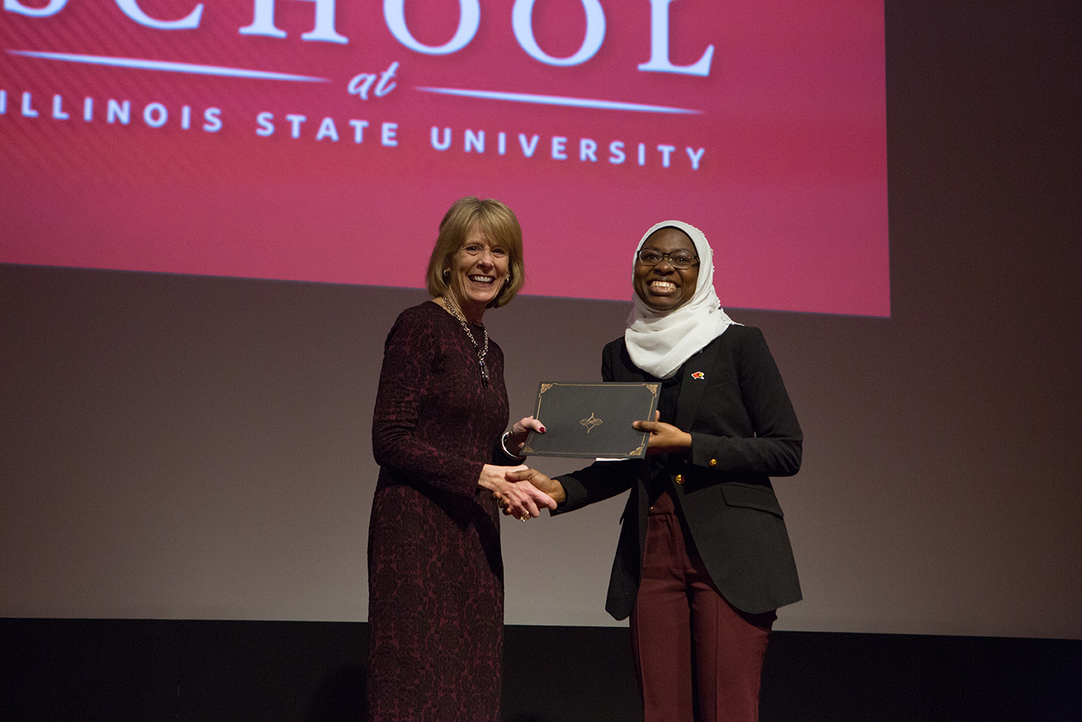
FY19 Report
Goal 1
Integrate relevant applied learning and technologies to provide an exemplary educational experience focusing on individual goals for both undergraduate and graduate students.
  Stephanie Stephens (KNR) won 1st place and Fatima Mohammed (AGR) won 2nd place in the university 3MT competition.

Slide 8
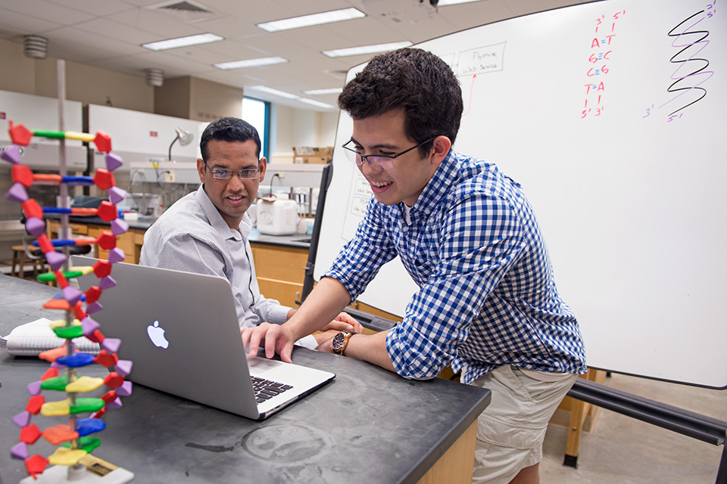
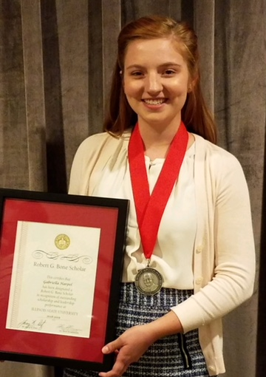
FY19 Report
Goal 1
  Basheer Bacerra (computer science and mathematics) and Gaby Harpel (interior design), were named Bone Scholars for 2018-2019.
  The newly established cybersecurity program has exceeded enrollment projections this year and we are working to secure needed laboratory and classroom space with the assistance of a gift from State Farm.

Slide 9

FY19 Report
Goal 1
  Undergraduate enrollment (4,244) was down slightly this year.

Slide 10
FY19 Report
Goal 1
  CAST graduate enrollment (370) level in FY19.

Slide 11

FY19 Report
Goal 2
Foster a cohesive culture of diversity, inclusion, and equity that reaches all our students, faculty, and staff.
  Through an inter-college partnership, CAS and CAST developed Courageous Conversations. This initiative encouraged specially trained faculty facilitators to host sessions focused on diversity and inclusion efforts in the colleges.

Slide 12
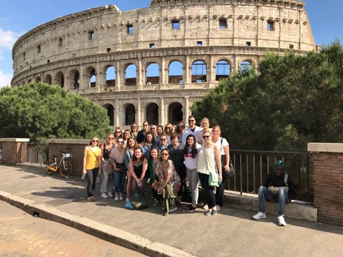
FY19 Report
Goal 2
  The Family and Consumer Sciences Department sent a group of over 20 students to Italy in May 2018. Three trips are planned for May 2019 – an FDM trip to Asia, an FND trip to Italy, (in conjunction with KNR) and an FNM trip to Argentina (in conjunction with AGR).

Slide 13
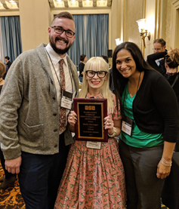
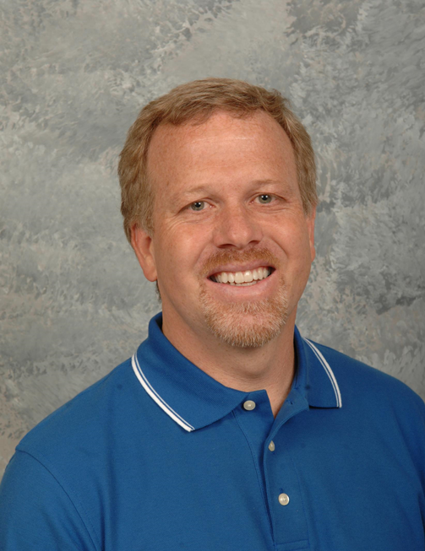
FY19 Report
Goal 3
Support a workplace that facilitates and rewards faculty and staff excellence.
  Dr. Shelly Clevenger (CJS), won the ASC Division of Women and Crime Best New Scholar Award.
  Dr. Dale Brown (KNR) was named the 2018 IAHPERD Scholar.

Slide 14
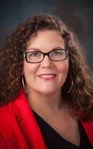

FY19 Report
Goal 3
  Dr. Nweze Nnakwe (FCS) completed a multi-year longitudinal study in Nigeria.
  Dr. Dawn Beichner (CJS) was elected to the Executive Committee of the World Society of Victimology and appointed as liaison to the United Nations.

Slide 15
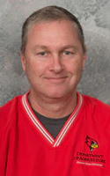
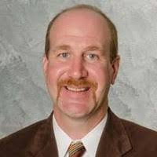
FY19 Report
Goal 3
  Undergraduate Advisor, Mr. Dave Malone (AGR) was recognized with the CAST Outstanding AP Staff Award.
  Dr. Chris Merrill (TEC) secured a $635,000 federal grant titled “Illinois Career and Technical Education Innovative Curriculum Resources Project.”

Slide 16
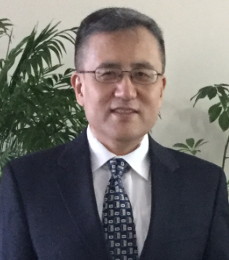

FY19 Report
Goal 3
  Dr. Qi Zhang (IT) published two articles related to bio-medical technology: “Layer-based visualization and biomedical information exploration of multi-channel large histological data” and “Web-based medical data visualization and information sharing towards application in distributed diagnosis.”
  For the second year in row, the Exercise Science Faculty (KNR) received Exercise Is Medicine on Campus Gold Level Recognition from ACSM.

Slide 17
FY19 Report
Goal 3
  Faculty submitted 53 extramural funding proposals totaling $7,092,422. In total, 51 proposals were funded for $2,128,645.
CAST Proposal Submissions
by Funding Source

Slide 18
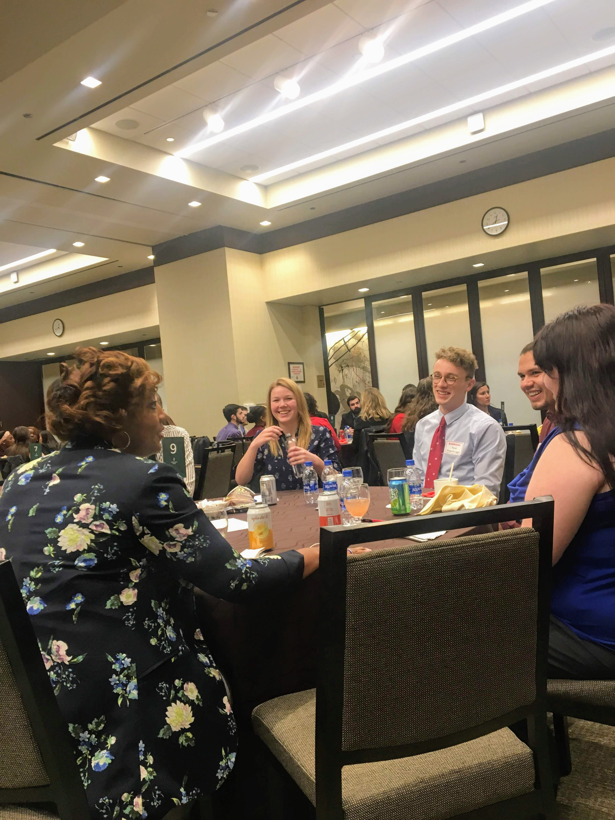
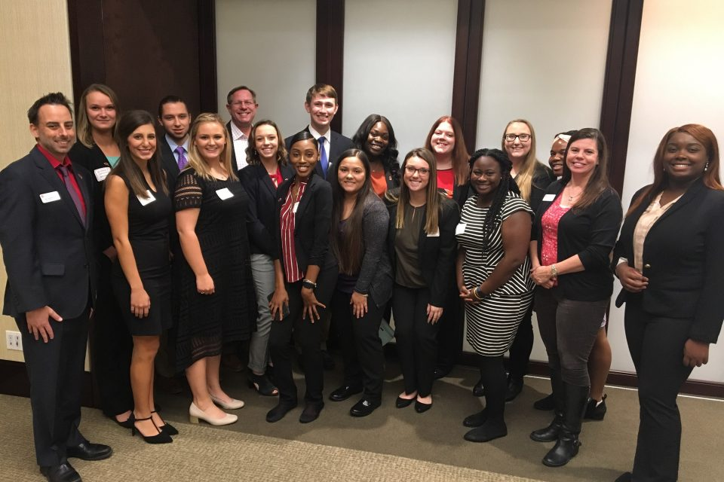
FY19 Report
Goal 4
Develop and maintain productive relationships with external constituencies.
  CAST held the inaugural edition of CAST Connections, a networking event aimed at connecting students with alumni. Over 90 students traveled to Chicago to meet with alumni.

Slide 19
FY19 Report
Goal 4
  FCS continued the Fresh FAVS program which includes participation by the Department, Wellness, Event Management, and Campus Dining. The program provides reasonably priced fresh fruits and vegetables to subscribers on campus. The program was developed by an FCS graduate student.
  Also in FCS, the award-winning Fix-It Friday initiative continued under the direction of Elisabeth Reed. Students set up a table either on campus or in the community to mend articles of clothing for free rather than see the items tossed in a landfill.

Slide 20
FY19 Report
Goal 4
  The garden collections at the Horticulture Center (AGR) were visited by approximately 3,000 guests at events throughout the year.
  MSC’s “Cadets Helping Kids” is a mentorship program that involves our cadets working with local elementary school children as tutors and role models.
  Dr. Glen Sagers (IT) organized the seventh annual Central Illinois High School Cyber Defense competition. Seventy-six students from ten central Illinois high schools competed to defend computers and networks from hacking attacks.

Slide 21

FY19 Report
Goal 4
  CAST hosts Science and Technology Week annually, providing a variety of events that pertain to both internal and external constituencies (students, faculty, staff, alumni, donors, and community members).
  Gamma Phi Circus is celebrating its 90th anniversary.
  KNR coordinated a summer PE Teacher Technology Workshop attended by alumni and professionals throughout the state of Illinois.
  Dr. Brent Teasdale (CJS) was named to the Governor’s task force on gun violence and mental illness.

Slide 22
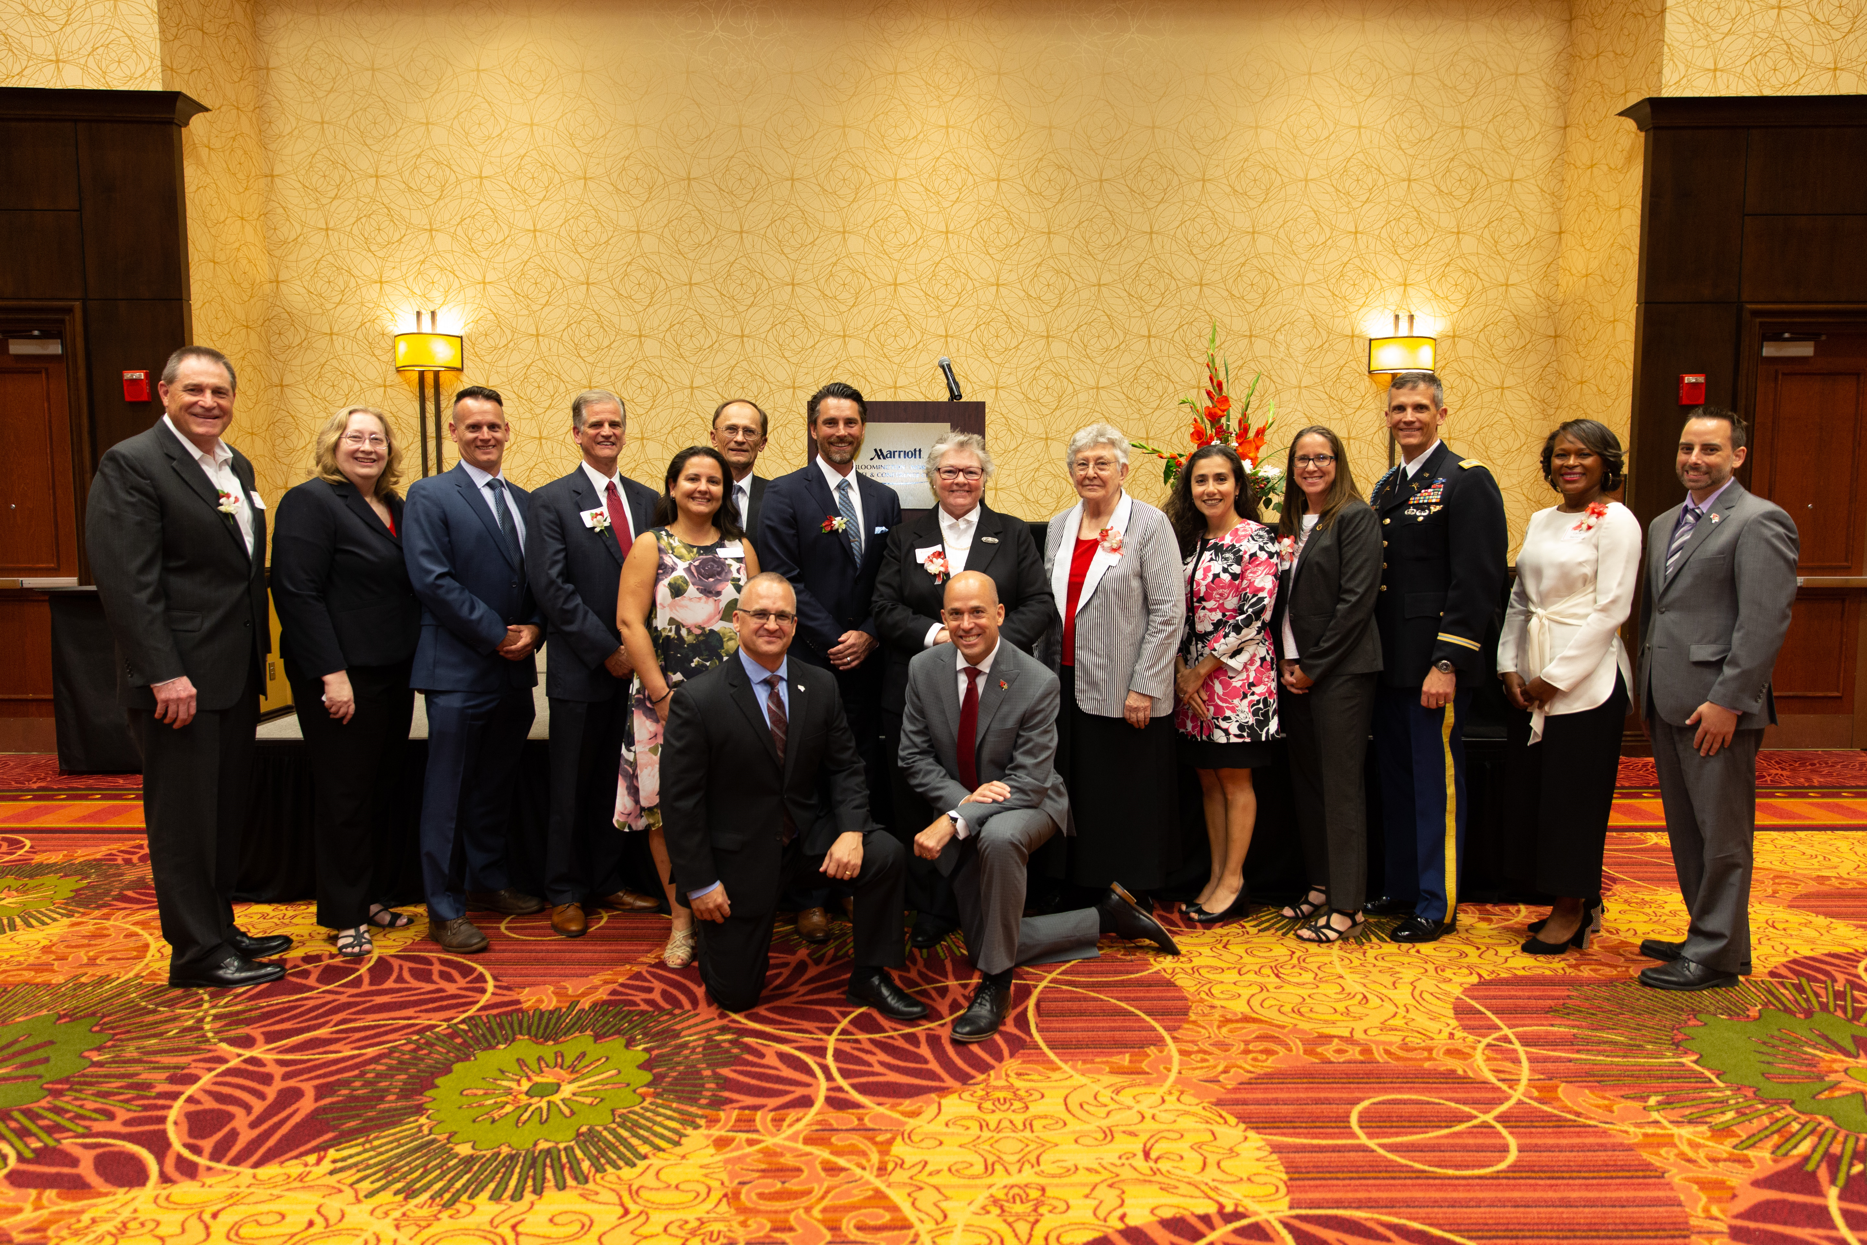
FY19 Report
Goal 4
  CAST inducted 8 new members to our Hall of Fame and will soon induct 7 new members to our Academy of Achievement which recognizes significant contributions to the discipline of the CAST alumnus within 20 years of graduation.

Slide 23
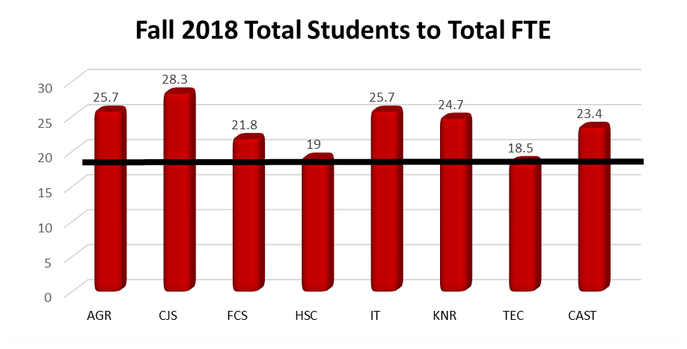
FY19 Report
Productivity
Measures
The total student to FTE ratio for the College (23 students per FTE) remains above the University target.
University Target 18:1
Notes:
The ratios for students to FTE faculty (TT + NTT) are higher than the University target for all CAST units. The CAST average is about 23 students per FTE.

Slide 24
FY19 Report
Productivity
Measures
Notes:
The historic 5-year averages for total FTE, total enrollment, and student to FTE ratios are depicted above. CAST enrollment dipped 1.5% in Fall 2018 but, given the number of applications and admits to CAST programs for Fall 2019, it is highly likely this 98 student reduction is temporary.

Slide 25
FY19 Report
Productivity
Measures
CAST faculty members published 197 peer-reviewed outcomes (manuscripts, books, book chapters, proceedings, etc.) and made 219 peer-reviewed and invited presentations.
This is an average of 2.8 refereed outcomes per total FTE. Since nearly all professional outcomes are generated by T/TT faculty (n=116), the adjusted productivity is 3.6 refereed outcomes per T/TT faculty member.

Slide 26
FY19 Report
Productivity
Measures
Faculty generated 92,626 credit hours (+1.2% from the prior year and +6.2% over 5 years).
T/TTs generated 51,814 credit hours and NTTs generated 35,057.
CAST T/TT generated an average of 455 (compared to the University average of 388).

Slide 27

FY19 Report
Productivity
Measures
Fundraising – We have raised $2,241,375, or 107% (and counting) of the $2.1 million annual goal.
Similarly, we are at 91% (and counting) of our Campaign goal of $14,000,000.

Slide 28
FY19 Report
Internal Reallocations and Reorganizations
  FCS hired an Assistant Director for their new Distance Dietetic Internship certificate.
  Dr. Cara Rabe-Hemp was temporarily reassigned to the CAST Dean’s office (Interim Associate Dean).
  In the Department of Health Sciences, Dr. Chris Grieshaber was hired as Department Chairperson.
  In Family and Consumer Sciences, Jeff Clark is serving as Interim Department Chair after Ani Yazedjian was named Associate Provost.

Slide 29
FY20 Planning
Major
Objectives
For Goal 1:
  Seek additional scholarships and support opportunities to benefit student recruitment and retention.
  Strategically revise existing curricula at the undergraduate level and consider proposals for new programs (B.S. in Mechanical Engineering) with input from faculty, advisory boards, corporate partners, and accrediting agencies.
  Maintain a standard of excellence through national program recognition and accreditation where appropriate.
Notes:
Goal I: Integrate relevant applied learning and technologies to provide an exemplary educational experience focusing on individual goals for both undergraduate and graduate students

Slide 30
FY20 Planning
Major
Objectives
For Goal 1:
  Calibrate available resources and our commitment to individualized attention of students as considerations for program enrollments.
  Continue support of the Washington, D.C Internship program and encourage participation by all academic units.
  Break ground on a dedicated laboratory space for the cybersecurity major.
  Renovate the interior and environmental design learning space in Turner Hall.
  Increase the number of graduate assistantships and the average award of stipends as resources permit.

Slide 31
FY20 Planning
Major
Objectives
For Goal 2:
  Promote inclusion, respect, and equity by creating awareness and through the continuation of Courageous Conversations and other professional development programming.
  Promote diverse educational opportunities as a means of broadening life experience, encouraging professional conduct, and fostering a cross-cultural understanding for students and faculty.
  Promote interdisciplinary and inter-departmental research projects where appropriate.

Slide 32
FY20 Planning
Major
Objectives
For Goal 2:
  Support activities of CAST RSOs geared toward service learning and civic engagement opportunities.
  Seek opportunities for development of student and faculty exchange programs with international universities and ensure inclusion of all CAST units.

Slide 33
FY20 Planning
Major
Objectives
For Goal 3:
  Conduct successful faculty searches as approved for FY20.
  Increase the overall scholarly output of tenure-track faculty members, especially in multi-disciplinary areas.
  Seek opportunities to unite the needs of corporate partners with available faculty expertise.
  Provide professional development support and opportunities for faculty, administrative professionals, and civil service staff.

Slide 34
FY20 Planning
Major
Objectives
For Goal 4:
  Support efforts to host influential guest speakers and professional development opportunities for the benefit of students, faculty, and the community.
  Continue the development of a research center in CJS and a Center for Renewable and Sustainable Energy in TEC.
  Surpass college fundraising goal for the comprehensive campaign.

Slide 35
FY20 Planning
Major
Objectives
For Goal 4:
  Continue to encourage and utilize the expertise of advisory councils in the departments and schools in CAST.
  Expand cultivation and stewardship activities with key alumni, internal, and external constituencies.
  Maintain and seek new relationships with external stakeholders to provide students with professional practice experiences and meaningful corporate and agency networks.

Slide 36
FY20 Planning
Permanent Funding Requests ($467,030)
  Graduate assistantships – increased number and stipends provided.
  Faculty & student travel

Slide 37
FY20 Planning
Strategic Budget Carryover ($539,263)
  Summer salaries
  Faculty travel
  Startup packages
  Laboratory equipment
  Instructional capacity
  Recruitment and retention scholarships

Slide 38
FY20 Planning
Provost Enhancements ($358,000)
  Facilities
    IED studio renovation
    Ag engineering technology lab HVAC

Slide 39
FY20 Planning
Personnel Requests (1 non-reappointment)
  9 new TT requests
    AGR (1)
    CJS (0)
    FCS (1)
    HSC (1)
    IT (2)
    KNR (3)
    TEC (1)
  4 new NTT requests
    AGR (1)
    CJS (0)
    FCS (1)
    HSC (1)
    IT (0)
    KNR (0)
    TEC (1)

Slide 40
FY20 Planning
Rank | Unit | Specialization | TT/NTT
1 | IT | Computer Science | TT
2 | KNR | Exercise Science | TT
3 | KNR | Recreation and Park Administration | TT
4 | FCS | Food and Nutrition Management | TT
5 | AGR | Agriculture Education/ Communications | TT
6 | TEC | Construction Management | TT
7 | HSC | Safety | TT
8 | AGR | Agribusiness | NTT
9 | FCS | Interior and Environmental Design | NTT
10 | IT | Computer Science | TT
11 | KNR | Recreation and Park Administration | TT
12 | HSC | Health Information Management | NTT
Ranked Faculty Search Requests

Slide 41


