Slide 1

College of Fine Arts
Budget Presentation
FY19 Annual Report
FY20 Planning Document
Jean M. Miller, Dean

Slide 2

College of Fine Arts
Leadership Team
Jean Miller/Dean
Sara Semonis/Associate Dean
Janet Tulley/Assistant Dean
Kendra Paitz/Director, Senior Curator, University Galleries
Nick Benson/Coordinator, Center for Performing Arts
Eric Yeager/Director, CFA-IT
Stephanie Kohl Ringle/Business and Communication
Associate
Vikkie Cossio/Budget Associate, CFA Dean’s Office
Molly McDonald/CFA Director of Development
Academic Units
Michael Wille/Director, School of Art
Stephen Parsons/Director, School of Music
Janet Wilson/Director, School of Theatre and Dance
Aaron Paolucci/Director, Arts Technology Program

Slide 3
College of Fine Arts
Big Red Marching Machine
Community School for the Arts
Saturday Creative Art and Drama
Illinois Arts Station (CAS/CFA)
9 Buildings and Facilities
Band Camps
Jazz Festival
Red Note Festival
ISU String Project
Friends of the Arts
Normal Editions Workshop
Civic Chorale
Illinois Shakespeare Festival
6 Orchestras and Bands
5 Choirs and Opera

Slide 4
College of Fine Arts
University Galleries
Center for the Performing Arts

Slide 5
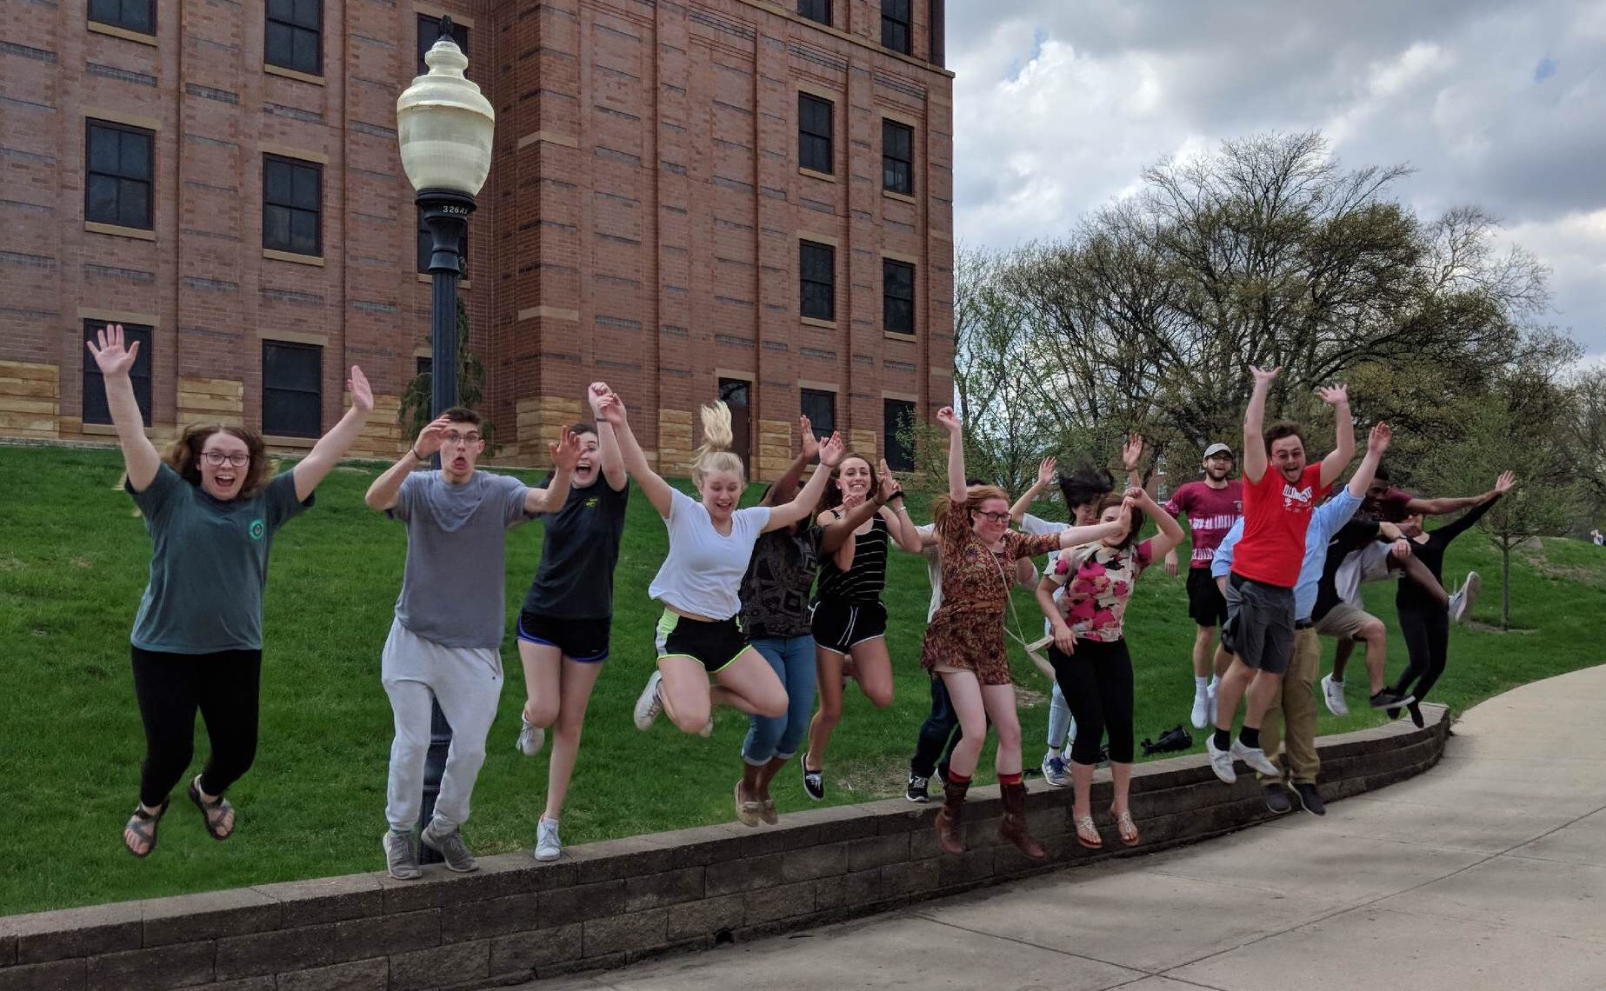
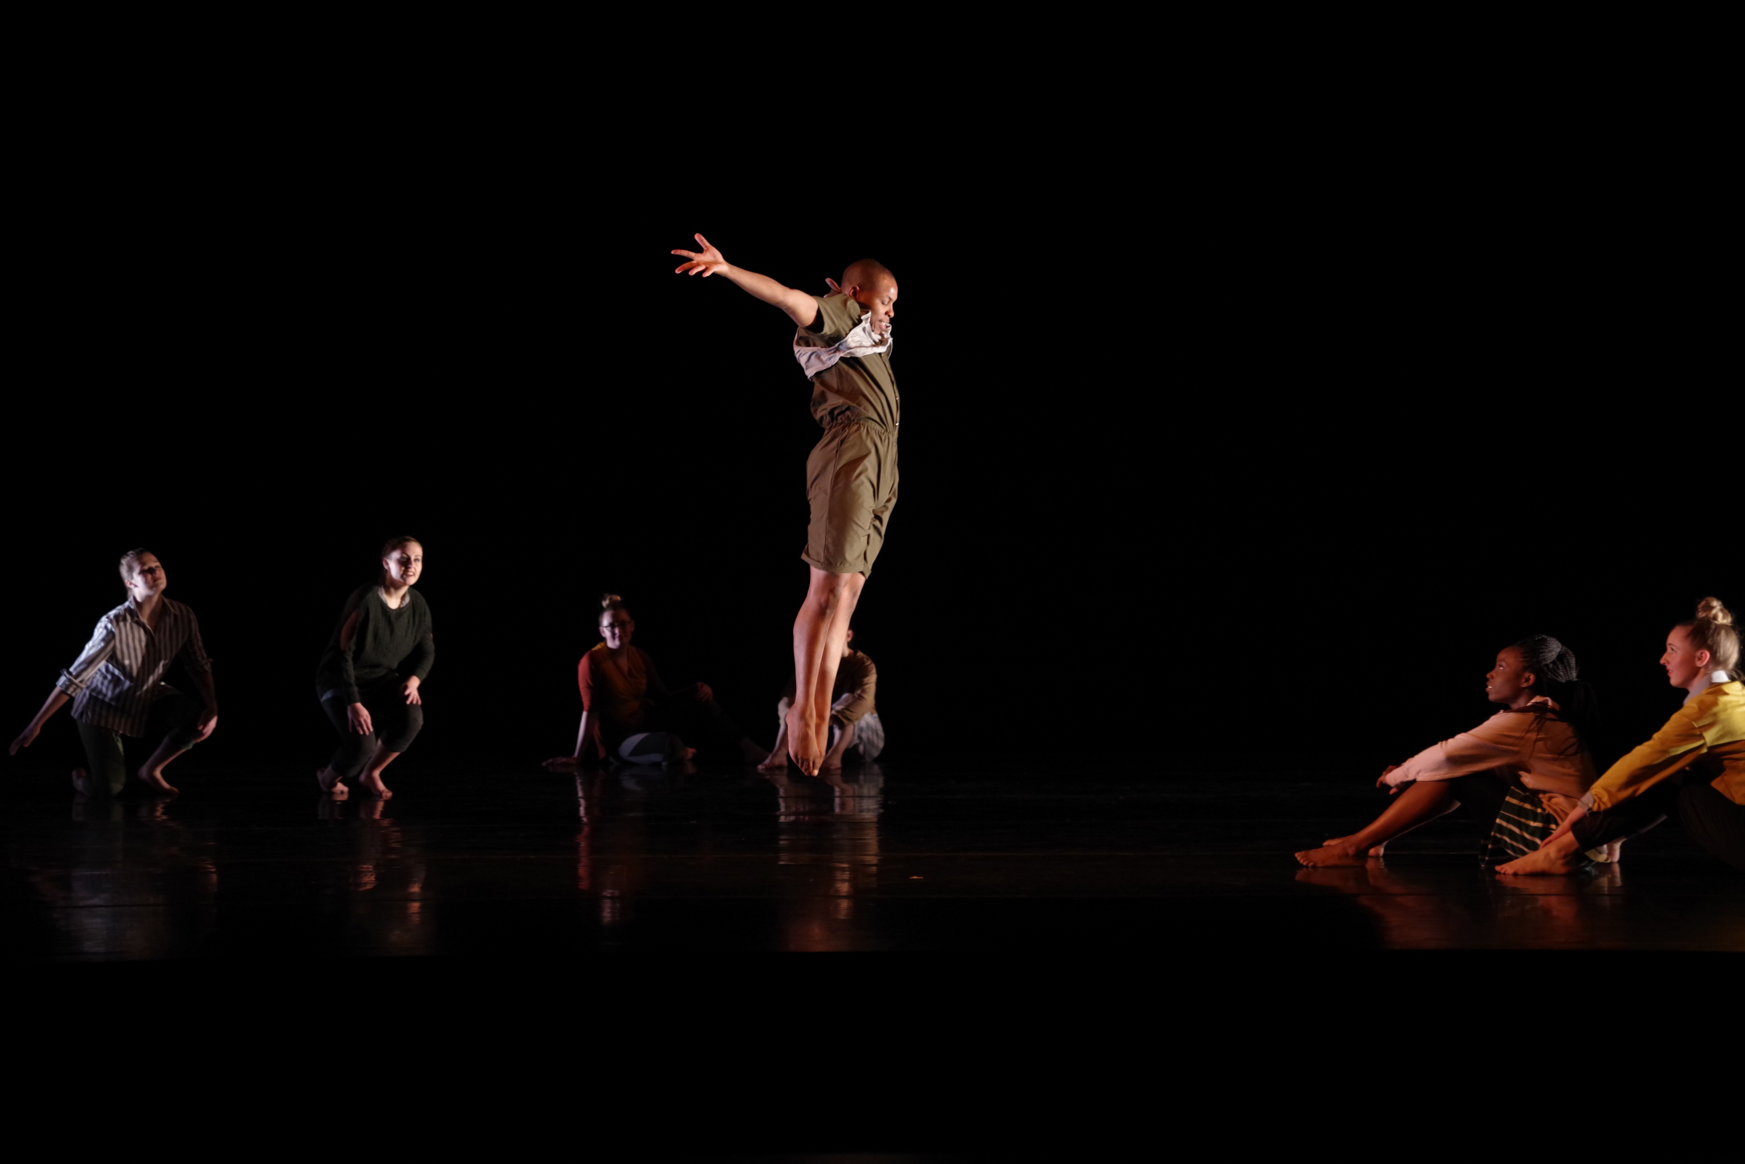
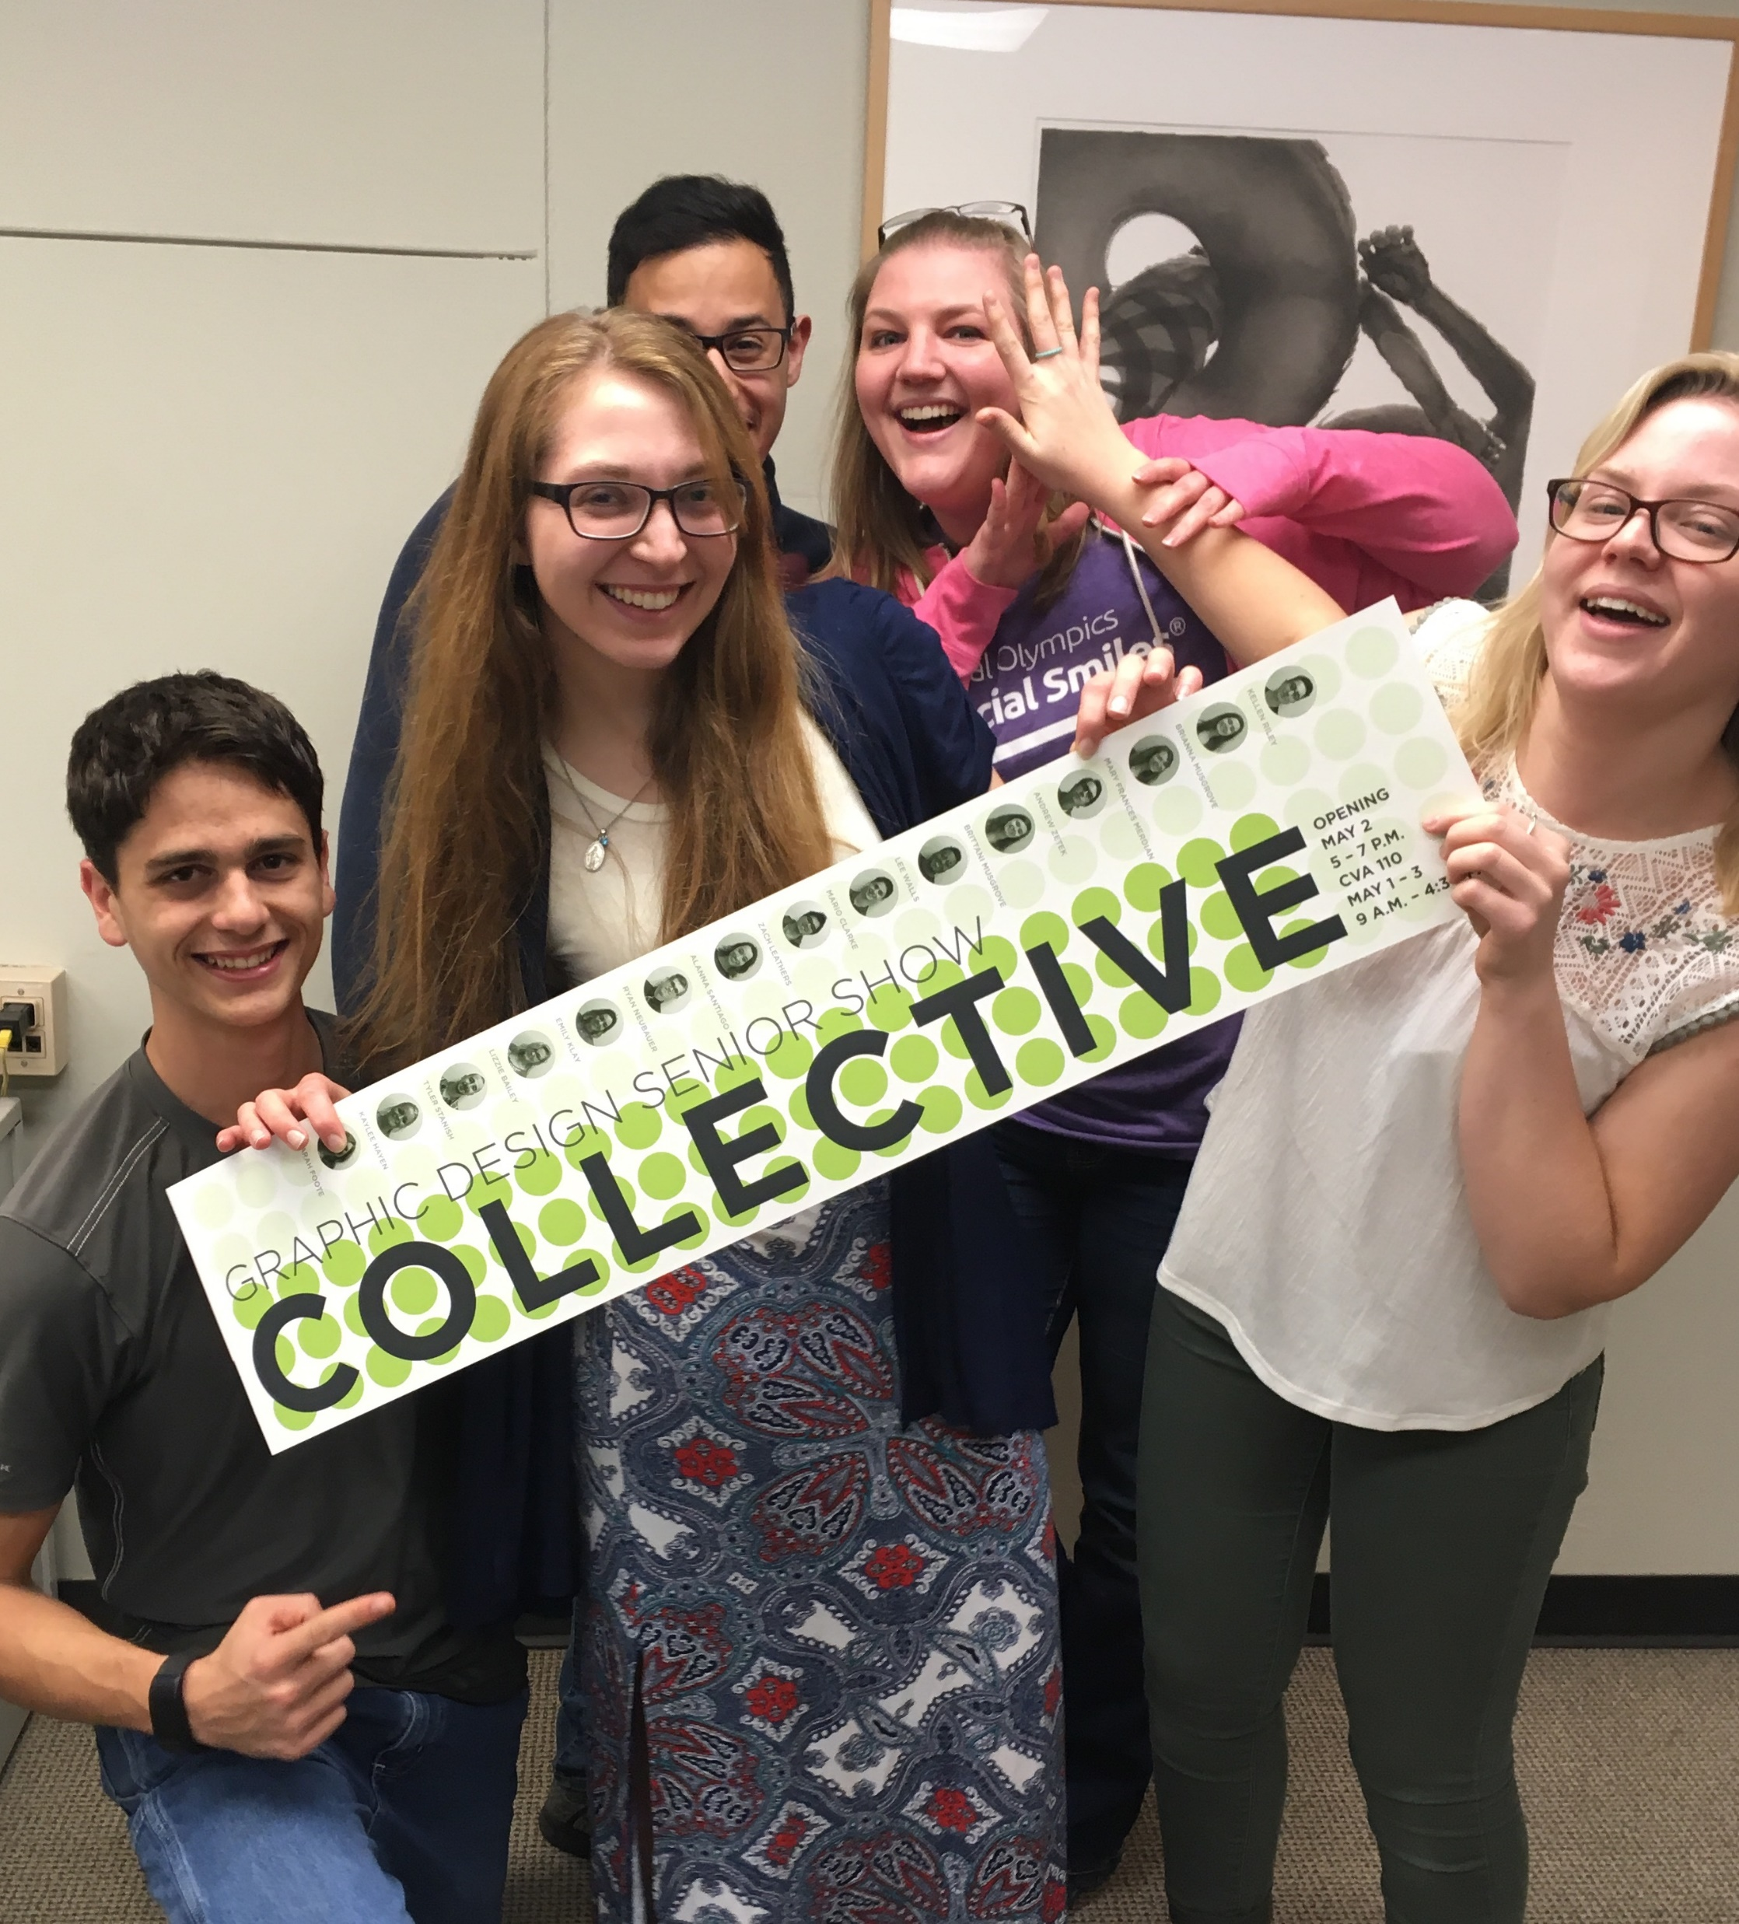
FY19 Enrollment and Retention
CFA Undergraduate Enrollment up by 4%

Slide 6
Enrollment and Retention
Increases in Schools of Art, Music, Theatre and Dance, and Arts Technology Program
10% of CFA undergraduates are Honors Students
Increased interest in for-credit choir courses/ensembles and the Big Red Marching Machine
College of Fine Arts 2017-2018 FTIC cohort retention rates ranged from 73% to 92%
Academic Year Graduate Enrollment down 5% (8 students)
21 full-time and 24 part-time graduate students enrolled in summer Master
of Music Education Program

Slide 7
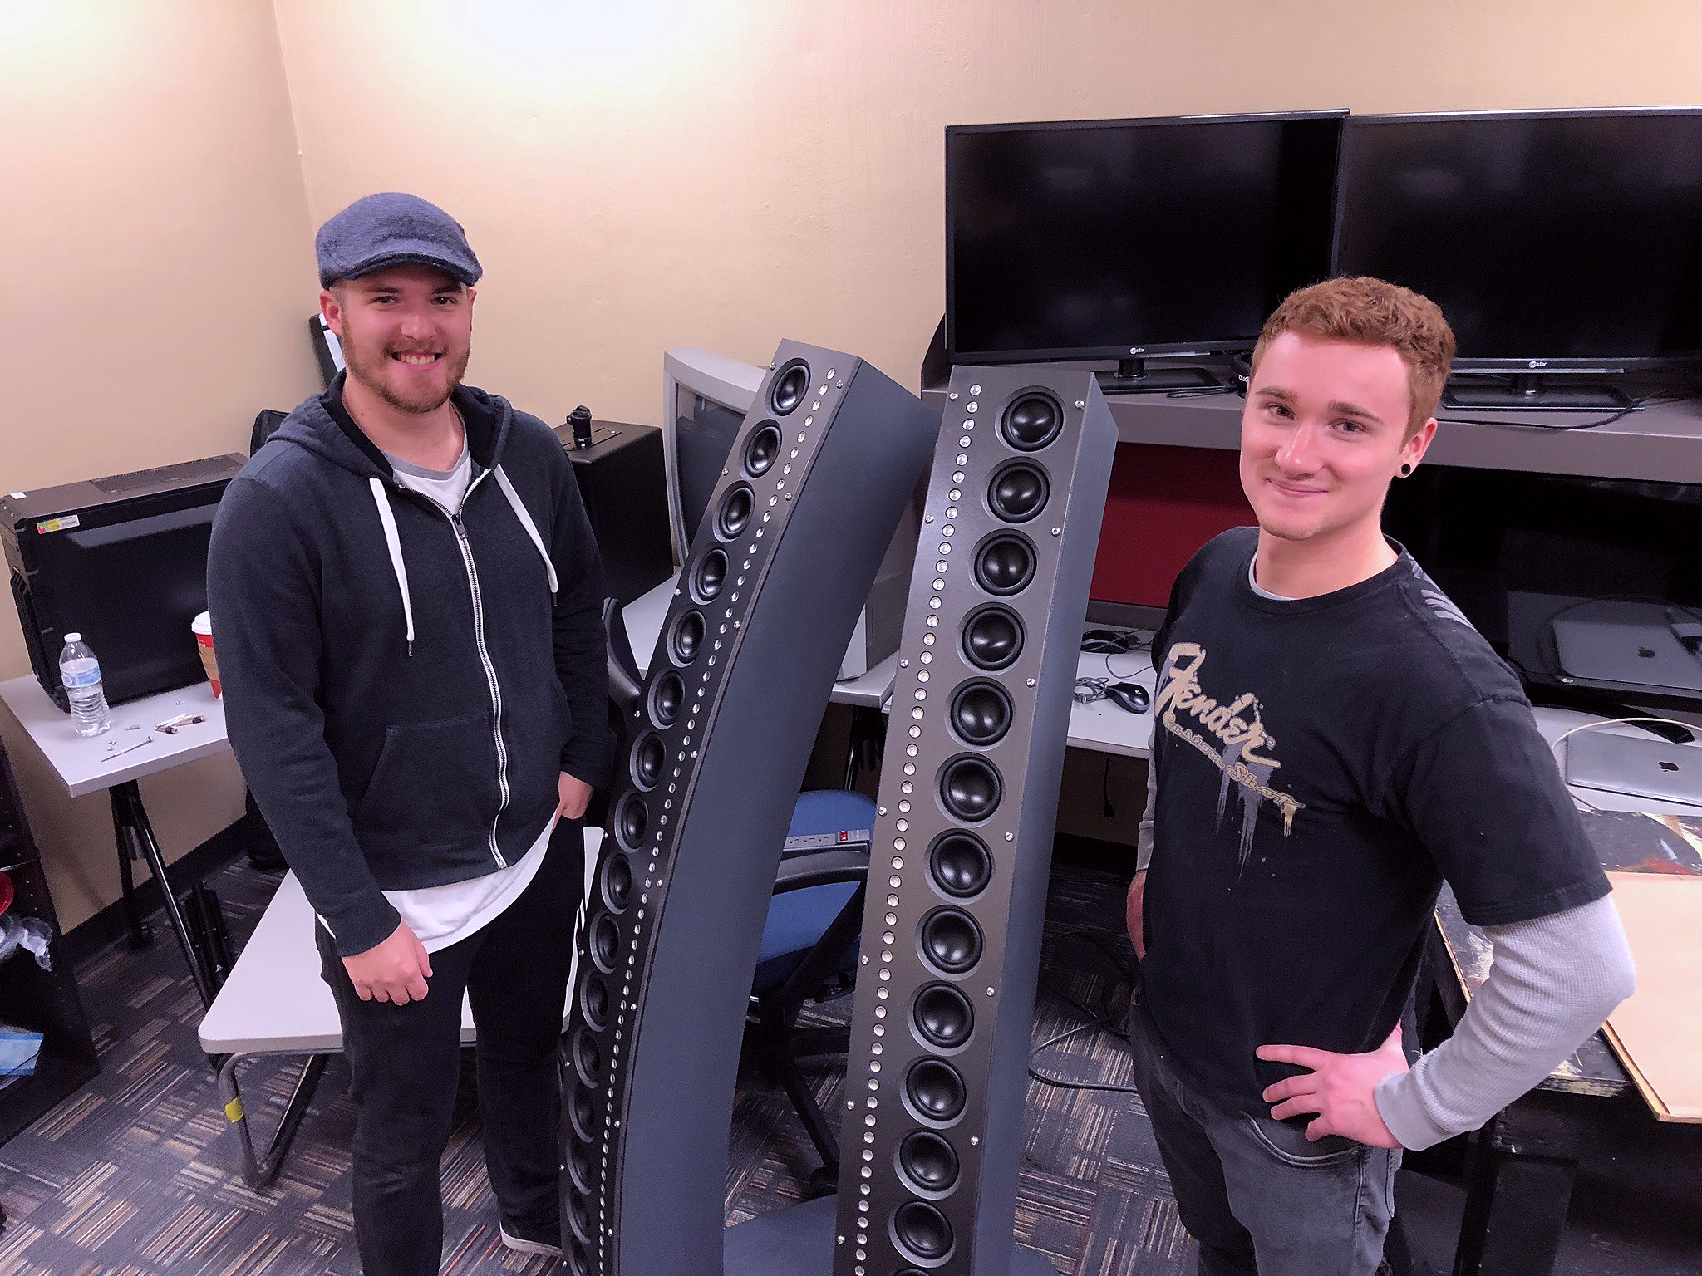
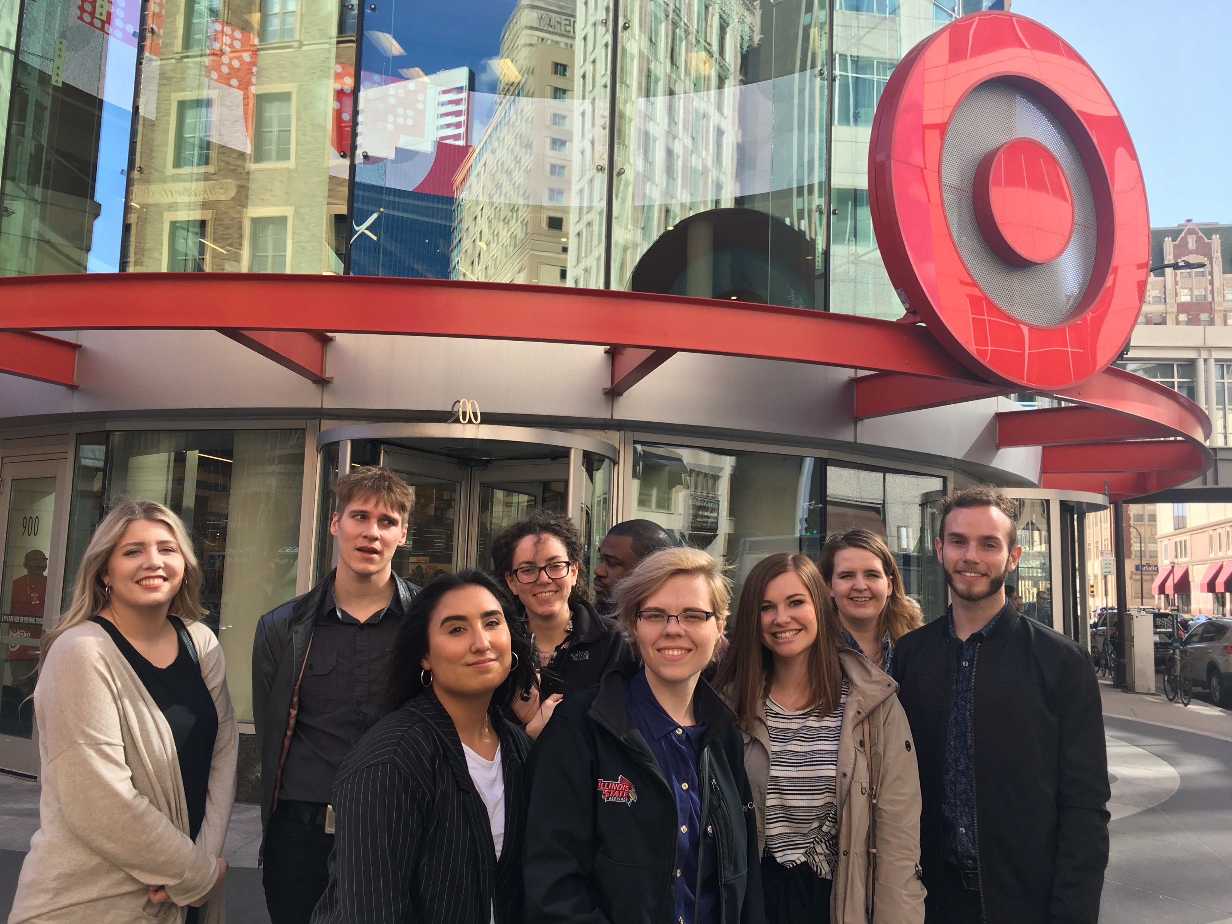
Anticipating development and enrollment growth in
fine arts technology-intensive design programs in all College of Fine Arts units
Integrated Design
Interactive Media Design
Performance Production
Music Composition and Movement/Choreography
Textile, Costume, Film and Sound
Video Game and Multimedia Design
Virtual Reality (VR), Augmented Reality (AR), Artificial Intelligence (AI)

Slide 8
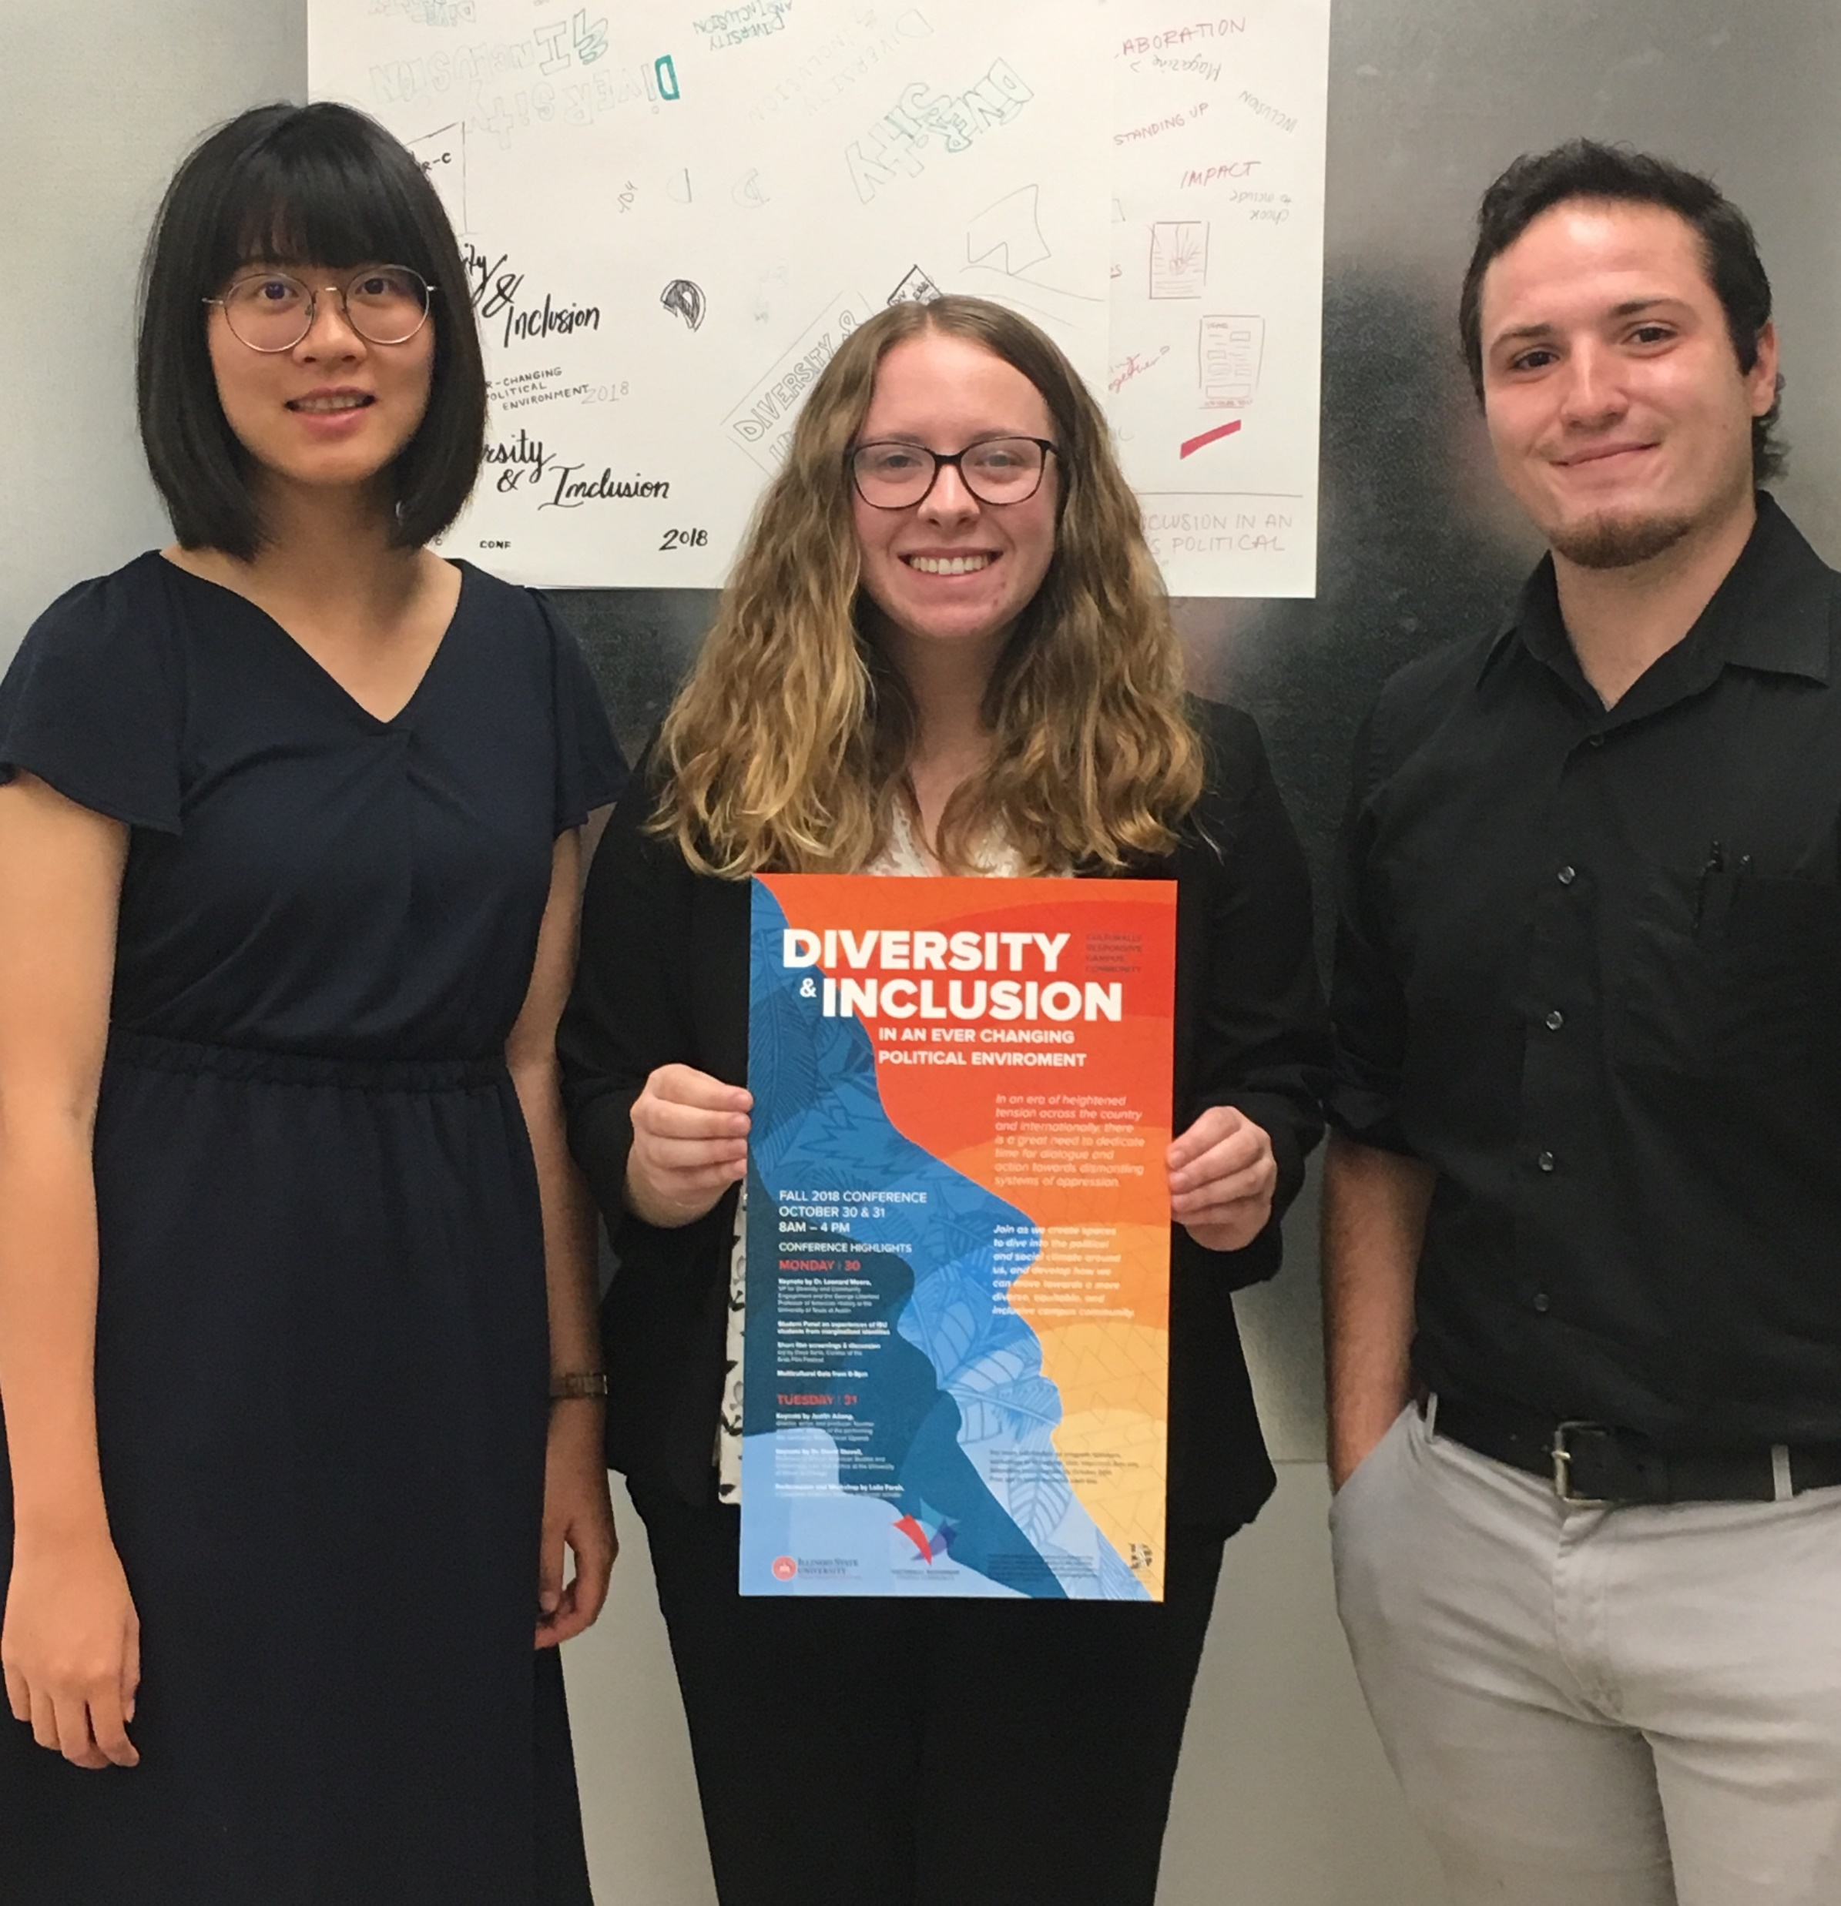
FY19 Faculty Searches
Art History
Graphic Design + Arts Technology
Graphic Design
Game Design
Dance
Musical Theatre
Music Education

Slide 9
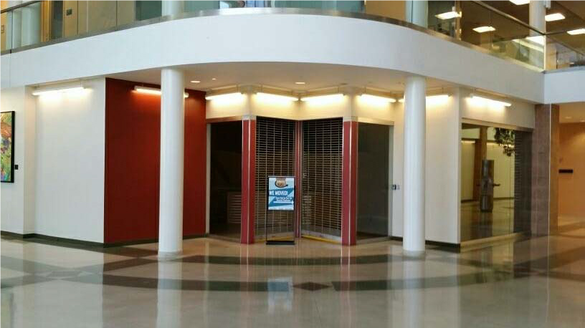
FY19 Facilities
New Student Gallery
Transpace II
at the
Central Illinois Regional Airport
(CIRA)

Slide 10
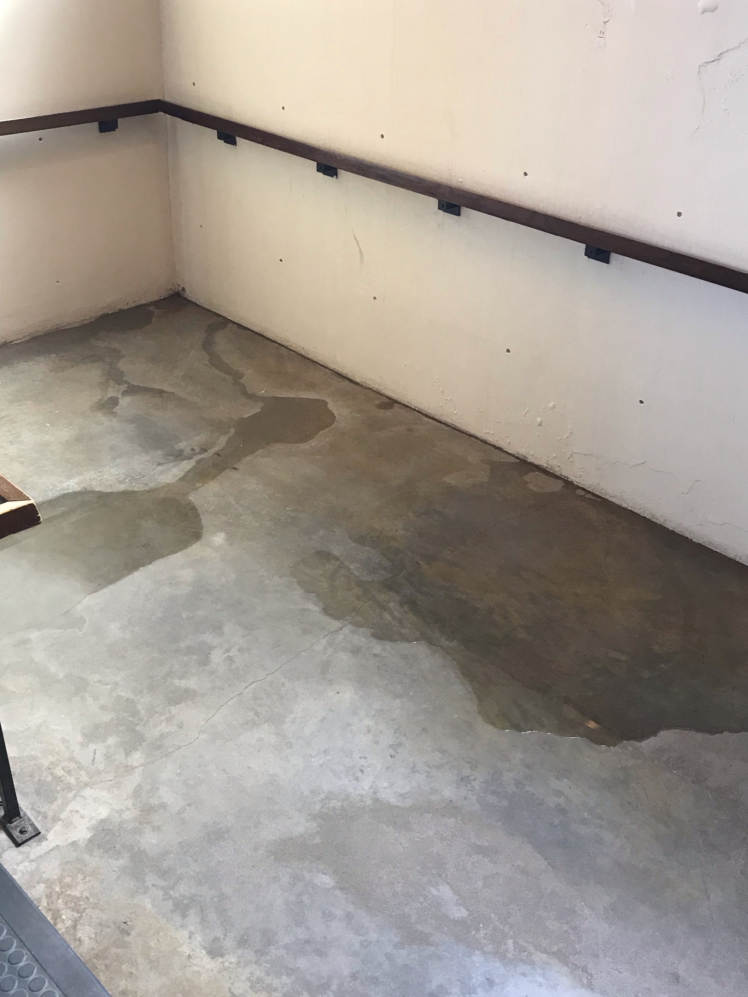
Facilities
Water leaks and other issues continue to be
problematic at many of the 9 CFA locations,
including water issues in the Center for the
Performing Arts, Cook Hall, and Centennial
East and West
$3 million and $9.6 million distributed for
limited CFA planning and renovation
Meetings scheduled with ISU Facilities Planning, RATIO Architects
and CFA Leadership throughout the spring 2019

Slide 11
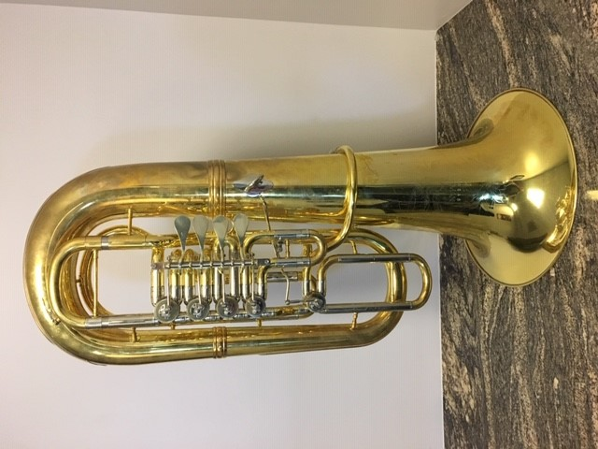
FY19 Provost Enhancement Projects
Glaze room dust collection/ventilation system for Ceramics classrooms
Revitalization of CVA 138/139
Recapitalization of dated faculty computers
Sound system upgrade in University Galleries
F Tuba
Revitalization of Cook Hall 305 and 308
Revitalization of Centennial East 209 and 220
Laboratory and classroom equipment and tools

Slide 12
FY19 CFA Staff Changes
Kendra Paitz
Director and Chief Curator
Lisa Lofgren
Registrar and Office Coordinator
Sara Semonis
Associate Dean Research and Planning
Molly McDonald
Director of Development
Vikkie Cossio
Budget Associate
Jessica Bingham
Curator
Molly Briggs Yonke
ISF Finance and Communication Manager

Slide 13
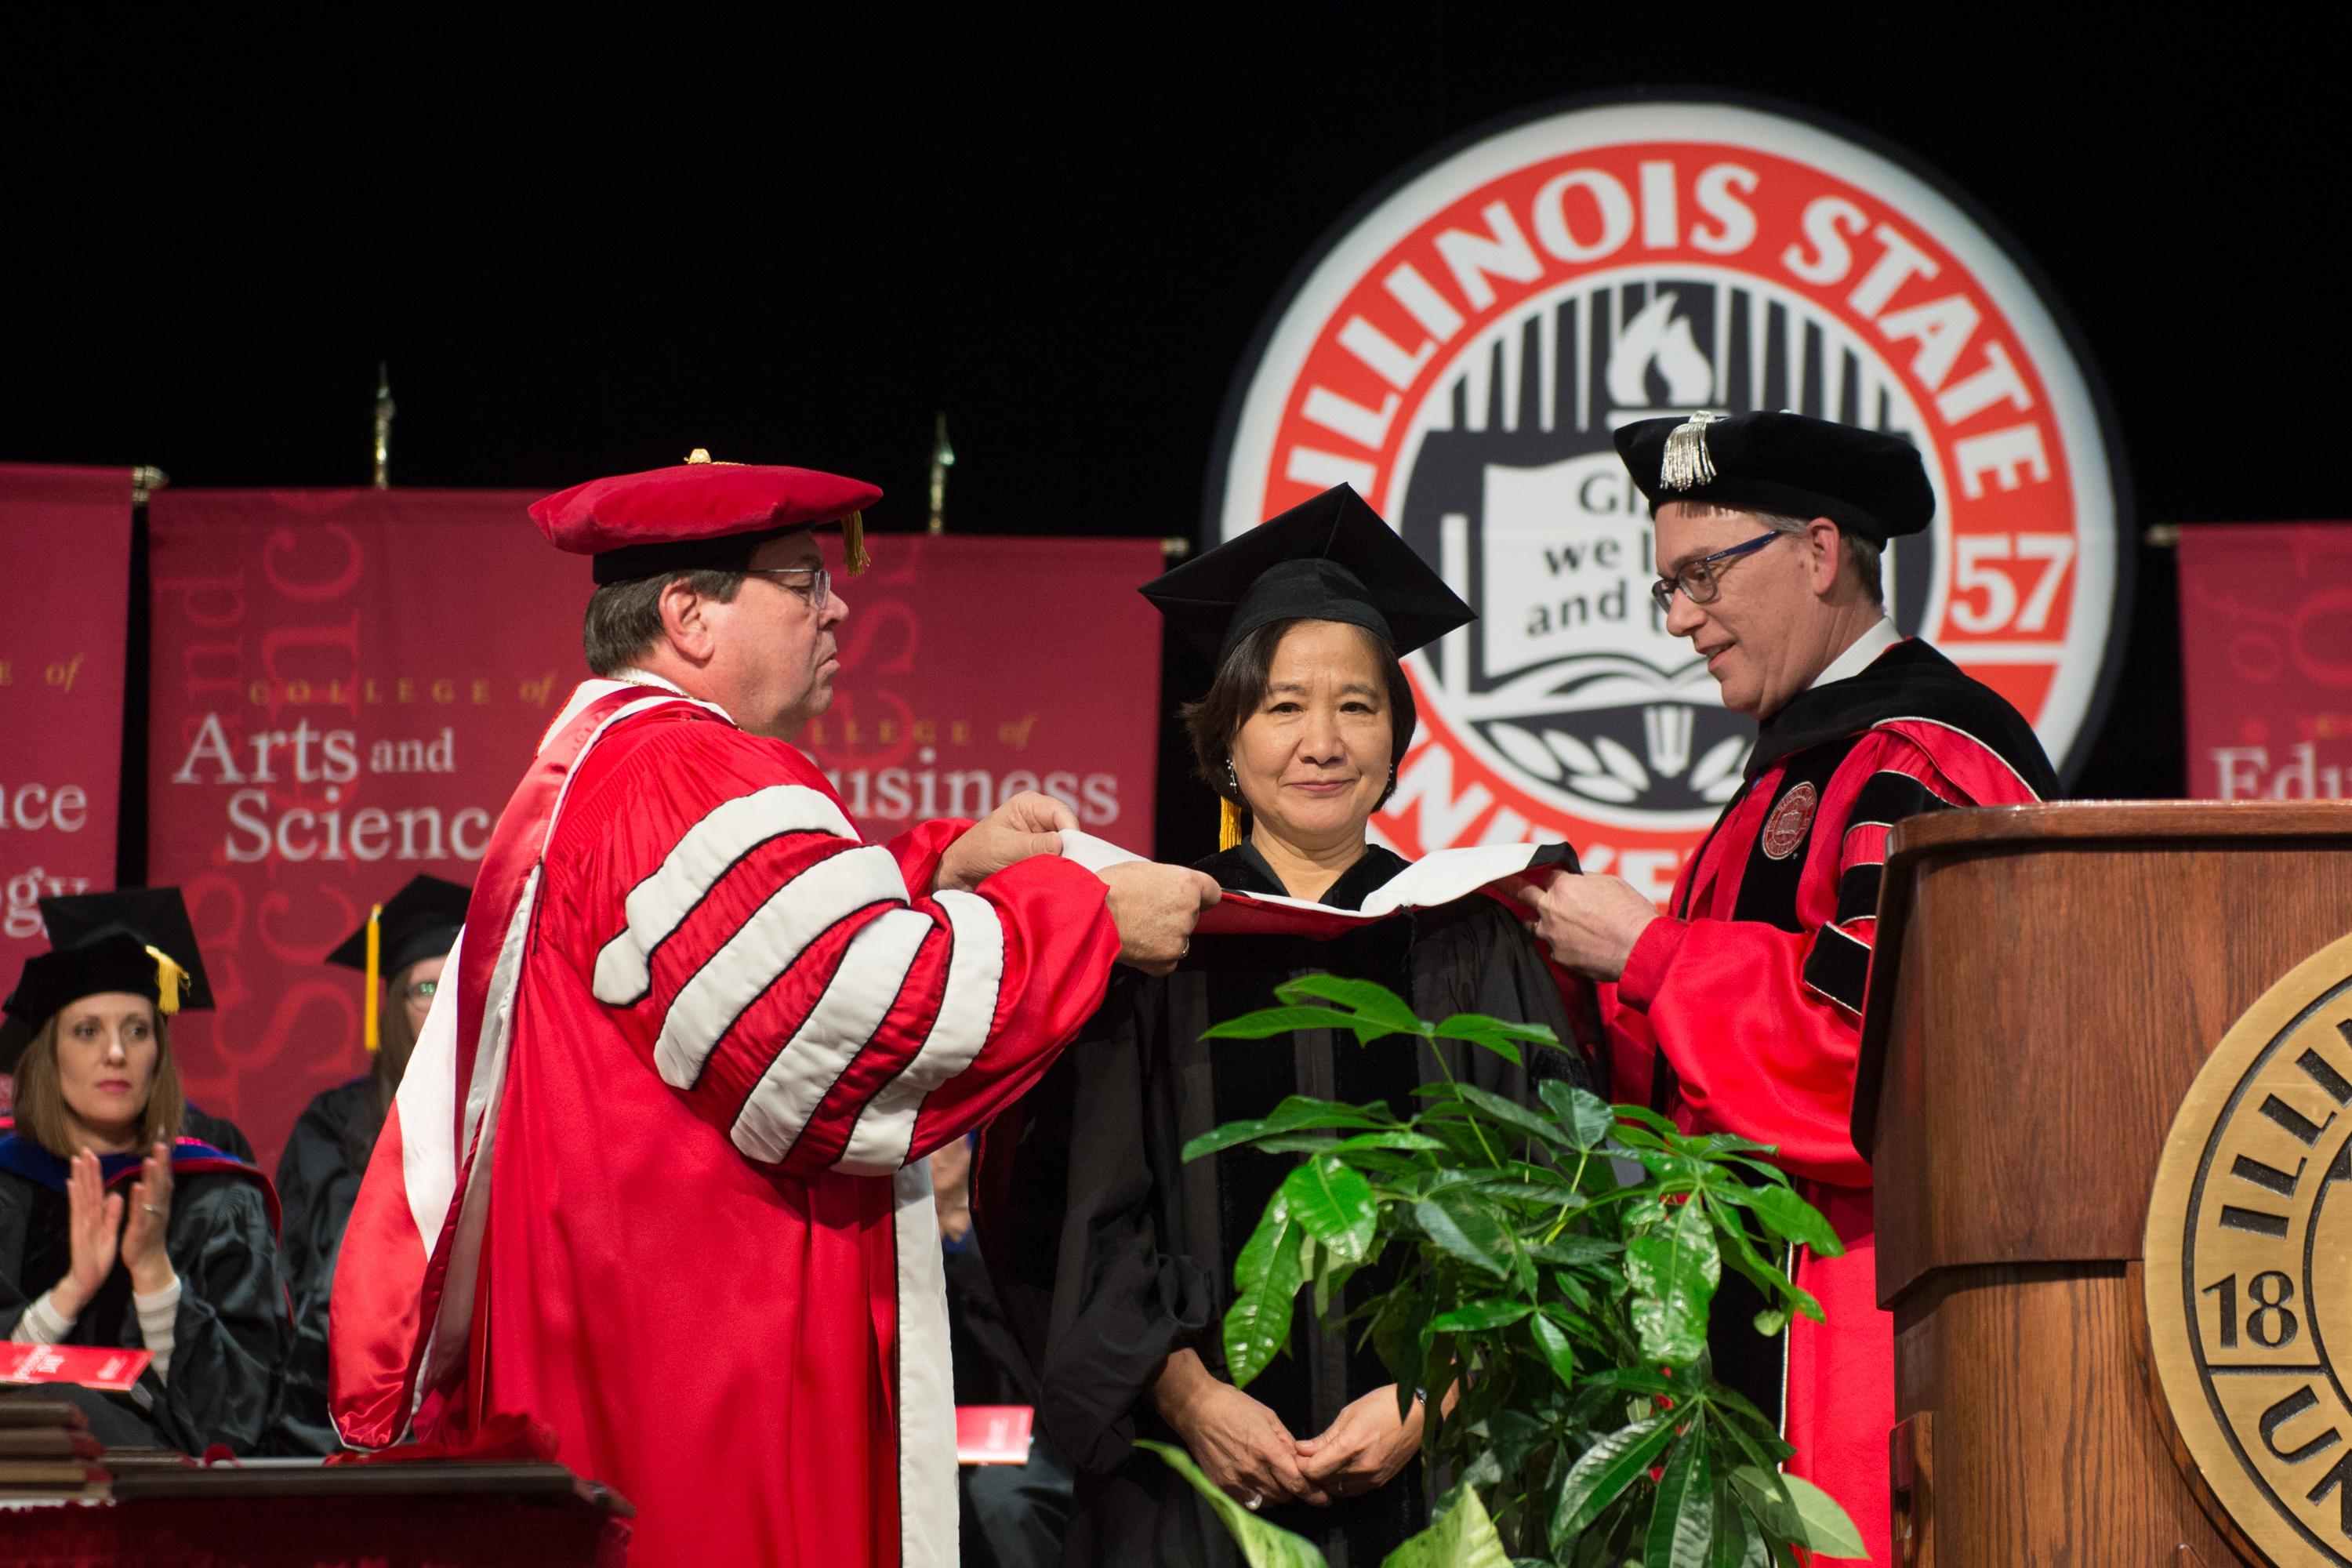
FY19 Points of Pride for our College
School of Art Alumna
painter and sculptor
Wonsook Kim
received an ISU
Honorary
Doctorate of Arts
on Founders Day

Slide 14

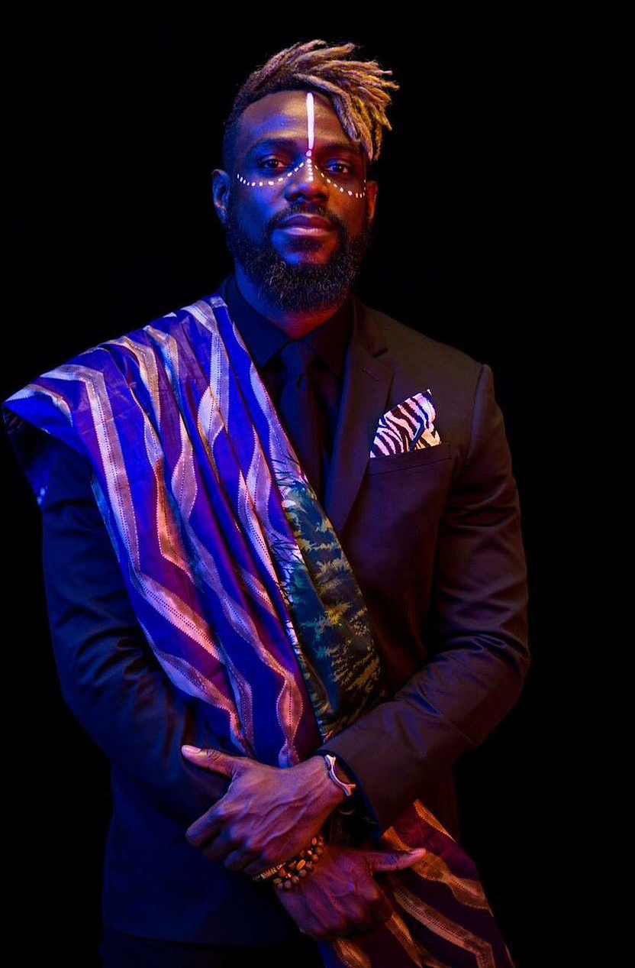
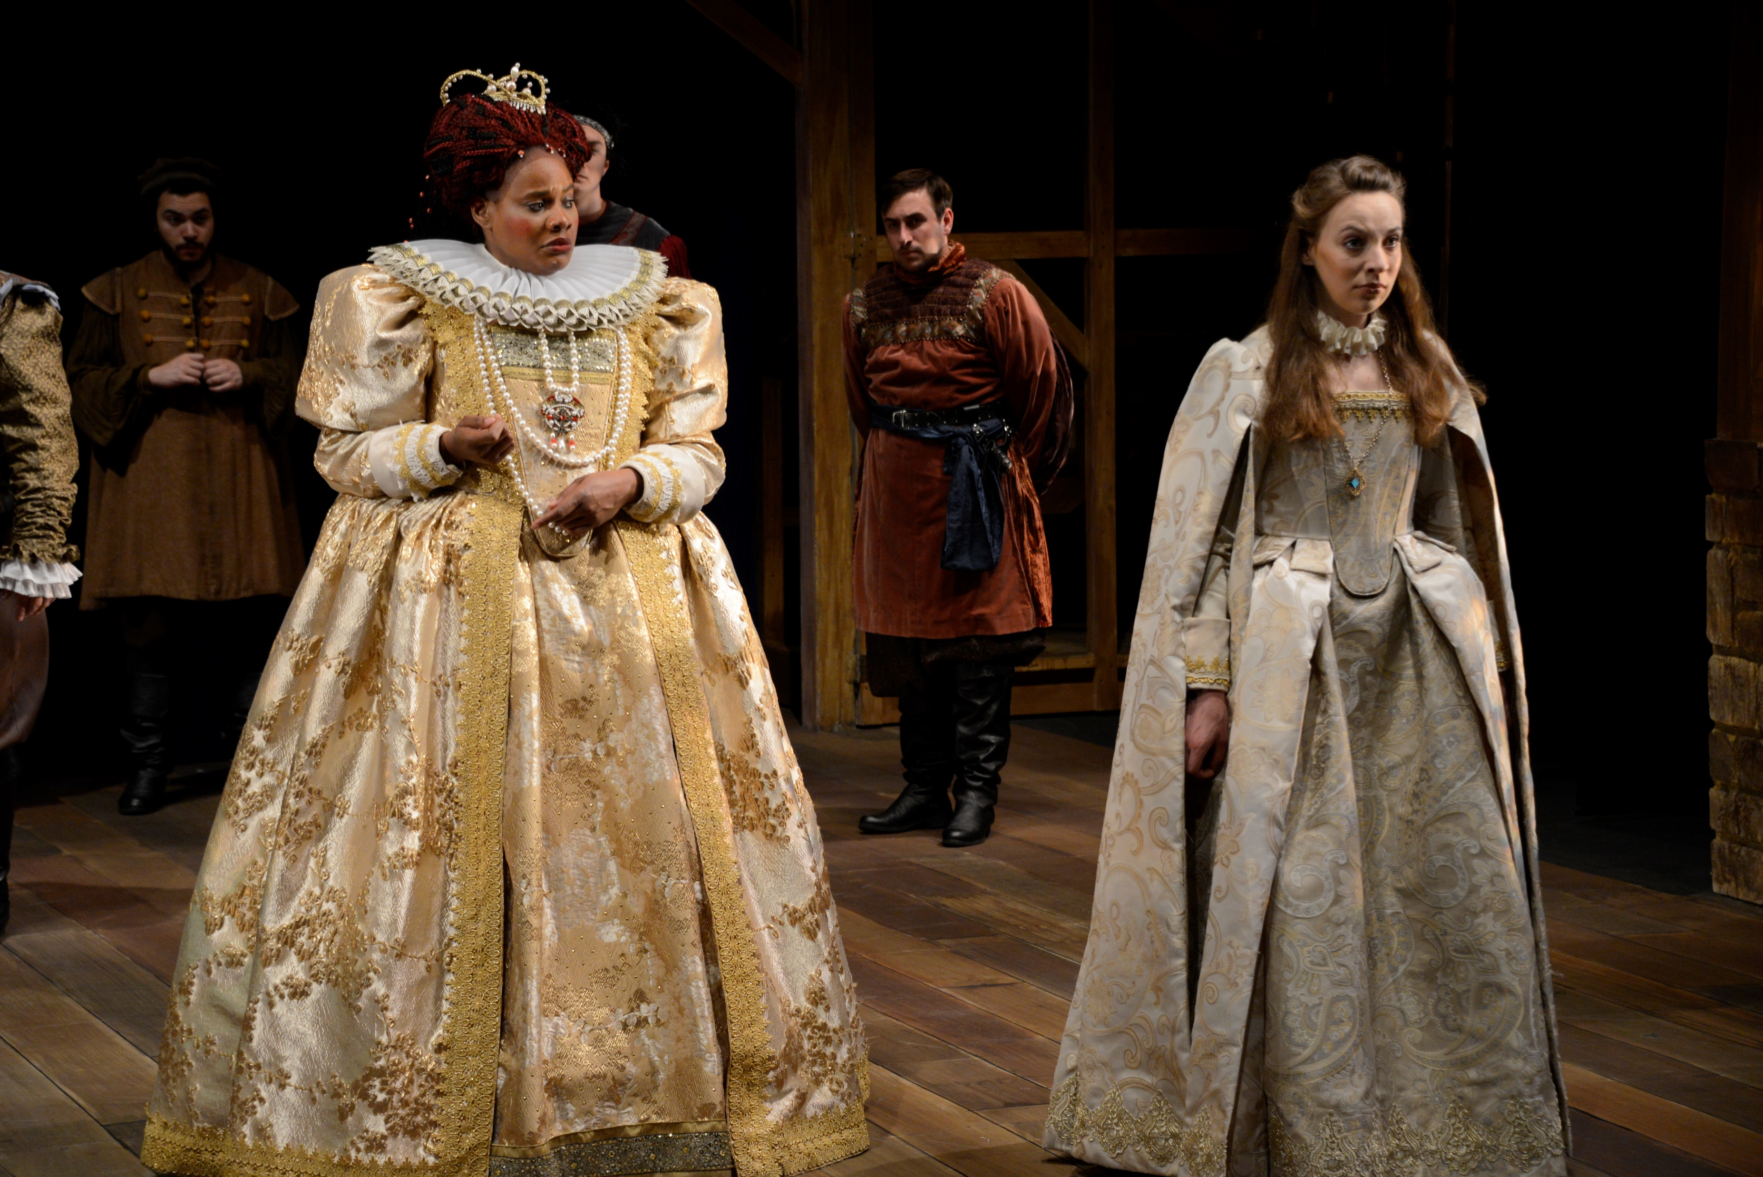
Points of Pride
School of Music hosted Omar Thomas
“The President’s Own” United
States Marine Band
School of Music hosted Pulitzer
Prize finalist Alex Ross
Illinois Shakespeare Festival
Fulbright Scholars, Louise Ju-Yu Wu
and Angelo Kakande
Civic Chorale celebrated its
50th Anniversary

Slide 15
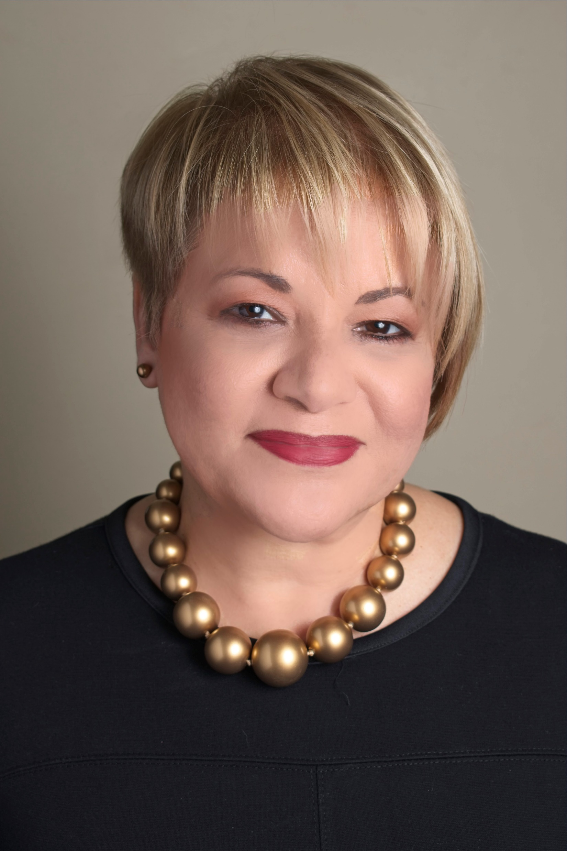
Points of Pride
CFA Alumna Lourdes Ramos
the first Latina to be named
President of the
Museum of
Latin American Art
in Long Beach, California,
will be the College of Fine Arts commencement speaker in
May 2019

Slide 16
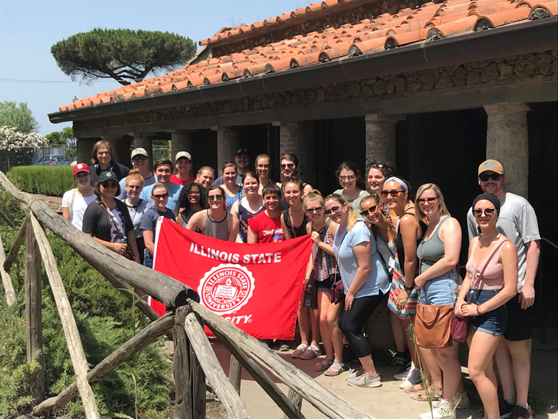
FY19 Faculty and Student Accomplishments
School of Art Associate Professor
Lea Cline, in collaboration with Associate
Professor of History Kathryn Jasper, will
travel to Lake Bolsena in the northern
part of the region of Lazio in Italy in
summer 2019 to launch an extensive
archeological research project at the
Valle Giannni Site
School of Art Professor James Mai
presented a paper and exhibition at the
National Museum of Science and
Technology in Stockholm, Sweden

Slide 17

Faculty and Student Accomplishments
Arts Technology graduate student Zach Buckley will present his paper
entitled Towards a Framework for Composition Design
for Music-Led Virtual Reality Experiences at the 26th
IEEE Conference on Virtual Reality and 3D User
Interfaces in Osaka, Japan in summer 2019
Professor Connie de Veer attended a book signing in
New York City as part of the September 2018 release
of her co-authored book Actor for Life: How to
Have an Amazing Career Without all the Drama

Slide 18



Faculty and Student Accomplishments
Six student actors were semi-finalists at the regional Kennedy Center American College Theatre Festival and design/directing students Jordon Gerow and Makenna Lockhart will advance to the national finals in Washington, D.C. in spring 2019
School of Music Director Steve Parsons was re-elected president of the Illinois Association of Music Schools and served as accreditation evaluator for the National Association of Schools of Music (NASM)
School of Theatre and Dance Director Janet Wilson conducted training workshops for new chairs and directors for the National Association of Schools of Theatre (NAST)

Slide 19
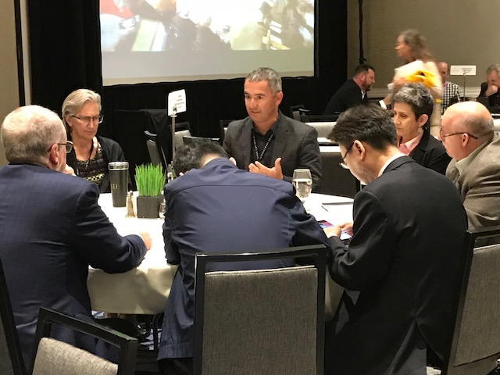

Faculty and Student Accomplishments
CFA Dean Jean Miller President-Elect of International Council of Fine Arts Deans and Arts Executives facilitated the ICFAD conference at Cornish College of the Arts and Seattle Art Museum and planned conferences at University of Texas-
Austin and Virginia Commonwealth University
School of Art Director Michael Wille was elected to the board of directors of the National Council of Arts Administrators (NCAA). He presented on 3 + 1 international initiatives at
the ICFAD conference
in October

Slide 20
FY19 Faculty Recognition
Professor of Music David Collier was named an ISU University Professor
Instructional Assistant Professor of Music Mark Grizzard received the Outstanding University Teacher Award
Professor Of Music Adrianna Ransom received the Outstanding University Service Award
Assistant Professor in Arts Technology Kristin Carlson received a University Service Initiative Award
School of Art Professor Claire Lieberman received the Outstanding University Creative Activity Award
School of Theatre and Dance Assistant Professor Dan Ozminkowski received the University Creative Initiative Award
School of Music Associate Professor and composer Carl Schimmel received a 2018 Guggenheim Fellowship, honoring exceptional scholars-writers-scientists
School of Theatre and Dance Directing graduate student, Enrico Spada, was awarded the Outstanding Graduate Student Teaching Award -Level I Master’s

Slide 21
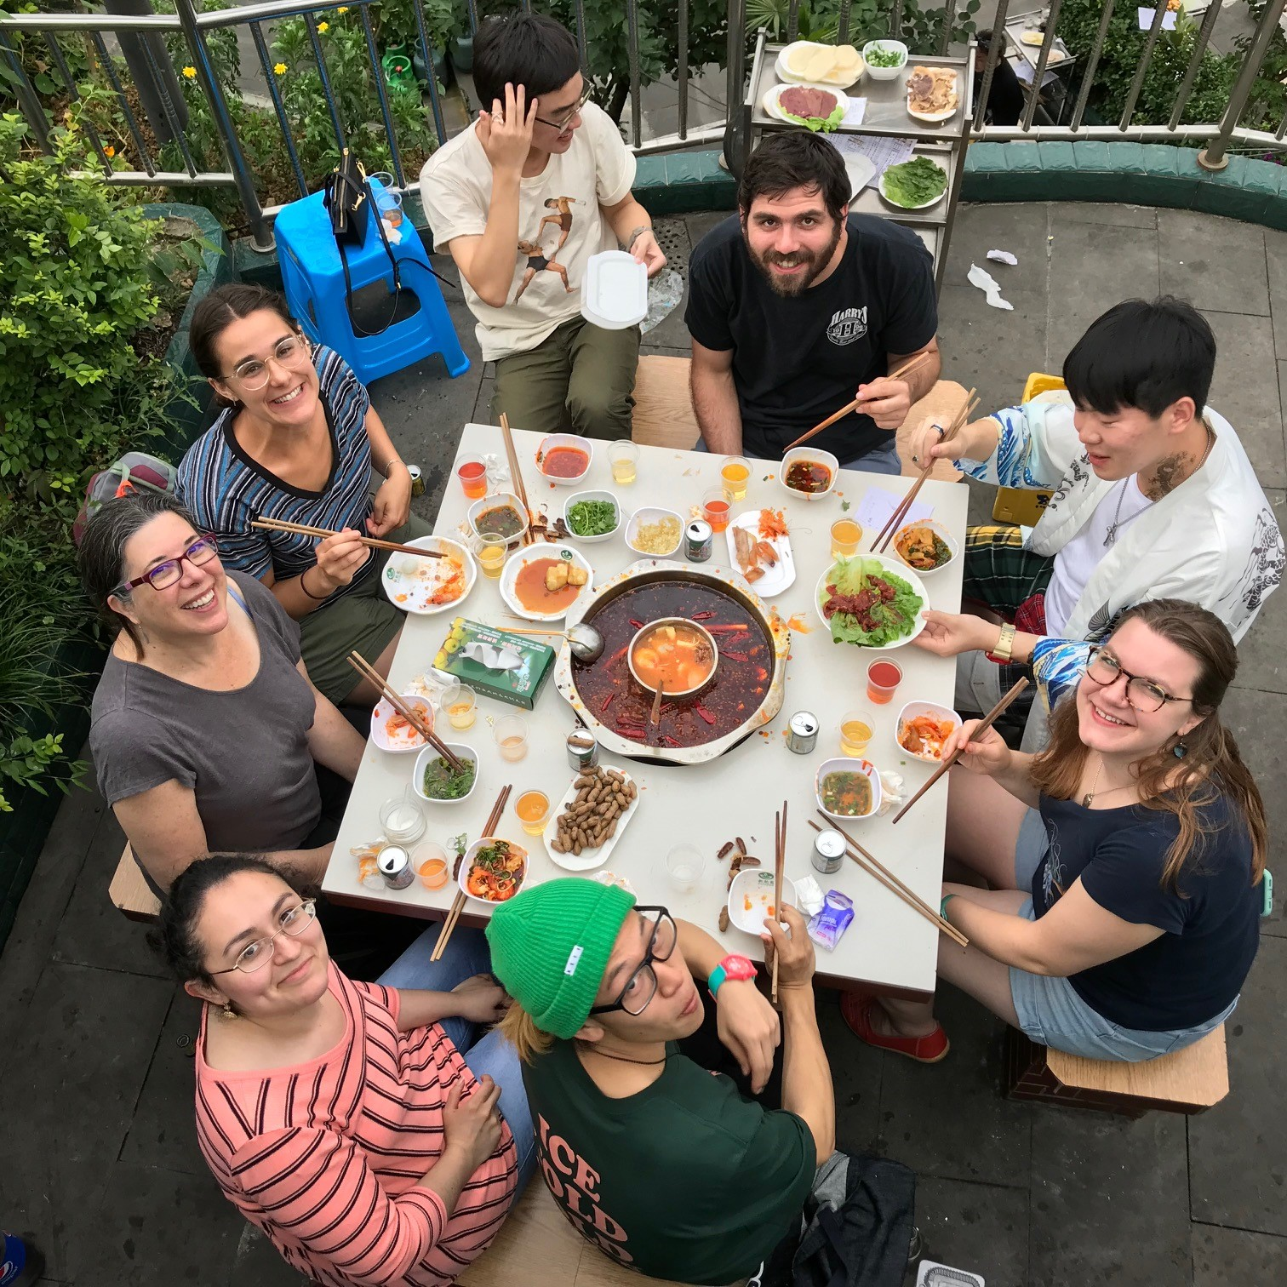
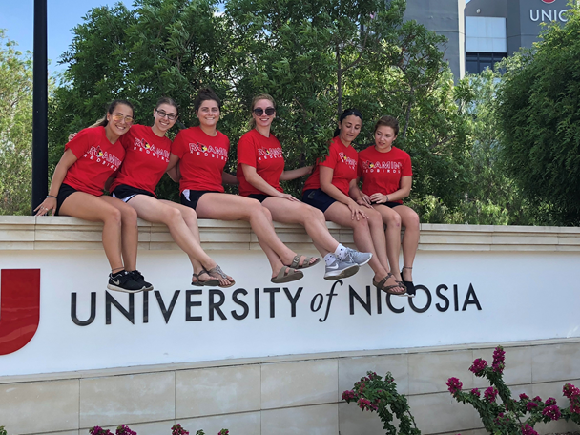
International Programs

Slide 22
Summer Study and Teaching Abroad
Summer 2018
Summer 2019
Australia
Uganda
Italy
Prague
England
China
Cyprus
Italy
China

Slide 23
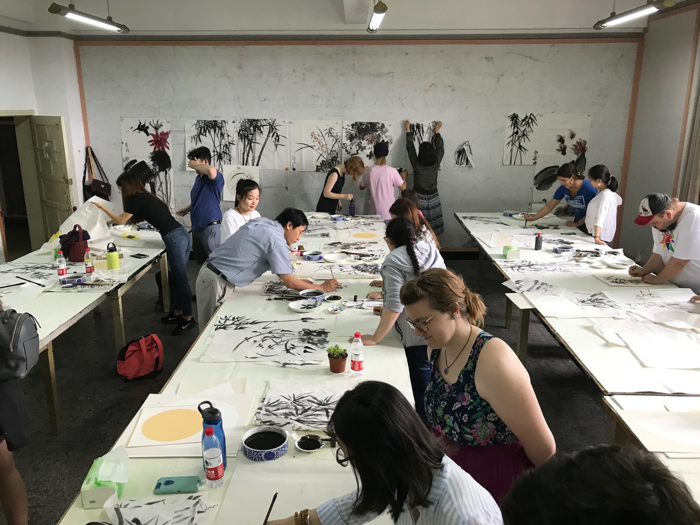
International
Two faculty members and two students from the School of Art taught at Tianhua College in Shanghai in December 2018
In April 2019 Michael Wille and Jeff Mavros will travel to Tianhua College to introduce 3 + 1 Art students to ISU campus resources in preparation for transferring in summer 2020

Slide 24
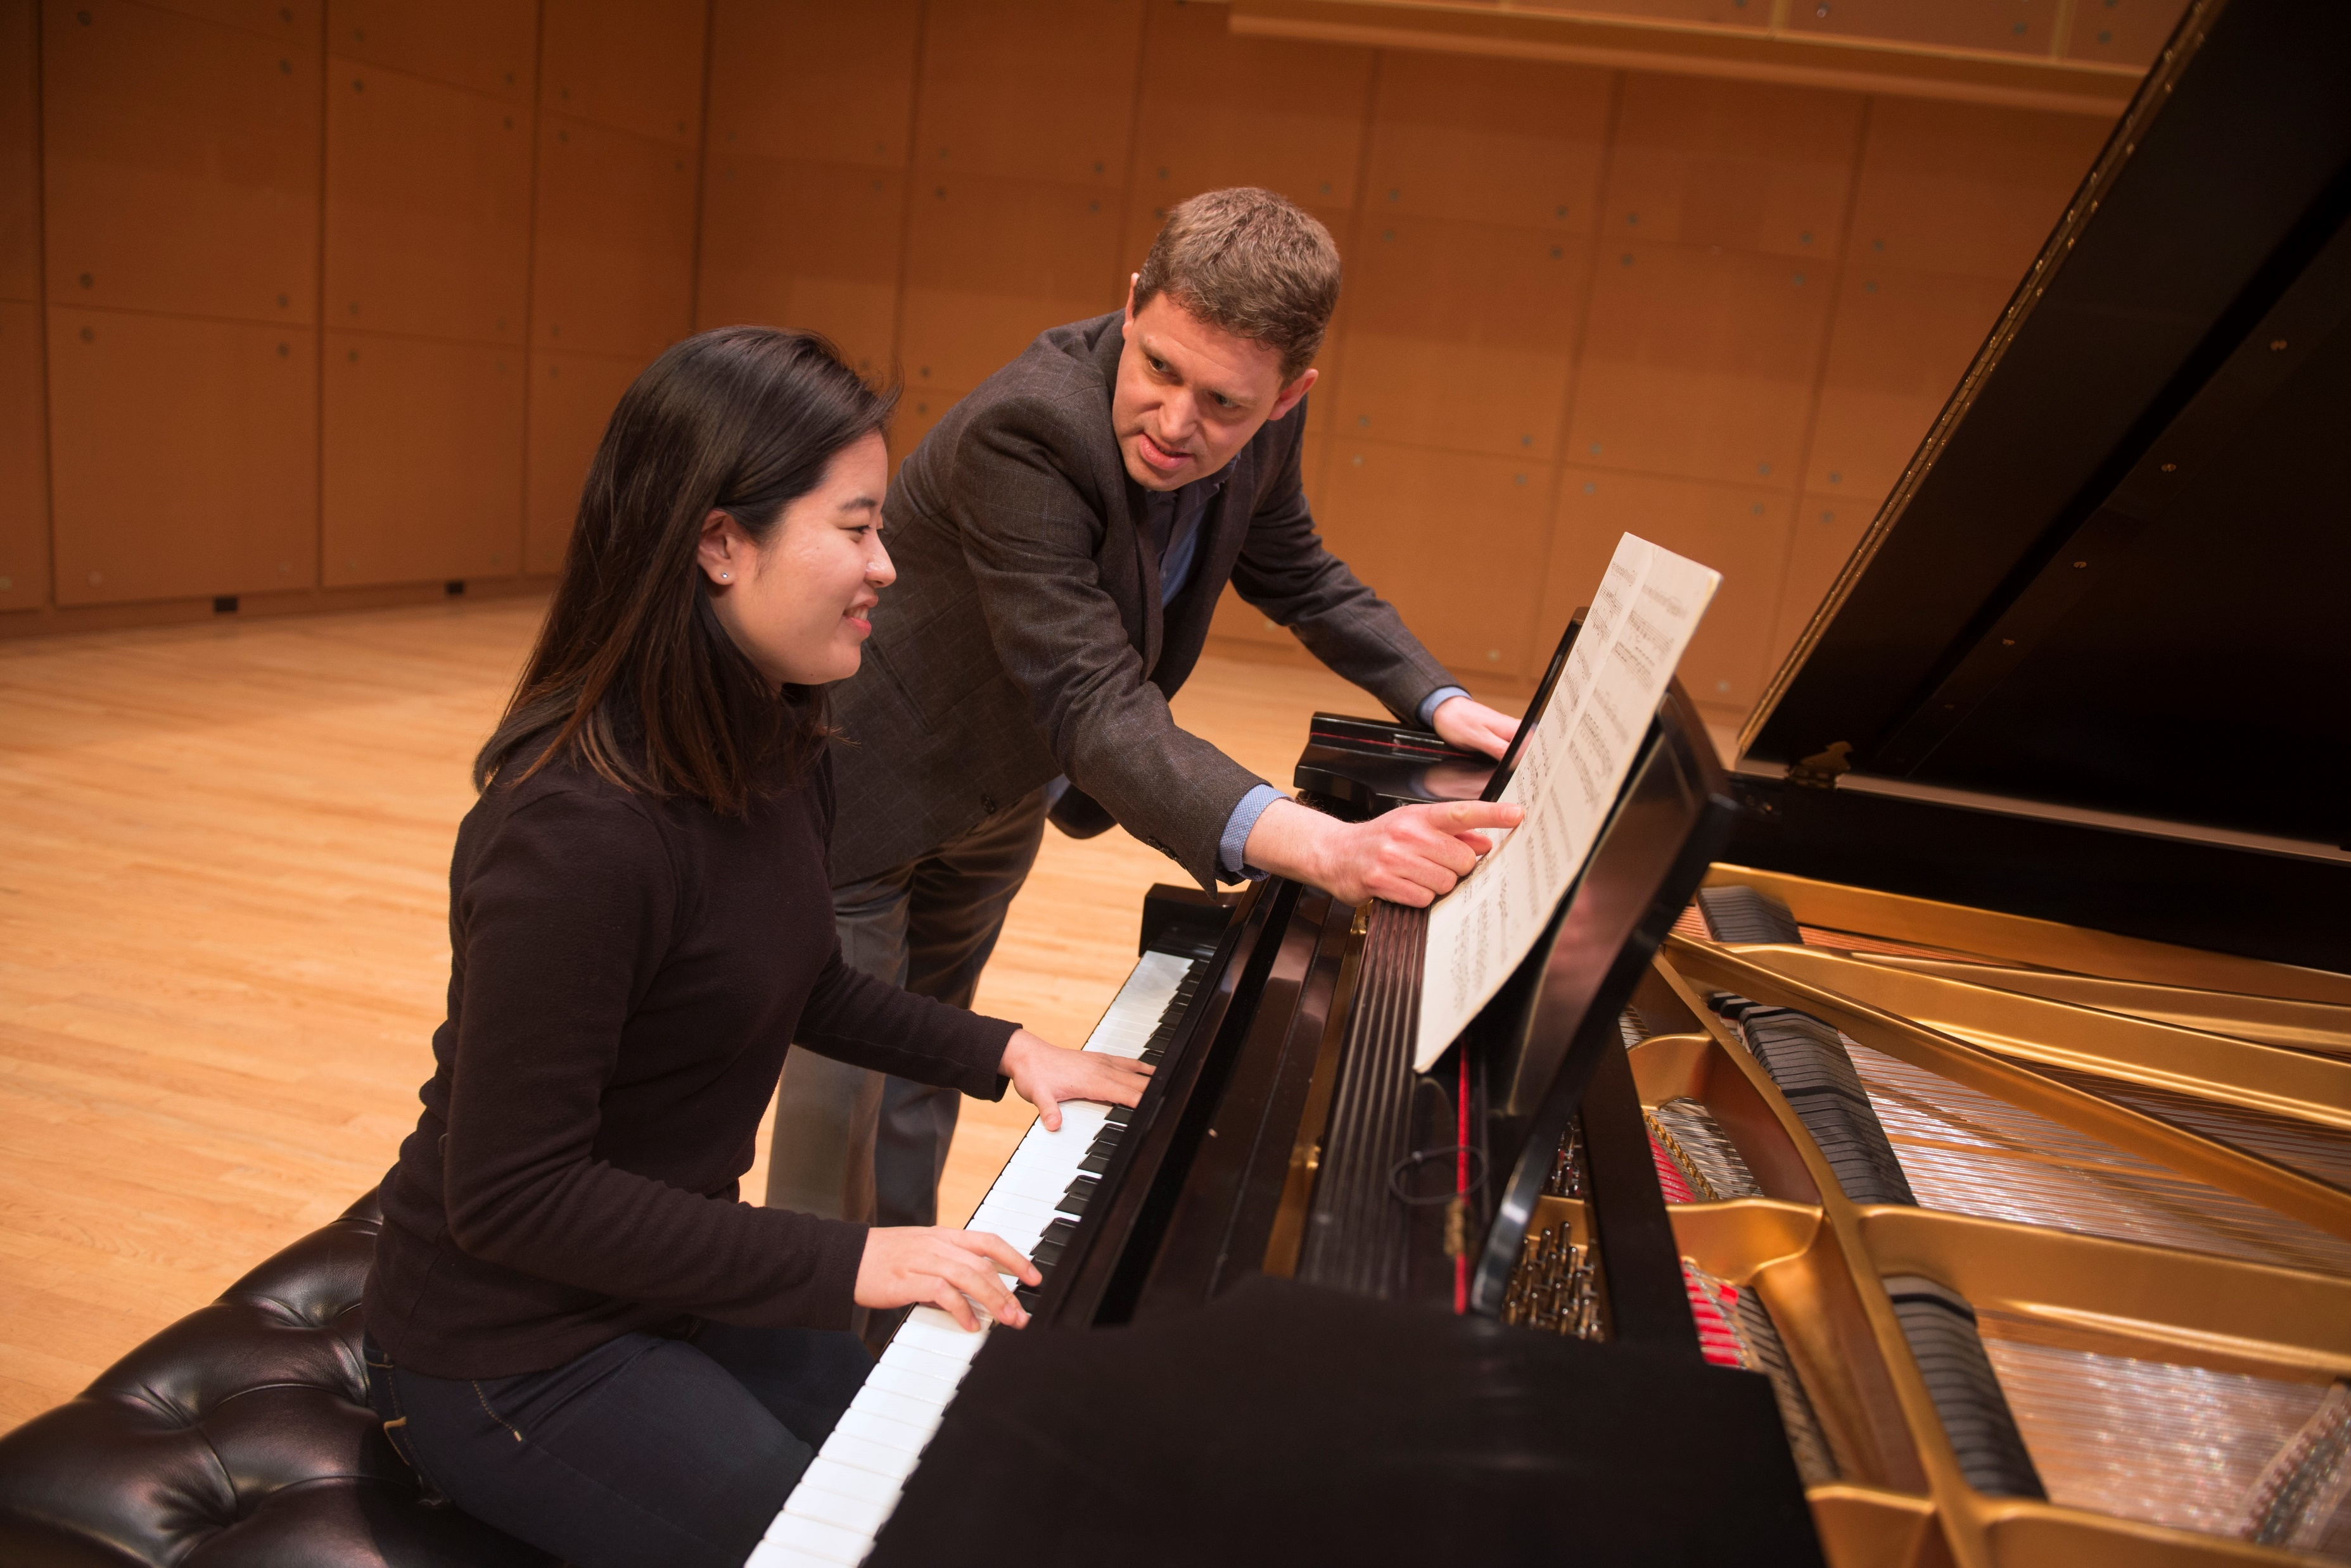
International
Professor of Piano Geoffrey Duce will teach at Southwest University (SWU) in summer of 2019
The School of Art is targeting summer 2020 for the second M.F.A. student and faculty travel/exhibition to SWU
in Chongqing, China

Slide 25
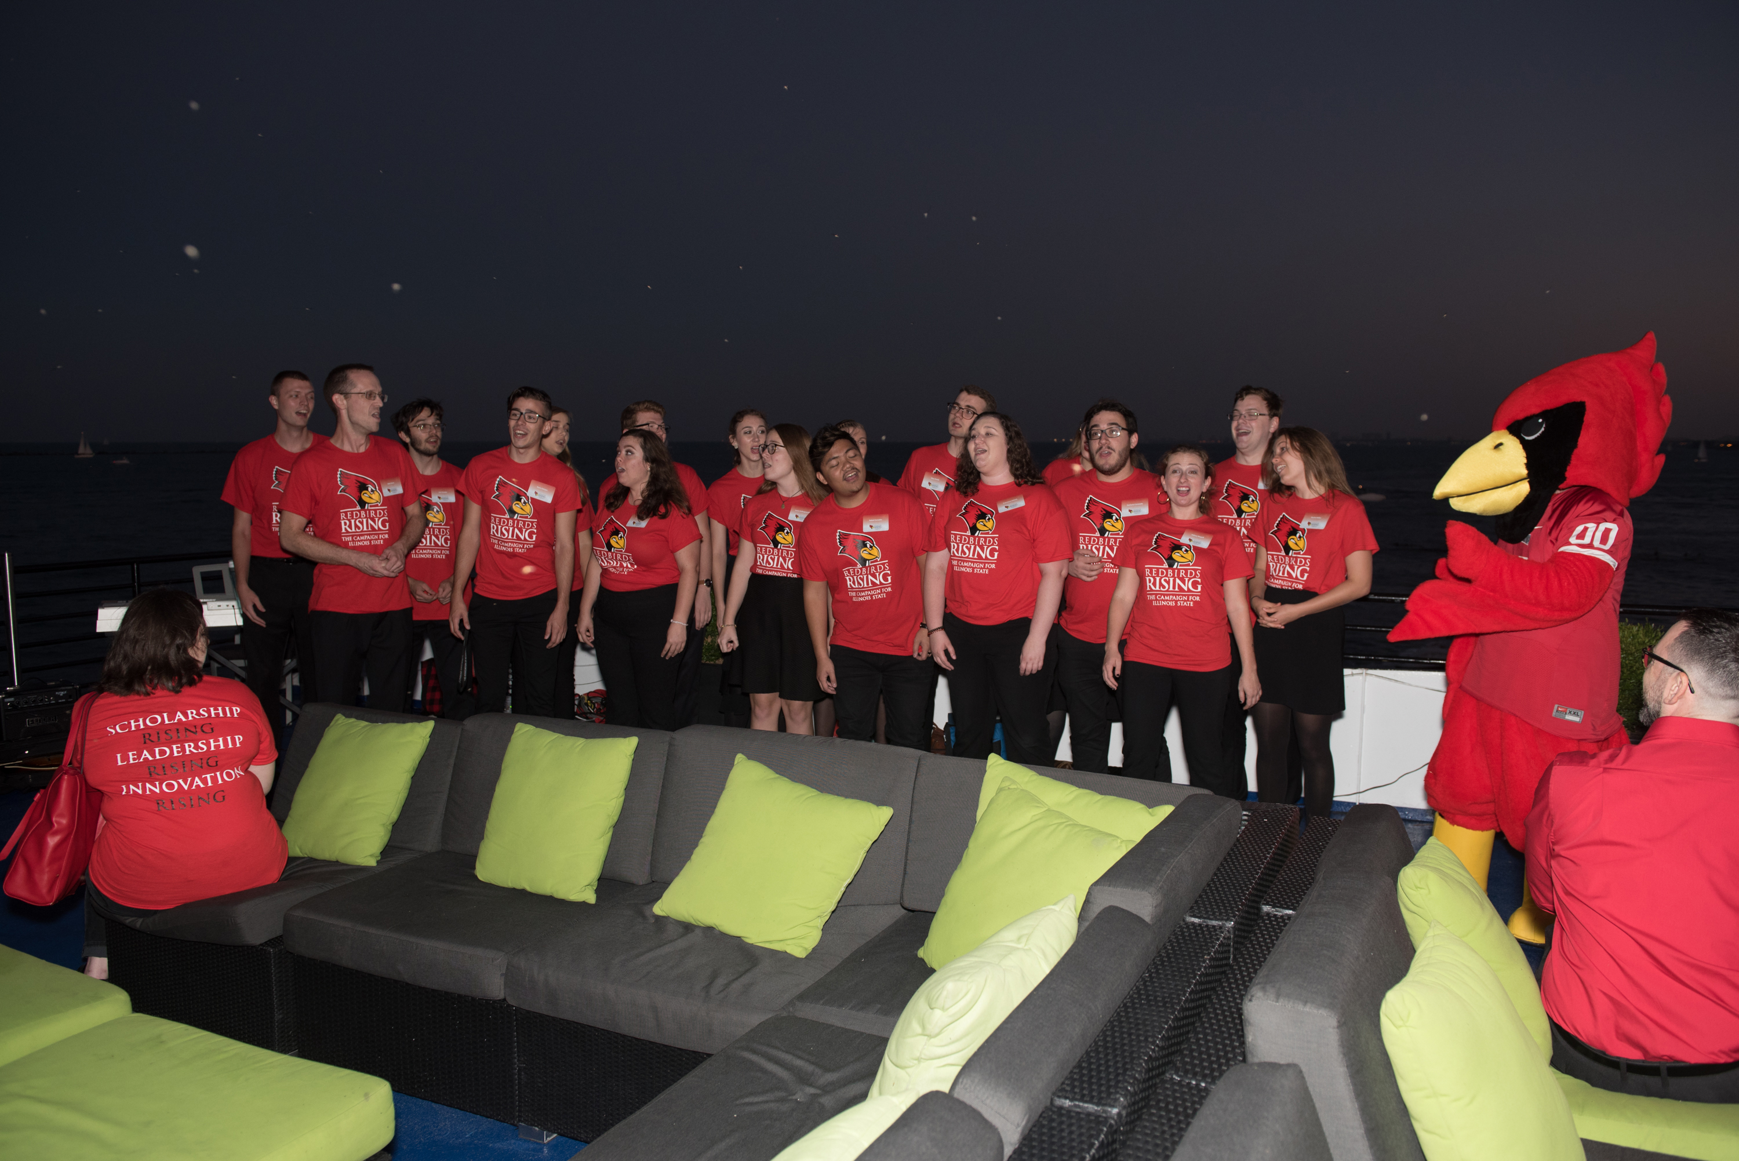
FY19 University Advancement
Gifts for scholarships and awards, student and faculty international travel, equipment, and project grants were given, as well as collections of artworks and a Steinway D concert grand piano
As of March 2019 the College of Fine Arts has met $11 million of its $12.5 million goal
Redbirds Rising!

Slide 26
FY20 Planning
Grow College of Fine Arts Enrollment by 100 students
Work with Facilities Planning and Construction on $3M and $9.6M projects
Prepare advisors, faculty, students and classrooms for summer 2020 transfer of 3 + 1 students from Tianhua College
Continue cultivating international partnerships
Continue building CFA study abroad options
Secure additional resources for faculty, students and staff research and creative activities
Mentor seven new tenure-track faculty members
Develop and market technology-rich curriculum and programs
Attain Redbirds Rising goal of $12 million+

Slide 27
FY20 Tenure Track Faculty Requests
Music History/Literature
Video Production
Digital Photography
Art Education
Theatre Management/Managing Director of ISF
Acting/Movement
Assoc. Director of Bands/Marching Band Director
Music Education Choral Music Specialist

Slide 28
FY20 Provost Enhancement Requests
Vitro Center-Glass Studio-$75,000
Scene Shop Floor Replacement-$20,000
Cook Hall 212-$28,300
CVA 20 Video Classroom-$172,000
Cook Hall 402 and 206-$6,210
Percussion Instruments-$21,693
Box Truck-$46,385
Arts Technology Space-CVA 17-$160,000
CVA 140-$85,000
Cook Hall 202 and 203-$7,450
University Galleries-Tech Tools-$13,503
Centennial East-Westhoff Lobby-$22,880
Intelligent/Moving Lighting-$97,087

Slide 29
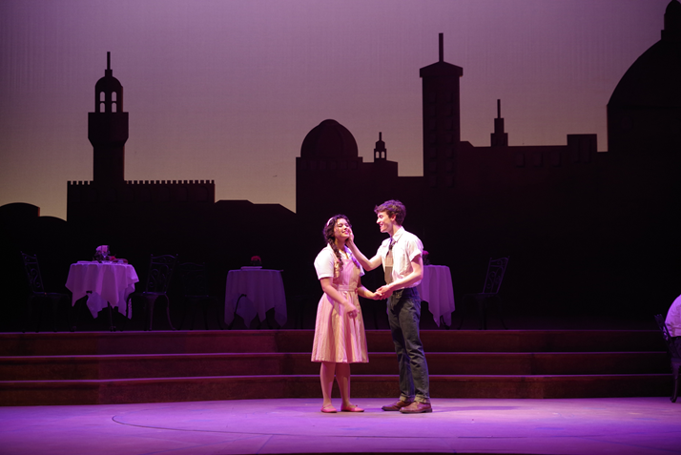
FY20 Permanent Funding and Non-Tenure-Track Requests
School of Music full-time Academic
Advisor (AP) to serve all Music
majors and minors
CFA-IT Technology Support Specialist
to serve the growth, expansion and
increasing technology based program
demands within the college
School of Theatre and Dance
Non-Tenure Track position to teach
courses in the areas of Acting,
Directing, and General Education
offerings

Slide 30
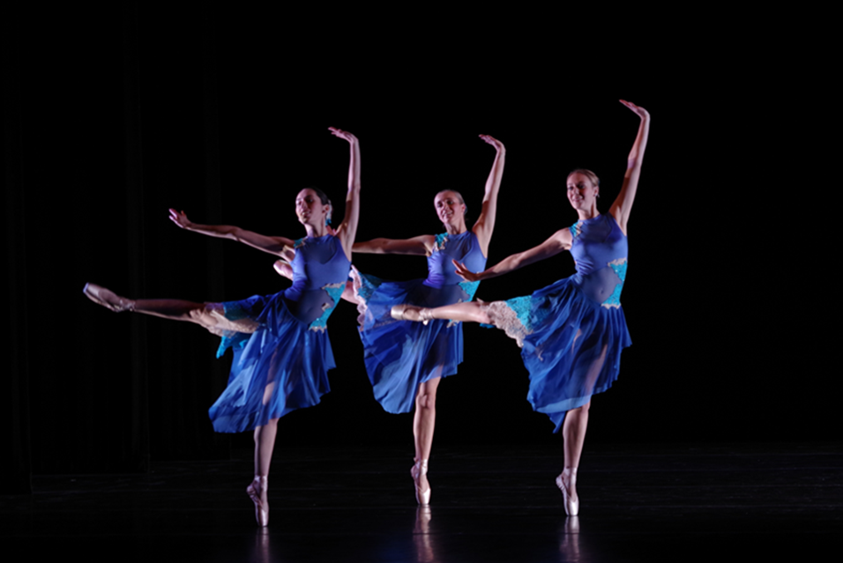
FY20 Strategic Budget Carryover Requests
Summer Salaries
CFA-IT-high end lab computer purchase
CFA-IT-MDM purchase and licensing
University Galleries-upgrade security cameras

Slide 31
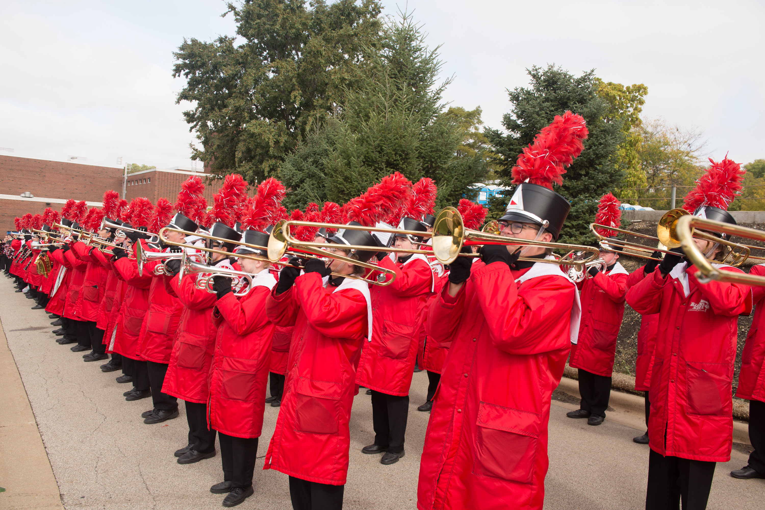
Questions?

Slide 32


