Slide 2
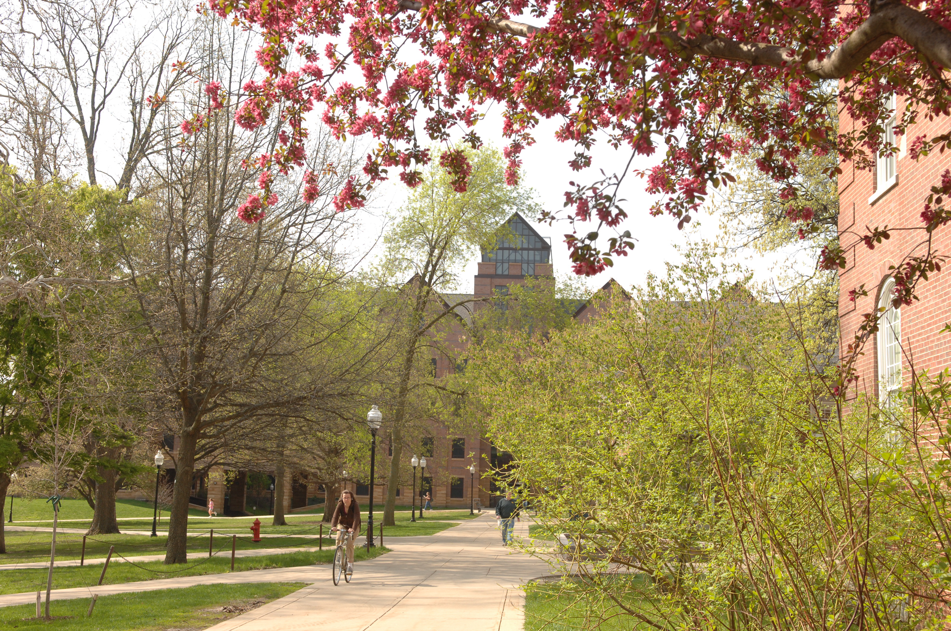
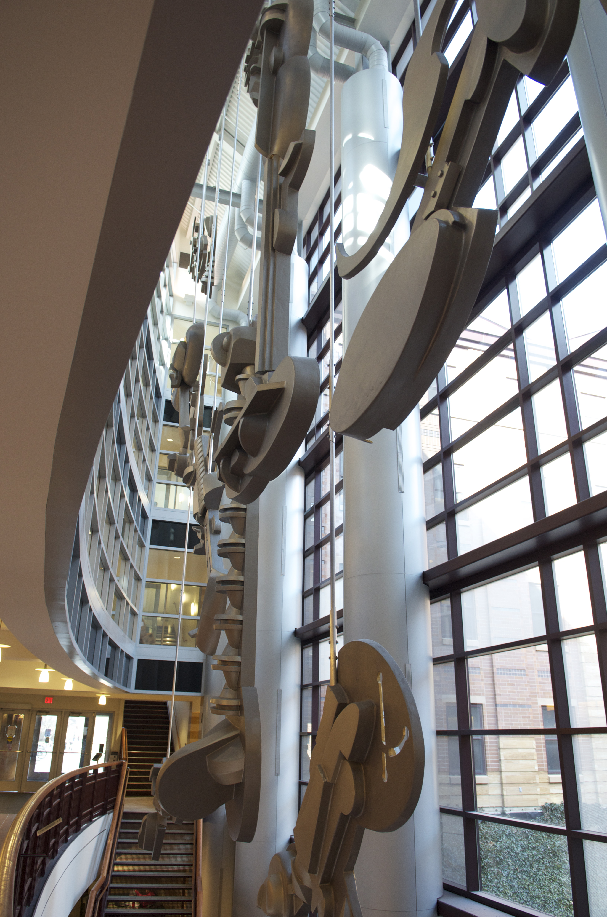
Budget Presentation
College of Business | Illinois State University | March 26, 2019

Slide 3
Budget Presentation
Introduction
FY19 Accomplishments & Productivity
FY20 Planning
Accomplishments
Productivity/Metrics
Use of Funds
Major Objectives
Permanent Funding
Strategic Budget Carryover
Enhancement Requests
Personnel Requests

Slide 4
College Leadership Team
Ajay Samant Dean
Deborah Lindberg Interim Associate Dean
Terry Noel Associate Dean
Debbie Seifert Chair, Accounting
Domingo Joaquin Interim Chair, Finance, Insurance and Law
Roberta Trites Interim Chair, Management & Quantitative Methods
Horace Melton Chair, Marketing

Slide 5

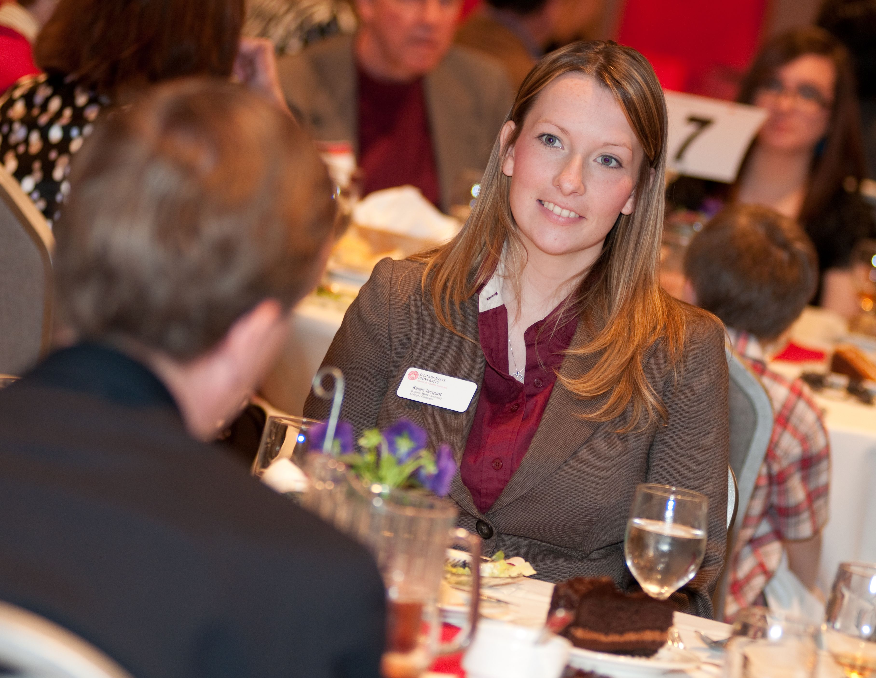

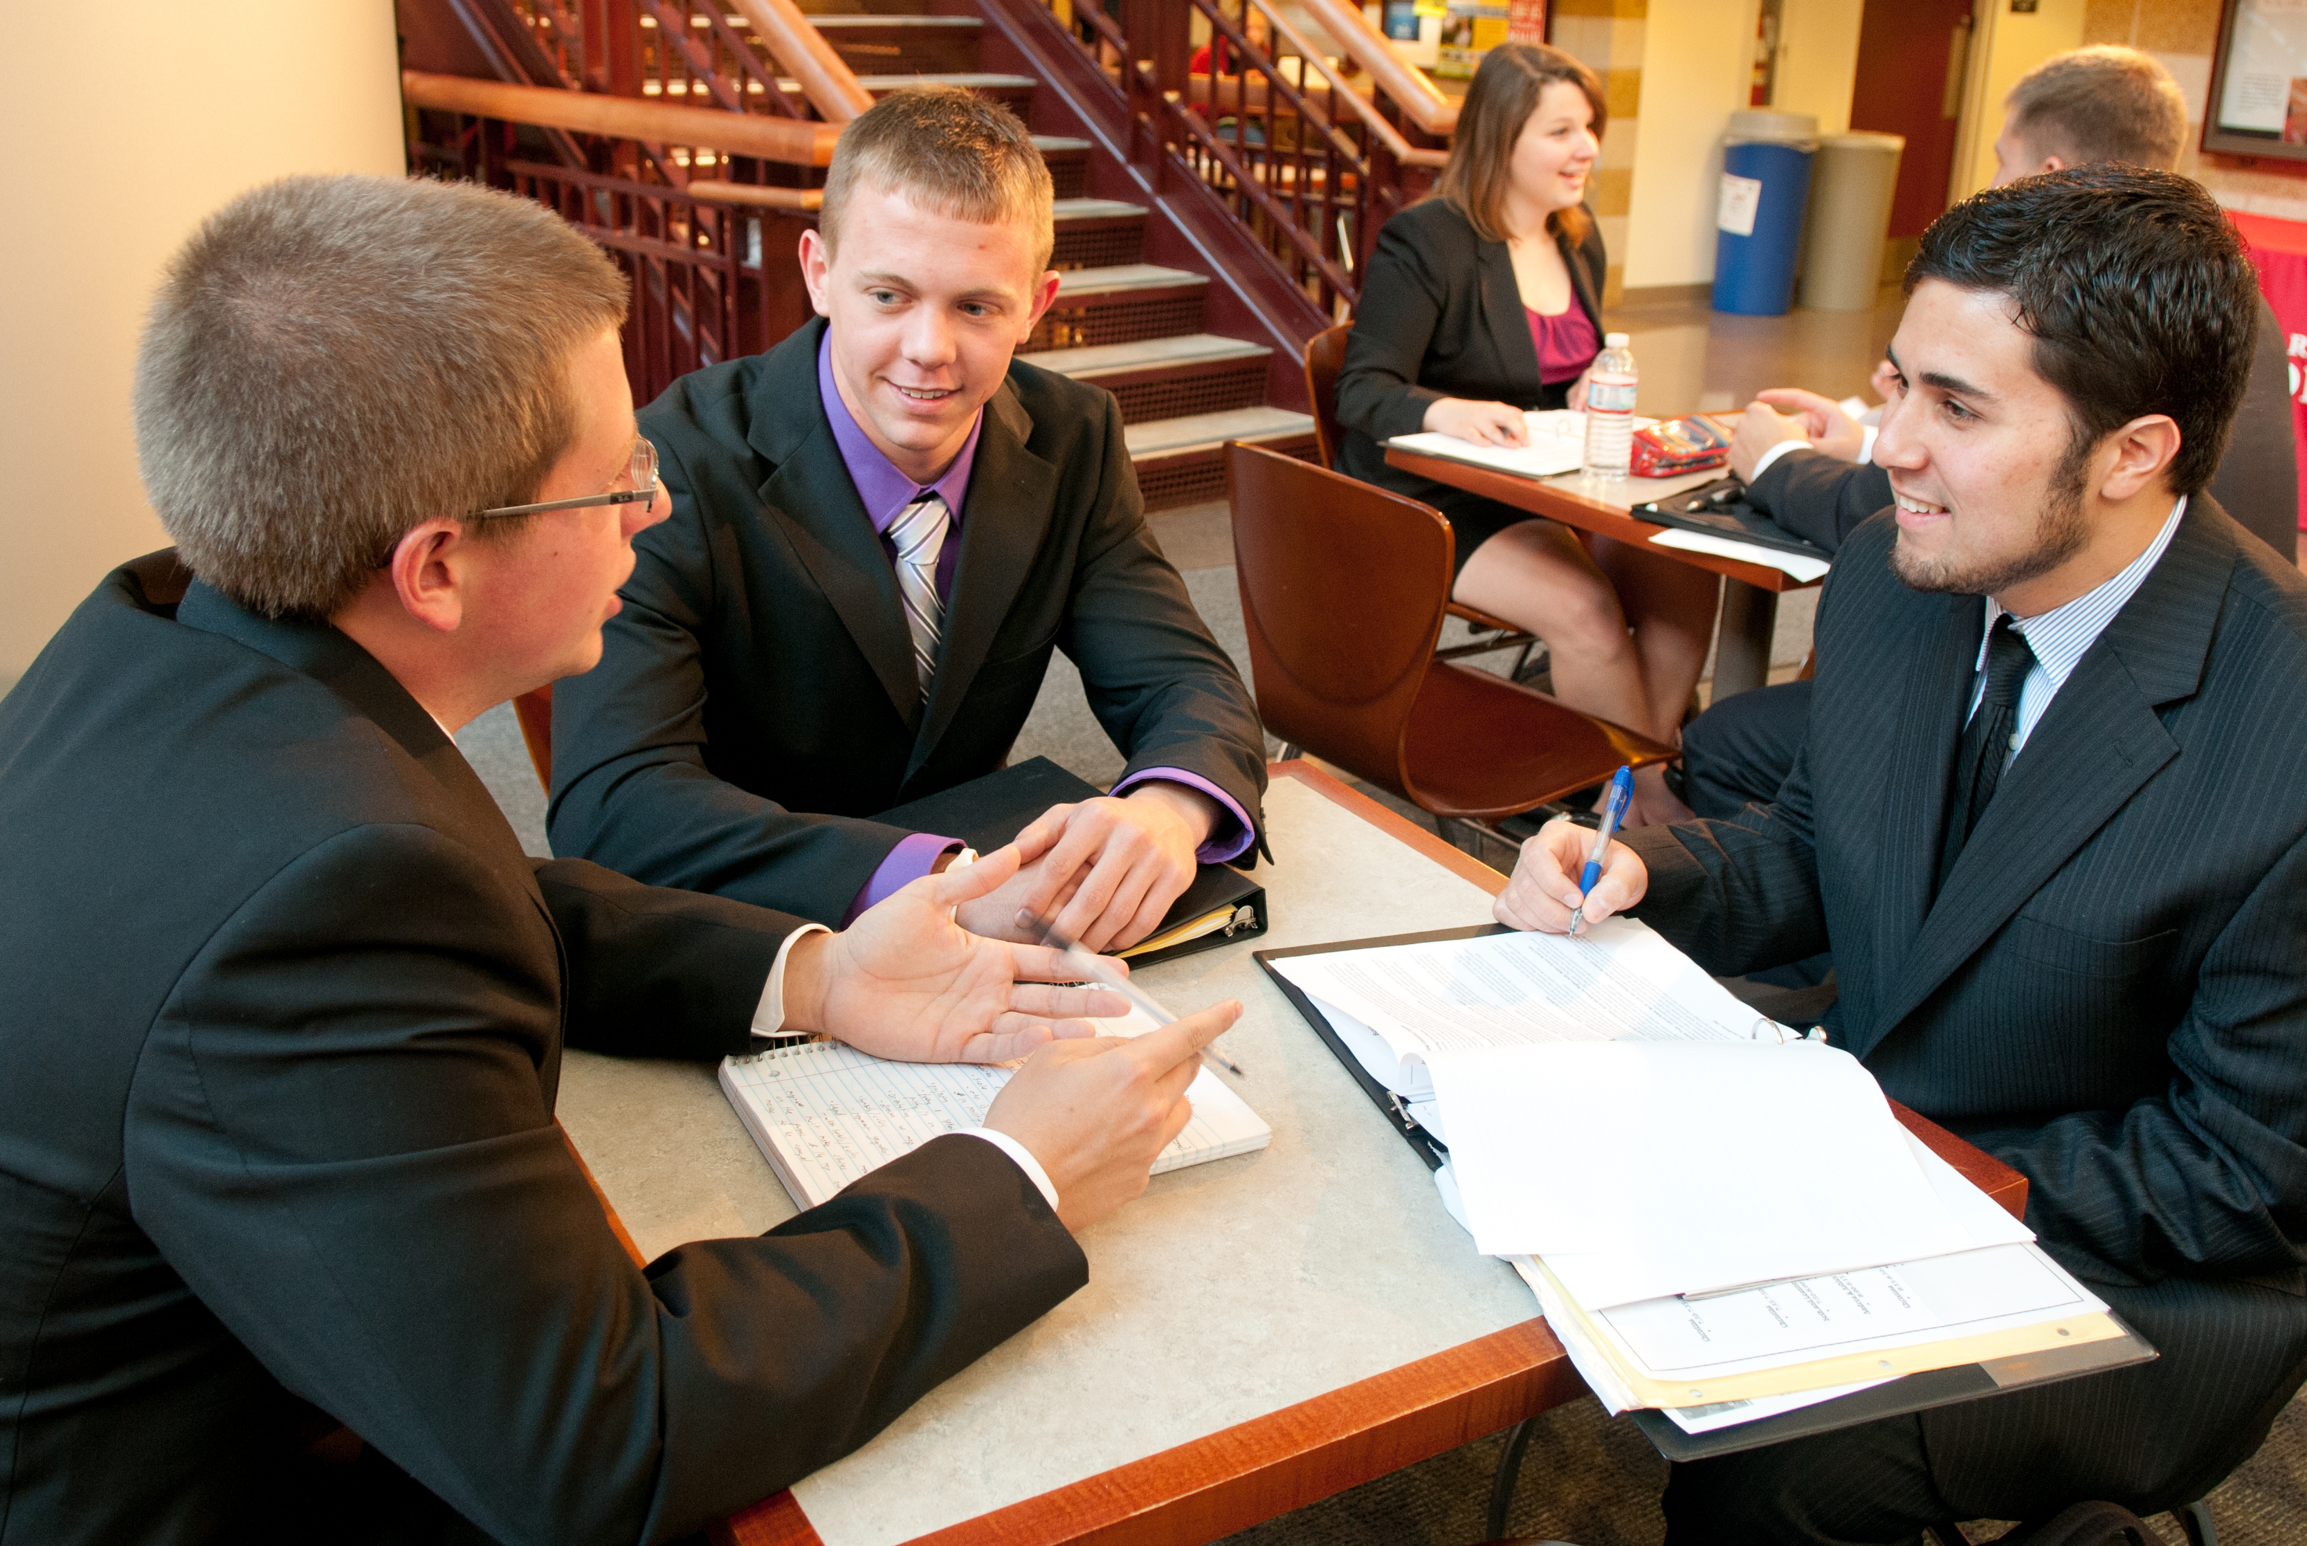

FIRST CHOICE IN
UNDERGRADUATE BUSINESS EDUCATION

Slide 6







FIRST CHOICE IN
UNDERGRADUATE BUSINESS EDUCATION

Slide 7
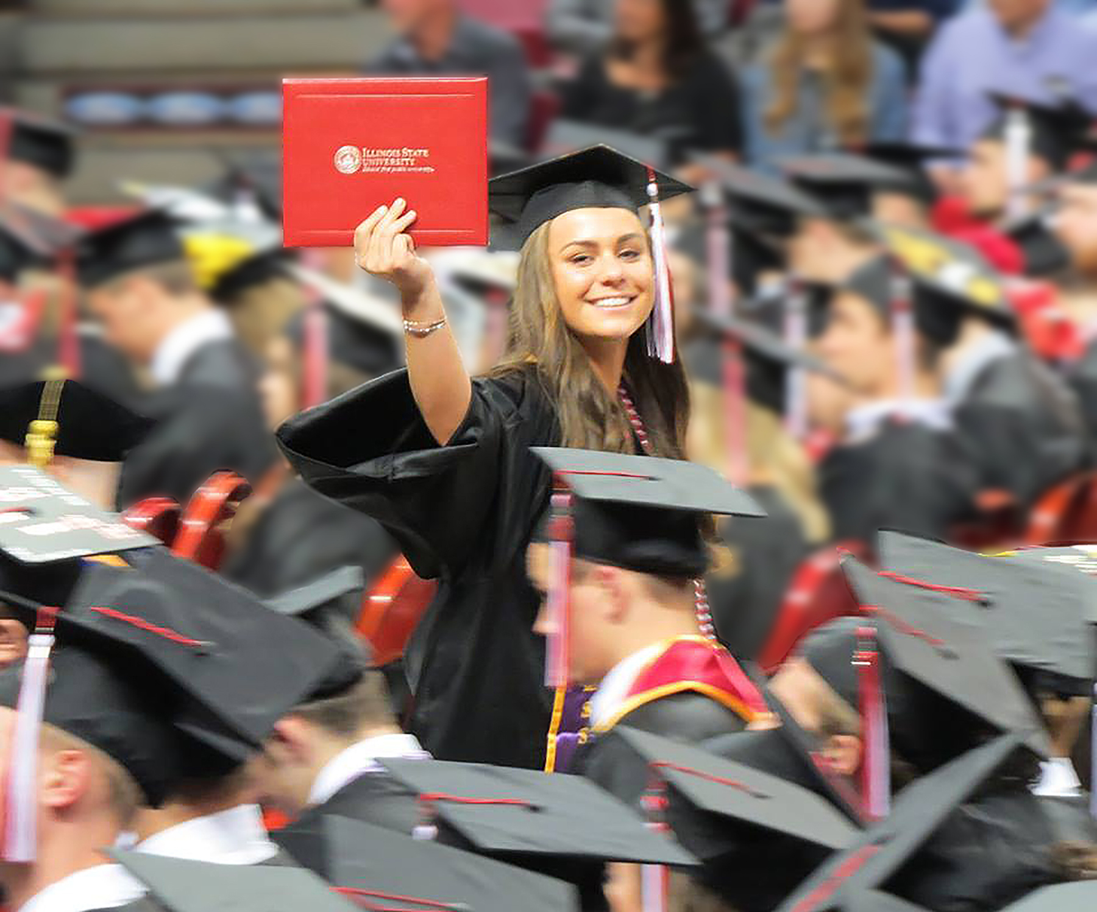
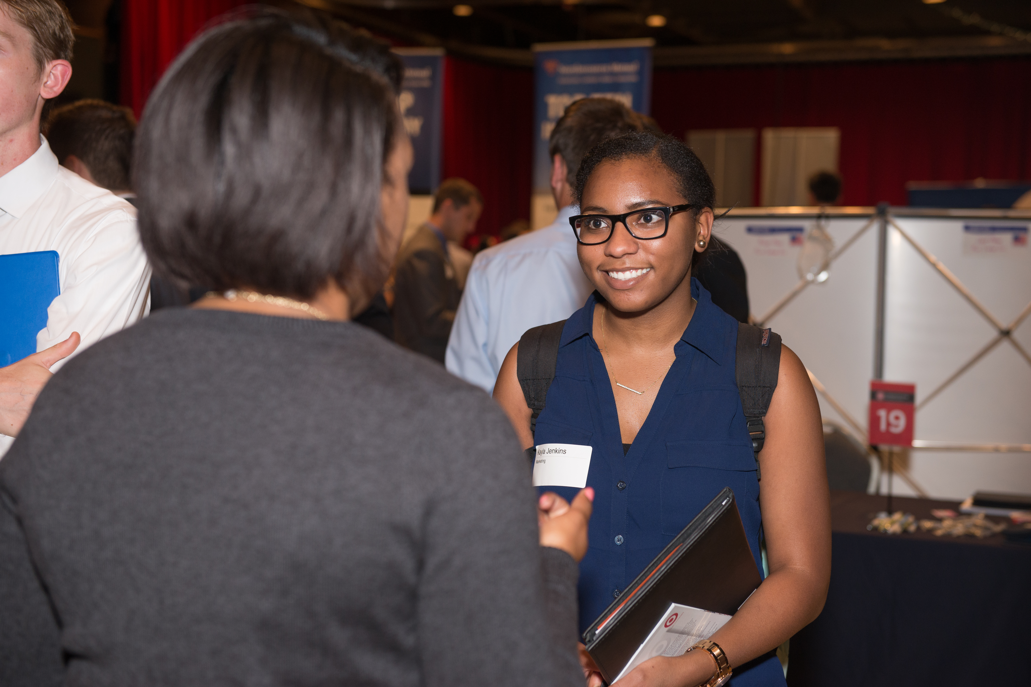
FY19
Accomplishments and Productivity

Slide 8
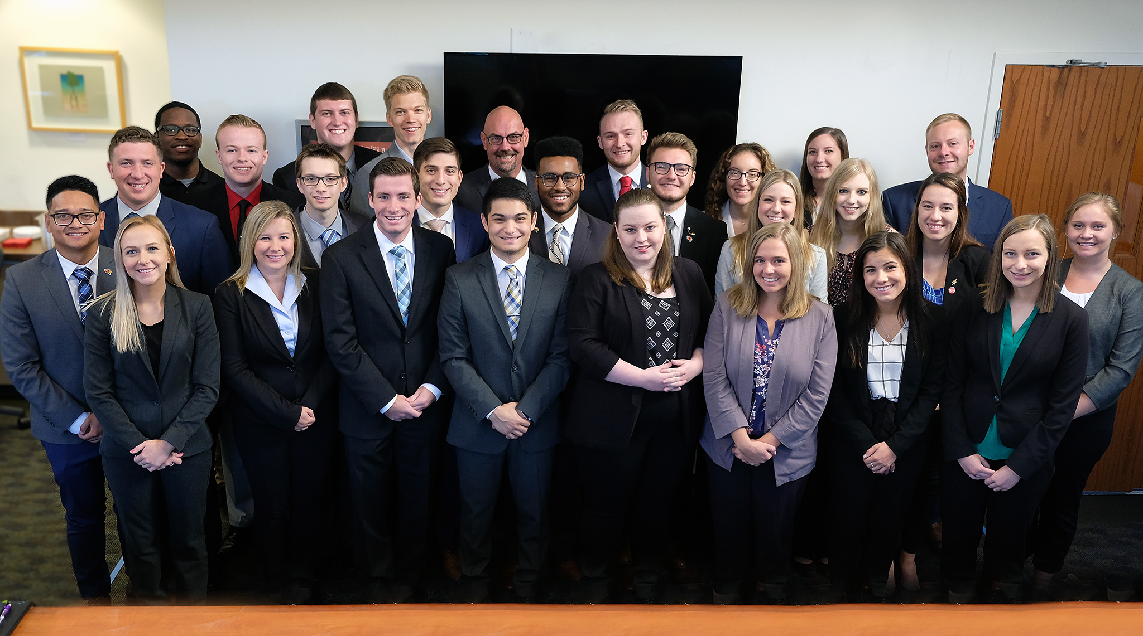
COBEC
College of Business Executive Council
Goal One
Prepare students for success in a diverse and global environment by providing excellent instruction and a transformative learning experience for every student.

Slide 9
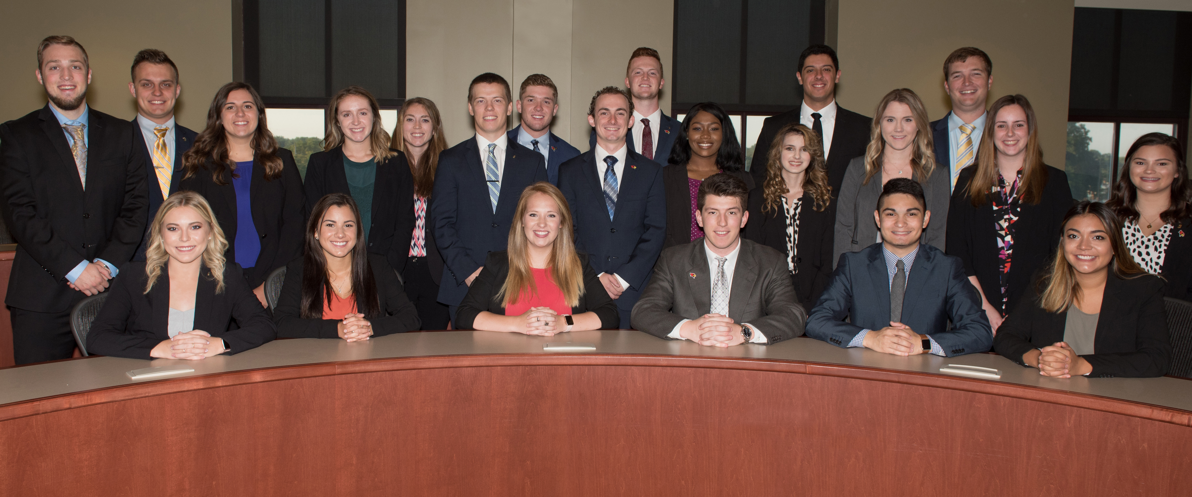
Goal One
Prepare students for success in a diverse and global environment by providing excellent instruction and a transformative learning experience for every student.
The Business Week program provides opportunities for students to learn and apply business skills outside the classroom

Slide 10
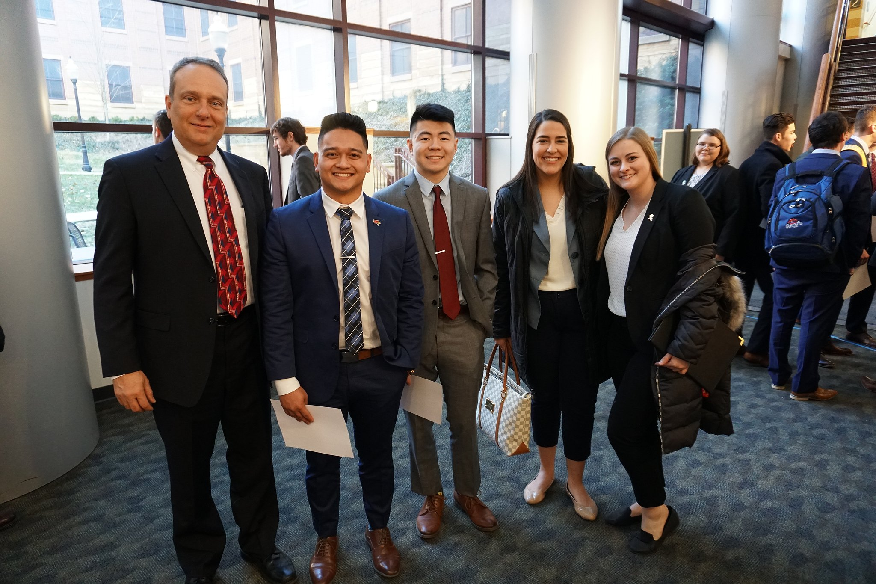
Goal One
Prepare students for success in a diverse and global environment by providing excellent instruction and a transformative learning experience for every student.
Business Week Mentor Program

Slide 11
Employ an excellent faculty and staff who meet the needs of COB stakeholders
Goal Two
Create a workplace that encourages and rewards excellence among faculty and staff.
DEEP
CONTENT
KNOWLEDGE
 | PROFESSIONAL DEVELOPMENT ACTIVITIES
Department | Instruction | Other Professional Development | Seminar or Workshop | Research Seminar | Tech | Assurance of Learning | Total
ACC |  |  | 3 | 4 | 3 |  | 10
FIL |  | 29 | 21 | 4 |  |  | 54
MKT | 6 | 7 | 17 | 13 | 3 | 3 | 49
MQM |  | 4 | 22 | 4 | 1 | 3 | 34
Total: | 6 | 40 | 63 | 25 | 7 | 6 | 147

Slide 12
Employ an excellent faculty and staff
who meet the needs of COB
stakeholders
Goal Two
Create a workplace that encourages and rewards excellence among faculty and staff.
DEEP
CONTENT
KNOWLEDGE
 | R E S E A R C H C A T E G O R I E S
Dept | Articles | Chapters | Present- ations | Proceed-ings | Grants | Books | Articles In Progress | Other | Total
ACC | 26 |  | 7 | 3 | 1 | 1 | 10 | 4 | 52
FIL | 20 | 1 | 21 |  | 2 |  | 34 | 3 | 81
MKT | 19 | 1 | 13 | 11 | 1 |  | 34 |  | 79
MQM | 22 | 2 | 29 | 15 | 10 |  | 29 | 3 | 110
Total | 87 | 4 | 70 | 29 | 14 | 1 | 107 | 10 | 322

Slide 13


Goal Three
Create an engaging and committed culture of diversity and inclusion across multiple dimensions.
COB faculty represent many countries from around the world
Students in the National Association of Black Accountants (NABA) have attended events and conferences
Marketing Chair Horace Melton will lead a team dedicated to designating specific activities to put ISU’s Educate-Connect-Elevate strategic plan and the COB’s diversity and core values into practice

Slide 14
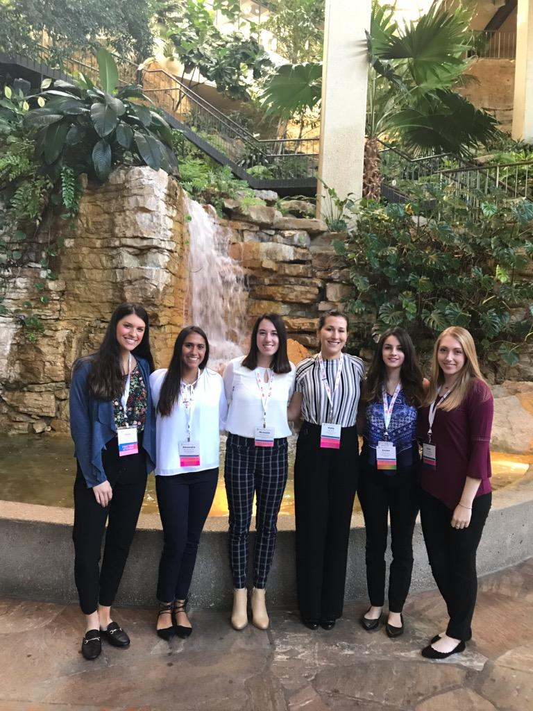
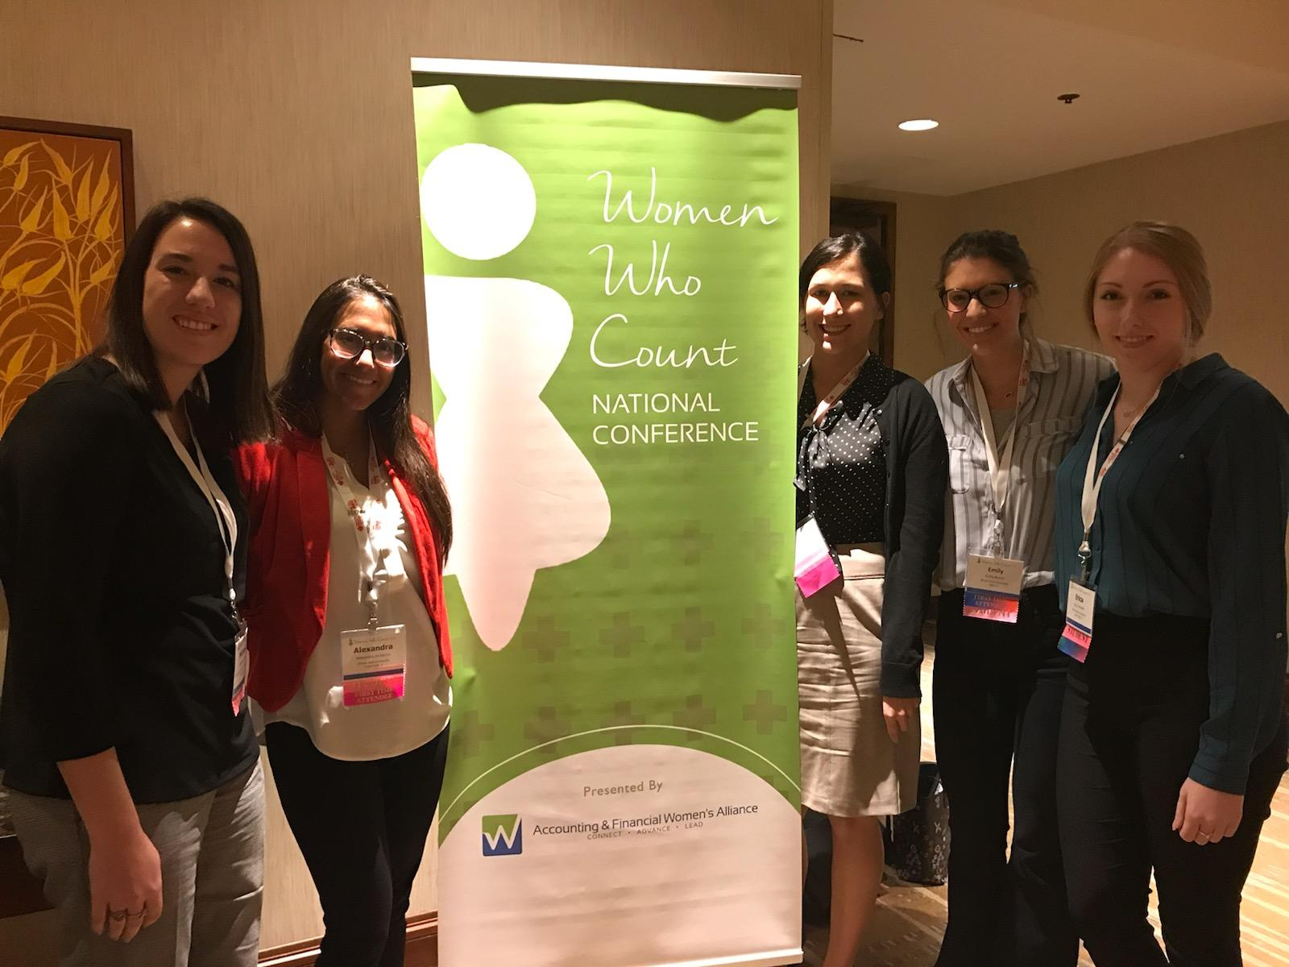
Goal Three
Create an engaging and committed culture of diversity and inclusion across multiple dimensions.
Accounting and Financial
Women’s Alliance (AFWA)
Students in AFWA have attended numerous events and conferences
ISU students launched a nationally recognized book club on female leadership
Accounting Department Chair Debbie Seifert won the “Women Who Count Academic Professional Award” from AFWA

Slide 15
Select Accomplishments
Goal Four
Promote and communicate our brand including COB successes and our vision of excellence and national recognition.
COB graduation survey to track employment.
(May, 2018 results)

Slide 16
Select Accomplishments
Goal Four
Promote and communicate our brand including COB successes and our vision of excellence and national recognition.
COB graduation survey to track internships.
(May, 2018 results)

Slide 17
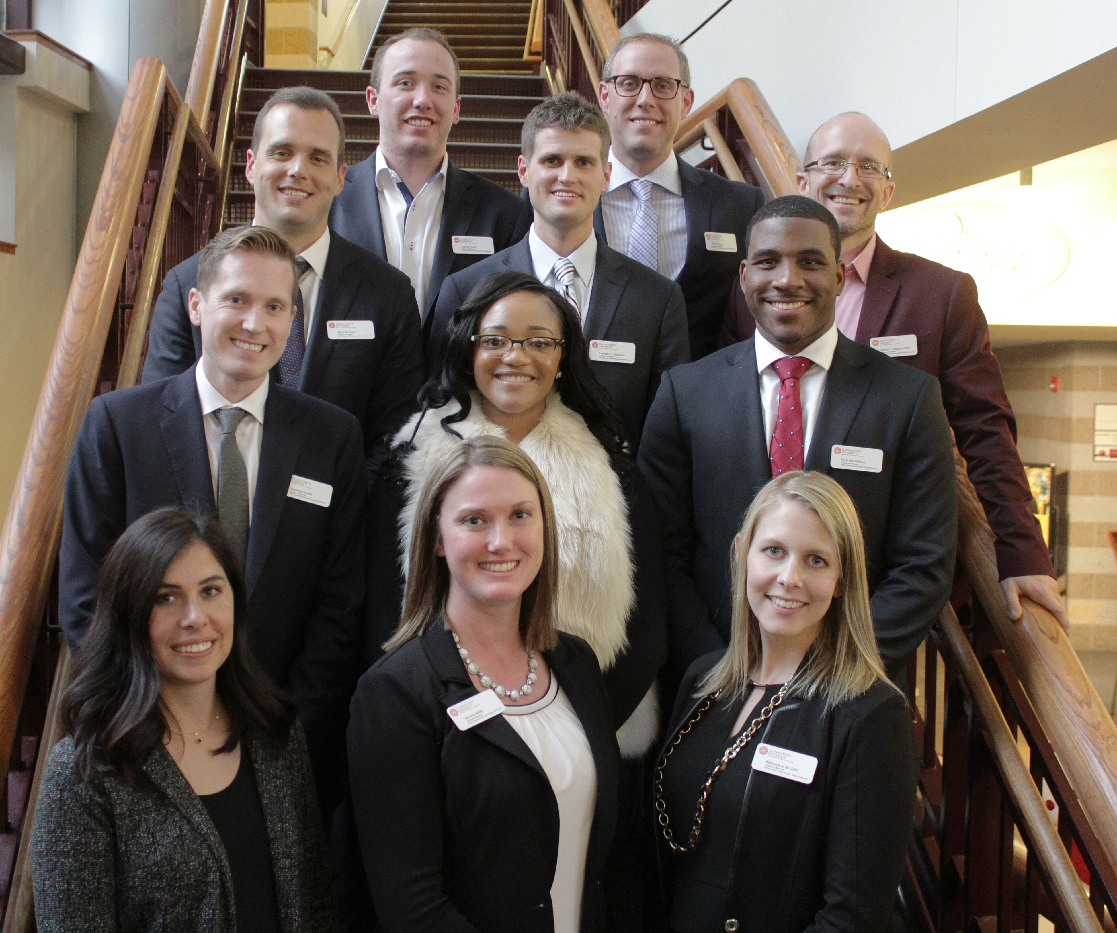
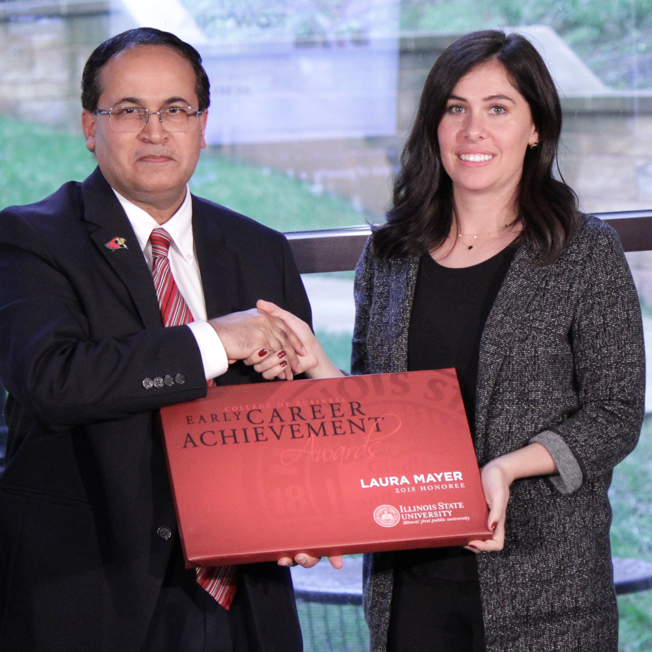
Select Accomplishments
Goal Five
Create and strengthen partnerships with alumni and business organizations.
Maintain existing and create new relationships with businesses and organizations that partner with the COB and hire our graduates.

Slide 18
Select Accomplishments
Goal Five
Create and strengthen partnerships with alumni and business organizations.
Increase Private Financial Support

Slide 19
Illinois State University
CAPITAL CAMPAIGN
College of Business
CAPITAL CAMPAIGN TARGET $28,000,000
College of Business
GIFTS RAISED-TO-DATE $26,178,936
Note: The vast the majority of the COB capital campaign funds are endowed; thus a very small percentage of the funds raised are expendable

Slide 20

Measures of Productivity:

Slide 21
Measures of Productivity: *
Enrollments
Fiscal Year
Students | FY 2014 | FY 2015 | FY 2016 | FY 2017 | FY 2018
 | Count | Count | Count | Count | Count
University Total | 21,400 | 21,714 | 21,736 | 22,027 | 21,682
Business | 3,516 | 3,866 | 4,038 | 4,174 | 4,135
ACC | 871 | 953 | 997 | 984 | 939
FIL | 535 | 596 | 618 | 683 | 716
MKT | 729 | 813 | 856 | 906 | 915
MQM | 1,217 | 1,363 | 1,432 | 1,487 | 1,452
MBA | 164 | 141 | 135 | 114 | 113
University enrollment increased by 1.3% from FY14 to FY18.
The increase in COB enrollment over that time span is over 17.6%.
*As requested, this and all productivity measures and metrics for this
section are those provided by PRPA

Slide 22
Measures of Productivity:
Credit Hours
Fiscal Year
Credit Hours | FY 2014 | FY 2015 | FY 2016 | FY 2017 | FY 2018
University Total | 506,003 | 515,941 | 515,792 | 525,974 | 519,452
Business | 61,663 | 65,543 | 65,976 | 70,950 | 73,278
Accounting | 18,373 | 18,928 | 19,790 | 21,747 | 21,295
Finance, Insurance, and Law | 15,229 | 16,347 | 16,096 | 16,703 | 17,485
Management and Quantitative Methods | 18,097 | 19,086 | 19,156 | 20,284 | 20,555
Marketing | 9,964 | 11,182 | 10,934 | 12,216 | 13,769
Master of Business Administration* |  |  |  |  | 174
Total credit hours at the university increased by 2.7% from FY14 to FY18; in the College of Business credit hours increased by 18.8% from FY14 to FY18.
*Credit hours for the MBA not provided by PRPA reports prior to FY18.

Slide 23
Measures of Productivity:
Credit Hours/TT
Fiscal Year
Credit Hours per TT | FY 2014 | FY 2015 | FY 2016 | FY 2017 | FY 2018
University Total | 376 | 366 | 372 | 395 | 388
Business | 485 | 491 | 492 | 487 | 516
Total TT Credit Hours | FY 2014 | FY 2015 | FY 2016 | FY 2017 | FY 2018
University Total | 262,091 | 251,927 | 257,122 | 268,348 | 266,865
Business | 37,845 | 39,295 | 38,845 | 38,007 | 39,193
Total TT Faculty | FY 2014 | FY 2015 | FY 2016 | FY 2017 | FY 2018
University Total | 697 | 688 | 691 | 679 | 687
Business | 78 | 80 | 79 | 78 | 78
Credit hours per tenure-track faculty are the highest, or among the highest, on campus each year. Credit hours per TT faculty have increased 6.4% from FY14 to FY18, compared to the university’s increase of 3.2% during that time period.

Slide 24
Measures of Productivity:
Credit Hours NTT
Fiscal Year
Total NTT Credit Hours | FY 2014 | FY 2015 | FY 2016 | FY 2017 | FY 2018
University Total | 187,234 | 208,218 | 193,444 | 196,619 | 195,725
Business | 23,785 | 26,239 | 27,124 | 32,934 | 33,978
Credit hours per non-tenure-track faculty are the highest, or among the highest, on campus each year. From FY14 to FY18, NTT credit hours at the University increased by 4.5%. In the COB, NTT credit hours increased by 42.9% during that time span.

Slide 25
Measures of Productivity:
Class Size
Class Size Average – Fall 2018
Class Level | COB Average | University Average
100 | 56.9 | 41.8
200 | 42.7 | 27.0
300 | 24.3 | 20.2
Grand Total | 39.0 | 31.1
College of Business class sizes are significantly larger than the University averages.

Slide 26
Use of Additional Funds to Enhance Accomplishments and Productivity
Instructional Capacity (NTT funding):
IC Funds from Provost $625,881
Permanent NTT $ (GR) $893,552
Total NTT Costs $1,519,433

Slide 27
Use of Additional Funds
to Enhance Accomplishments and Productivity
Summer Session Funding - 2019:
Received from Provost $545,000
Permanent $ (GR) $226,072
Total committed to Summer $771,072

Slide 28
Use of Additional Funds
to Enhance Accomplishments and Productivity
Technology Tuition Dollars:
Received from Provost $113,053
Funds Provided by COB $22,479
Total committed to activity $135,532
Numerous constituents across campus use the computer labs in the State Farm Hall of Business building; as a “campus partner” we provide lab monitors, technical assistance, and other services

Slide 29
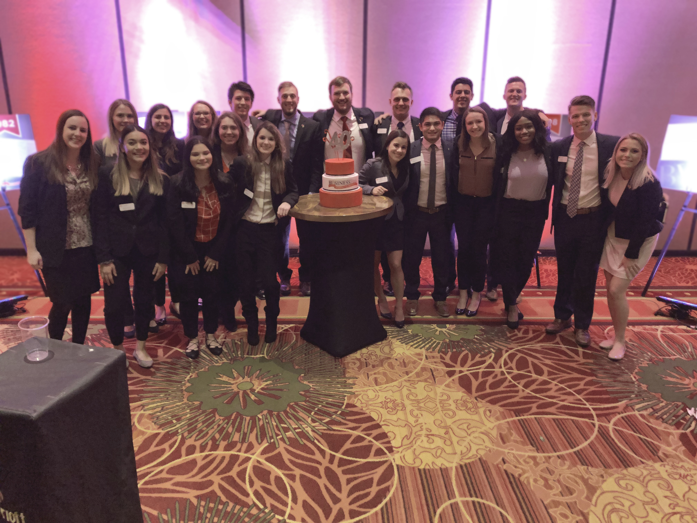
Looking Ahead
PLANS FOR 2019-2020

Slide 30
FY 2020
College of Business
ILLINOIS STATE UNIVERSITY
VISION
To be the first choice for business education
in Illinois and beyond.
MISSION
Within Illinois State University’s College of Business, through our shared commitment to excellence in learning, we prepare students to become skilled business professionals who think critically, behave ethically, and make significant contributions to organizations, communities, and our global society.

Slide 31
Our Future Goals are aligned with Educate • Connect • Elevate
Goal One
Prepare students for success in a diverse and global environment by providing excellent instruction and transformative learning experience for every student
Goal Two
Create a workplace that encourages and rewards excellence among faculty and staff
Goal Three
Create an engaging and committed culture of diversity and inclusion across multiple dimensions
Goal Four
Promote and communicate our brand including COB successes and out vision of excellence and national recognition
Goal Five
Create and strengthen partnerships with alumni and business organizations

Slide 32
FY20 Major Objectives
Continue momentum from AACSB extension of accreditation for 2017 to 2022 by continued implementation and monitoring of our 5-year strategic plan
Z
Some Perspective:
No. of business schools/colleges world wide > 10,000
No. of those accredited by AACSB 831
No. accredited in both business and accounting 187
The ISU COB is in the elite 1.87 percent of accredited business and accounting schools world wide. We can proudly say that we have attained and maintained the accreditation gold standard.

Slide 33
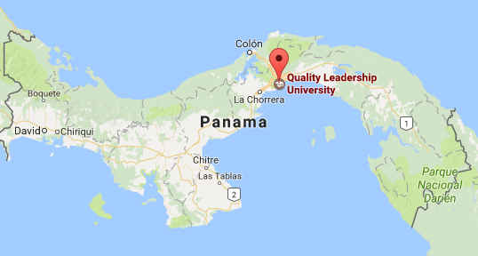
FY20 Major Objectives
Continue Implementation of the B.S. in International Business degree in partnership with Quality Leadership University (QLU) , which began in March, 2018
Continue Implementation of the MBA degree in Panama in partnership with QLU, which began in May of 2018

Slide 34
Major Objectives
Build on the success of the Redbird Career Portfolio (career and professionalism program) for all COB students.

Slide 35
FY20 Major Objectives
Leverage use of mentor cloud software to enhance professional mentoring opportunities between COB students and alumni
MORE LIKELY TO ATTEND EXTRA CURRICULAR EVENTS
MORE LIKELY
TO HAVE AN INTERNSHIP

Slide 36
FY20 Major Objectives
Increase the number of Academic Advisors in the COB
AACSB peer review team cited our high advising case load as an opportunity for improvement. National best practice average = 350; COB average = 700.

Slide 37
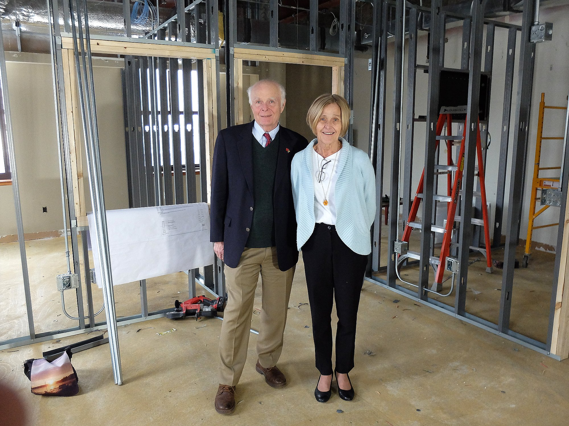
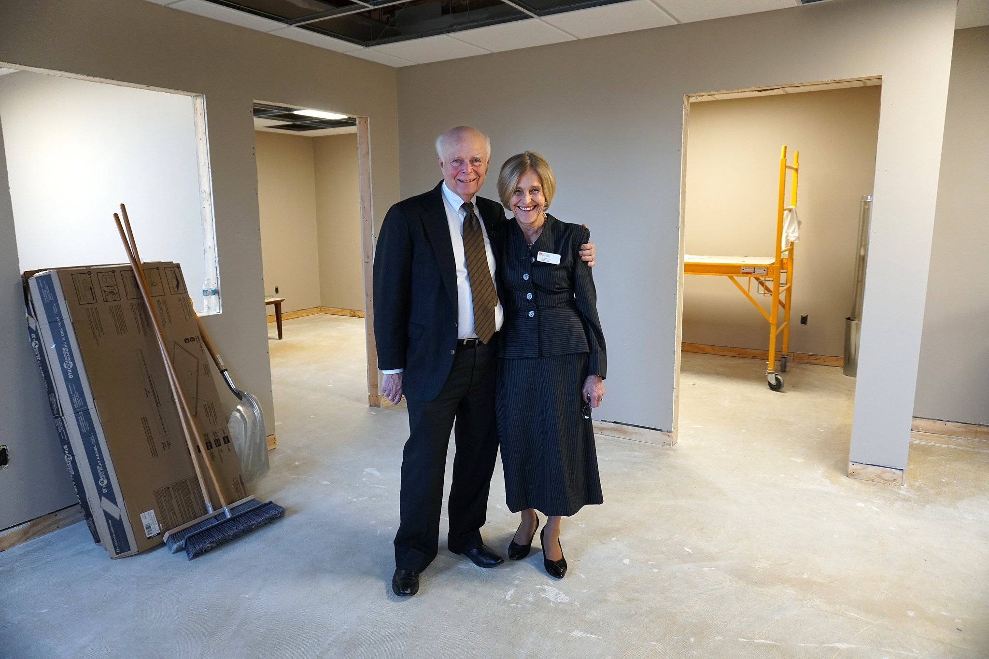
FY20 Major Objectives
As a result of the generous gift by Carson and Iris Varner, the Varner International Business Institute is under construction in the State Farm Hall of Business building.

Slide 38

FY20 Major Objectives
Strengthen enrollment in the MBA/CMBA Programs

Slide 39
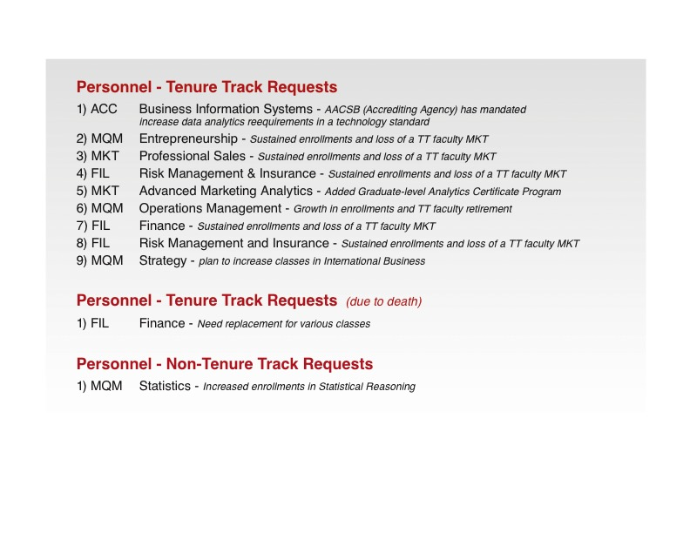
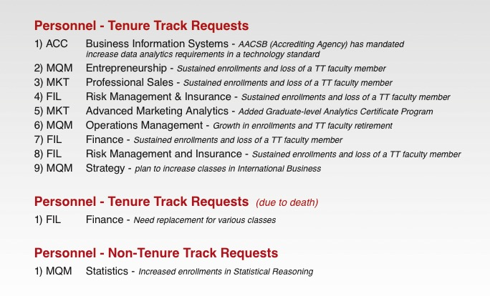
FY20 Personnel Requests

Slide 40
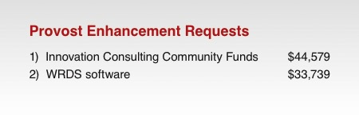
FY20 Provost Enhancement Requests
Notes:
The amount for #1 changed to $110,000 per the quote; the amount for #2 changed to $150,500 per the quote. (DLL 3/29/18)

Slide 41
FY20 Strategic Budget Carryover
SBC REQUESTS ARE FOR:
Summer School costs for classes scheduled for July 1 or later
Travel costs
New faculty startup packages and support
Student recruitment and retention
Faculty retention, support, and professional development
Note: The majority of the SBC requests are encumbered (such as for summer school costs, contractual obligations for new faculty, etc.)

Slide 42
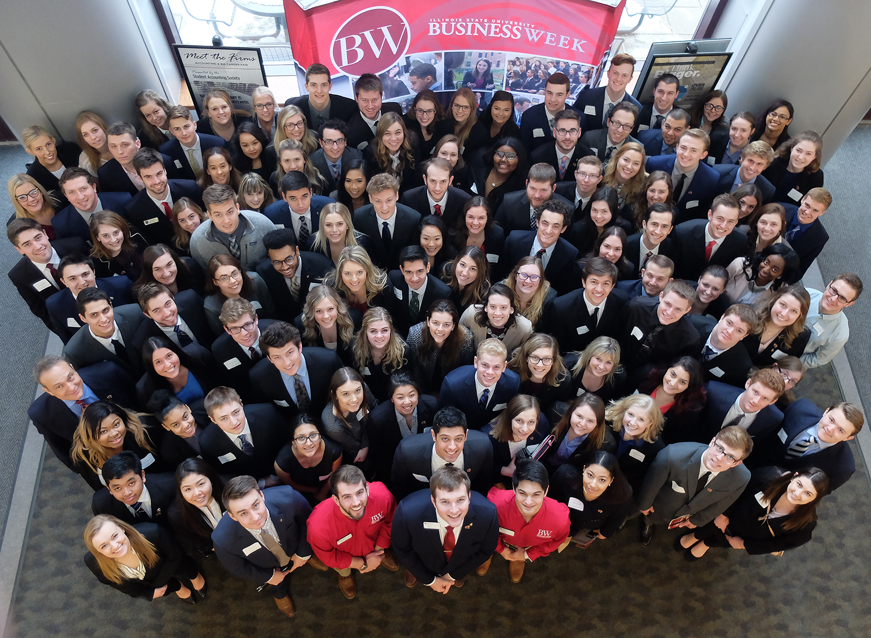

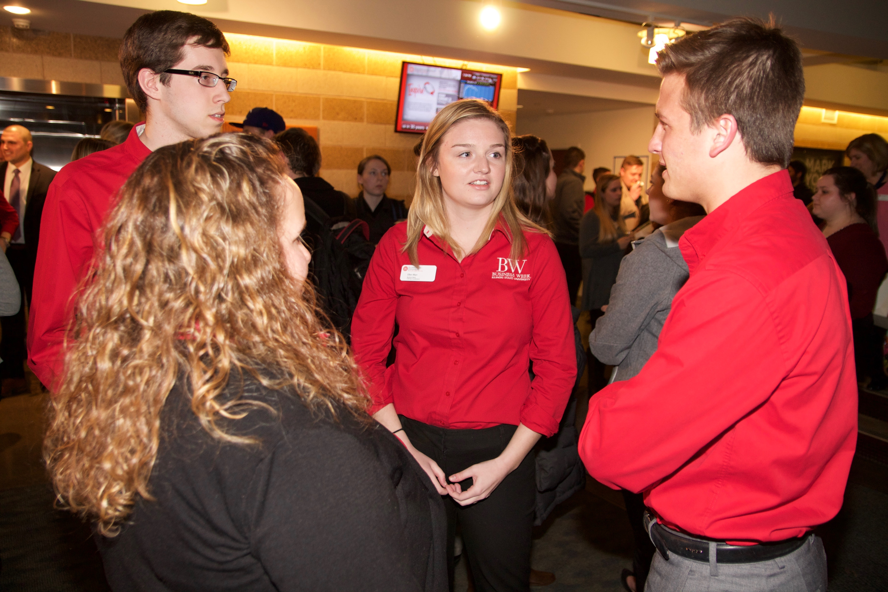
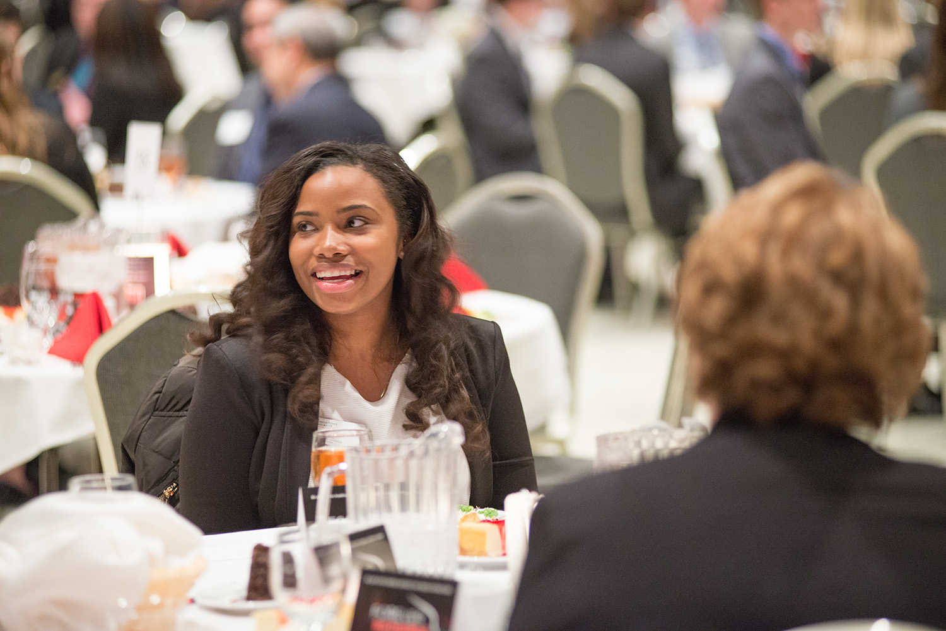
Thank you!

