Slide 1
2019 Program Planning & Budget Report

Slide 2
Leadership Team
Barb Meyer
Associate Dean
Christy Borders
Interim Associate Dean
Dana Kinley
Lab School Superintendent & Assistant Dean
Alan Bates
Interim Director, School of Teaching & Learning
Deb Garrahy
Director, Lauby Teacher Education Center
Stacey Jones Bock
Chair, Department of Special Education
Len Sutton
Chair, Department of Educational Administration & Foundations
Kelli Appel
Director of Enrollment & Transition Services
Wilma Bates
Director of Development
Tory Jenkins
Assistant to the Dean for Financial Affairs
Wes Matejka
Director of Facilities & Technology Services
Andy Read
Interim Director of Constituent Relations

Slide 3
Leadership Team
Amy Fritson Coffman
Principal, Metcalf School
Andrea Markert
Principal, University High School
Linda Vernon
Director, Center for the Advancement and Support of Educational Initiatives
Lynne Haeffele
Director, Center for the Study of Education Policy
Maria Zamudio
Executive Director, National Center for Urban Education
Aimee Julian
Director, Illinois Center for Specialized Professional Support
Deborah MacPhee
Interim Director, Mary & Jean Borg Center for
Reading & Literacy
Kris Mason
Director, National Board Resource Center
Jodi Nibbelin
Coordinator, Special Education
Assistive Technology Center

Slide 4
8th
Best college of education
6th
Best college of education for Veterans
33rd
Best college for the money in the U.S.
#1
producer of teachers in Illinois
21st
Best High School (U-High) in Illinois
100%
Pass rate on State of IL content exam
88th
Best graduate school in Education
1 in 7
Illinois public teachers graduated from ISU
6th
Largest producer of teachers in the
U.S.
9th
Top Special Education College in U.S.
7th
Largest producer of special education majors in the U.S.
#1
producer of teachers in the
Midwest
2 out of 3
Number of recent years Redbird has won Teacher of Year Award
$400,000
Recruitment and retention scholarships
8th
Largest producer of elementary education in the U.S.
Top 10%
Subject specific education programs in U.S.
99%
Percentage of students who achieve passing scores on edTPA
1 in 4
first-year teachers in Illinois graduated from ISU

Slide 5
FY20 Budget Requests
Personnel
Permanent request
Provost enhancement requests
Strategic budgeted carryover

Slide 6
Faculty
TT/T Faculty
Year

Slide 7
Enrollment
Students
Year (fall census)

Slide 8
Recruitment & Retention
$160,000 general scholarships
$99,000 incentive scholarships
$28,000 retention*
Future teacher signing days!
47 Redbird Educator Sessions
4 future educators sessions
Future Teachers’ Conference
Donuts
with
Districts

Slide 9
University Laboratory Schools Enrollment
Thomas Metcalf
Preschool 28
K – 8th grade 386
Total 414
University High School
9th grade 158
10th grade 156
11th grade 152
12th grade 144
Total 610

Slide 10
Lauby Teacher Education Center
862 Cooperating teachers
674 student teaching placements
8,414 Pre-student teaching clinical field experiences
D Garrahy was here

Slide 11
Faculty Productivity

Slide 12
External Submissions & Awards
Unit | Number of Submissions | Grant Submission Amounts | Number of Awards Received | Awards Received
Dean’s Office | 0.25 | $12,487 | 1 | $1,760,250
EAF | 26 | $4,012,357 | 29 | $8,277,950
SED | 5.5 | $2,564,258 | 3.5 | $2,650,530
TCH | 9 | $939,705 | 5 | $494,232
Lab Schools | 2 | $2,500 | 2 | $2,253
TOTAL | 42.75 | $7,531,307 | 40.5 | $13,185,215

Slide 13
Scholarly Productivity
211 Refereed presentations
4.6
Scholarly outcomes per TT/T faculty
82 Referred
journal articles
32 Books or
book chapters

Slide 14
Scholarly Productivity
2015 2016 2017 2018

Slide 15
Personnel Requests: Tenure Track
Educ Admin & Foundations
Higher Education Administration
Leadership, Equity, & Inquiry
P-12
Special Education
Learning Behavioral Specialist (LBS) – Literacy
LBS – Math
LBS – STEM/Secondary Education
LBS – Early Childhood
Teaching & Learning
School Library
English Language Learner/Bilingual
Elementary Educ – Science
Education Technology
Elementary Educ – Literacy
Middle Level Educ – Literacy
Secondary Education – Generalist
Elementary Education – Generalist

Slide 16
Personnel Requests: Non-Tenure Track
Virtual Nest Laboratory personnel

Slide 17
FY20 Budget Requests
Personnel
Permanent request
Provost enhancement requests
Strategic budgeted carryover

Slide 18
Permanent Request
GROWTH mentoring program $10,000

Slide 19
FY20 Budget Requests
Personnel
Permanent request
Provost enhancement requests
Strategic budgeted carryover

Slide 20
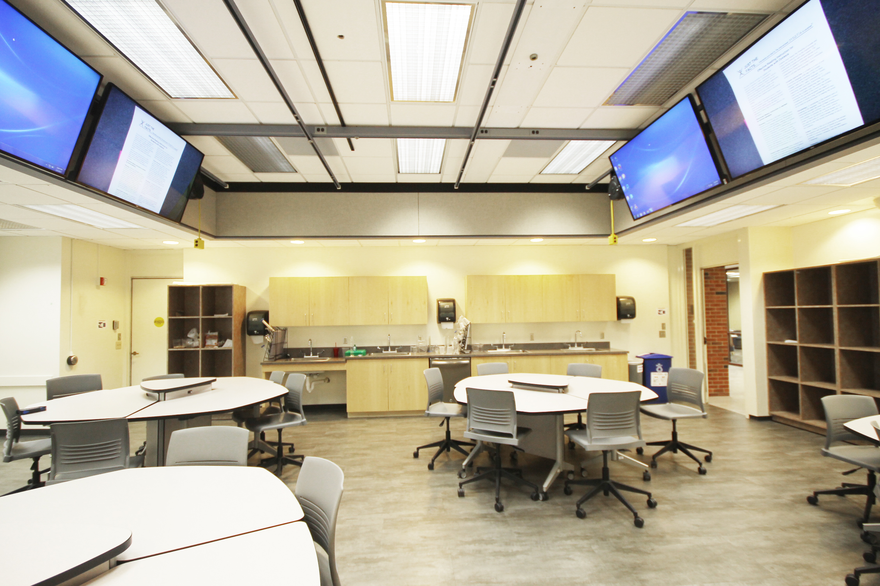
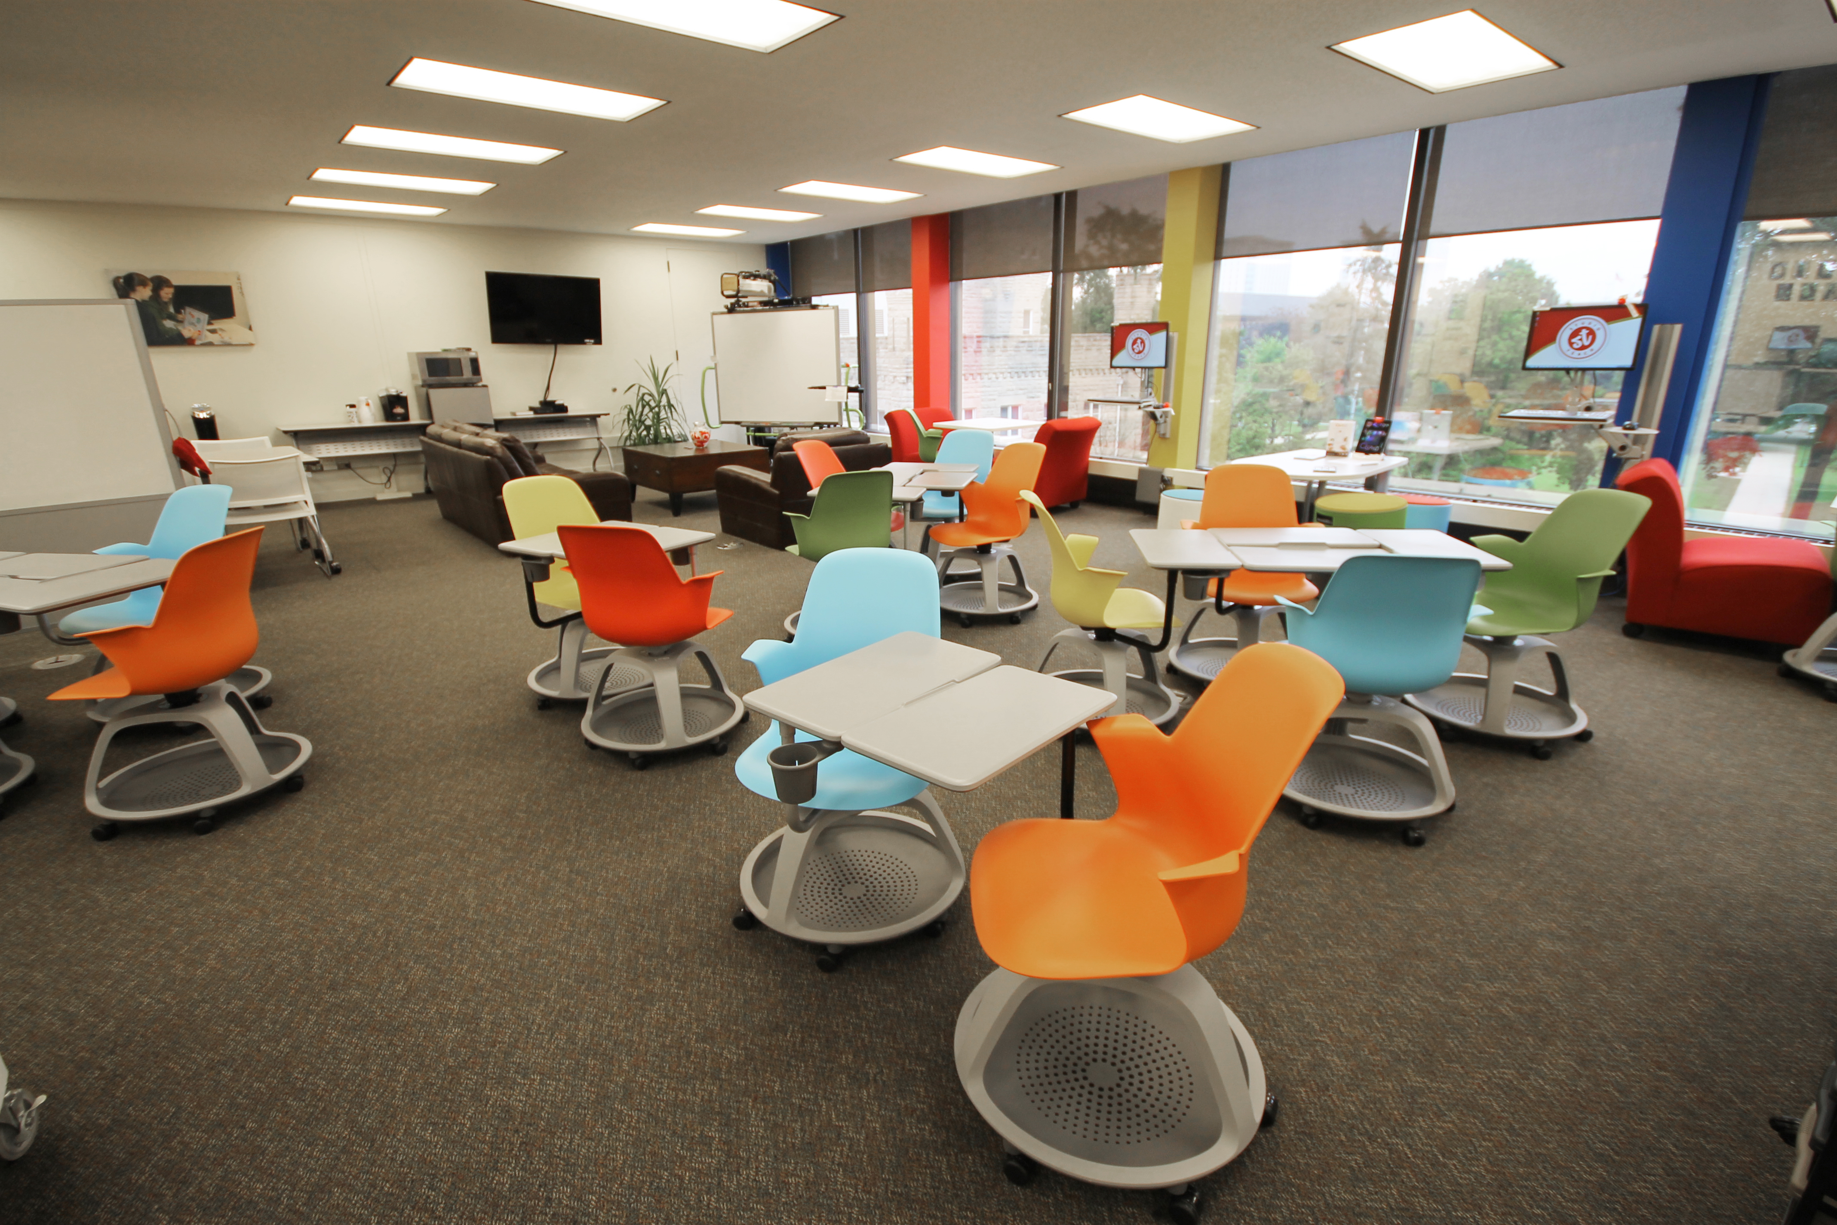
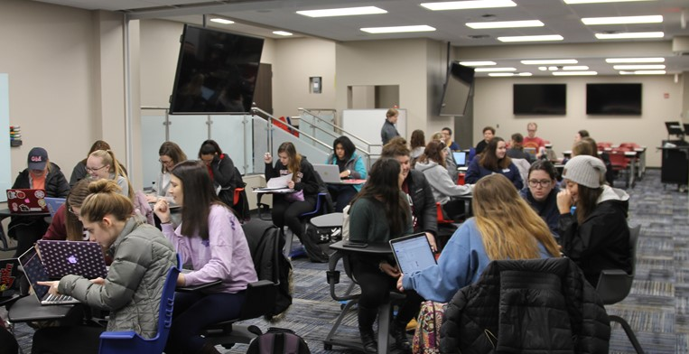
Recent Facility Renovations

Slide 21
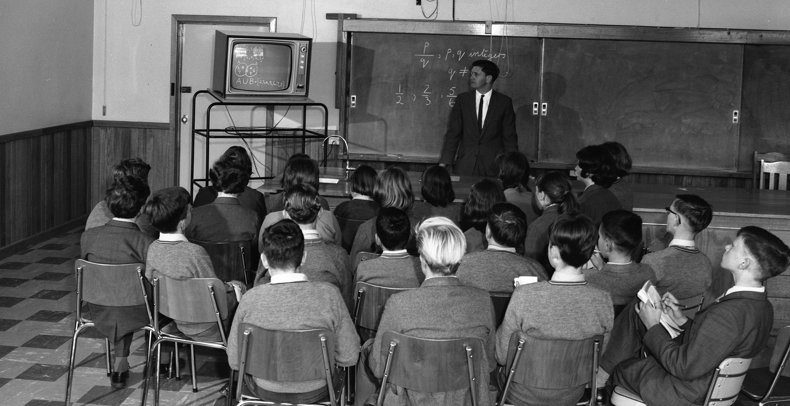

Slide 22
Provost Enhancement Requests: Facilities
Classroom Renovations
DeGarmo 305 $112,000
DeGarmo 306 $89,000
DeGarmo 504 $54,000

Slide 23
Gift Production in FY18
Unit | Amount
Laboratory Schools | $756,501
School of Teaching & Learning | $35,965
Educational Administration & Foundations | $164,911
Special Education | $154,877
College of Education | $1,849,127
TOTAL | $2,961,384

Slide 24
Reached Campaign Goal $14,250,000
Thank you Wilma Bates!

Slide 25
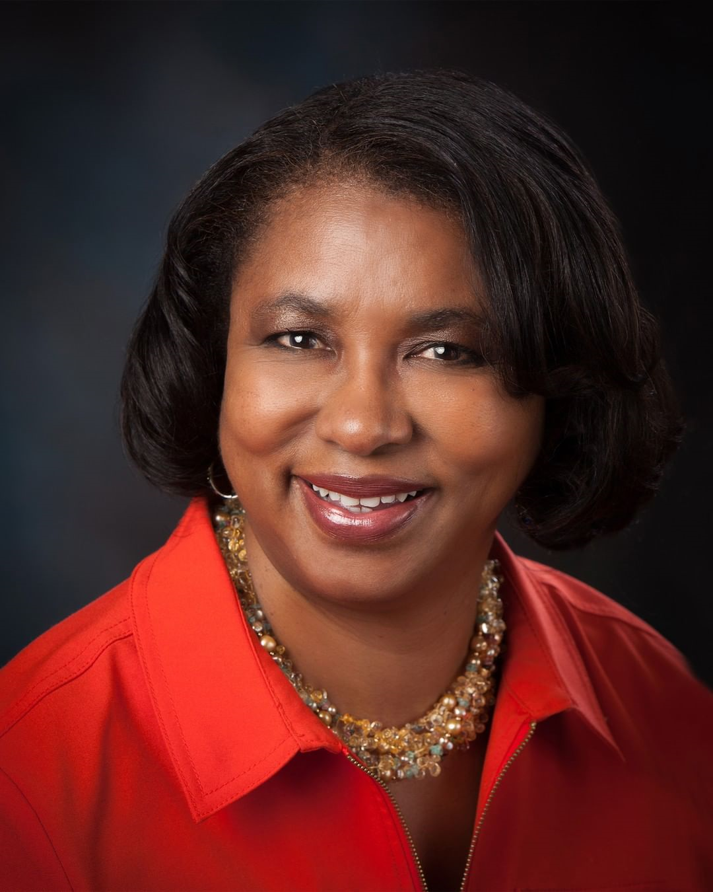

Slide 26
FY20 Budget Requests
Personnel
Permanent requests
Provost enhancement requests
Strategic budgeted carryover

Slide 27
Strategic Budgeted Carryover
Summer teaching $255,555
FY20 instruction $175,000
TCH technology upgrades $10,000
TCH student teaching in Spain $10,000
TCH common area renovation $75,000
DeGarmo 506 renovation $145,000

Slide 28
Total FY20 Budget Requests
Personnel
15 tenure track
1 non-tenure track
Permanent request
SED Mentoring program
Provost enhancement
Classroom renovations
Strategic budgeted carryover

Slide 29
FY20 Planning

Slide 30
FY20 Planning
Strategic Plan 2019-2024
Phyllis McCluskey-Titus (Chair), EAF
Jim Palmer, EAF
Tara Kaczorowski, SED
Lydia Kyei-Blankson, EAF
Maribeth Lartz, SED
Yun-Ching Chung, SED
Mindy Ely, SED
Miranda Lin, TCH
Lara Handsfield, TCH
Ryan Brown, TCH
Jay Percell, TCH
Jennie Frank, Lab School
Kirsten Hany, Lab School
Molly Turner, Lab School
Derek O’Connell, EAF Student
LaTonya Harris, SED Student
Amy Smith, TCH Student

Slide 31
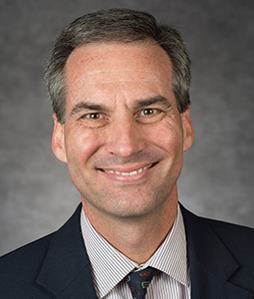
FY20 Planning
April 6-9, 2019
Legislative Issues
Dean Jim Wolfinger

Slide 32
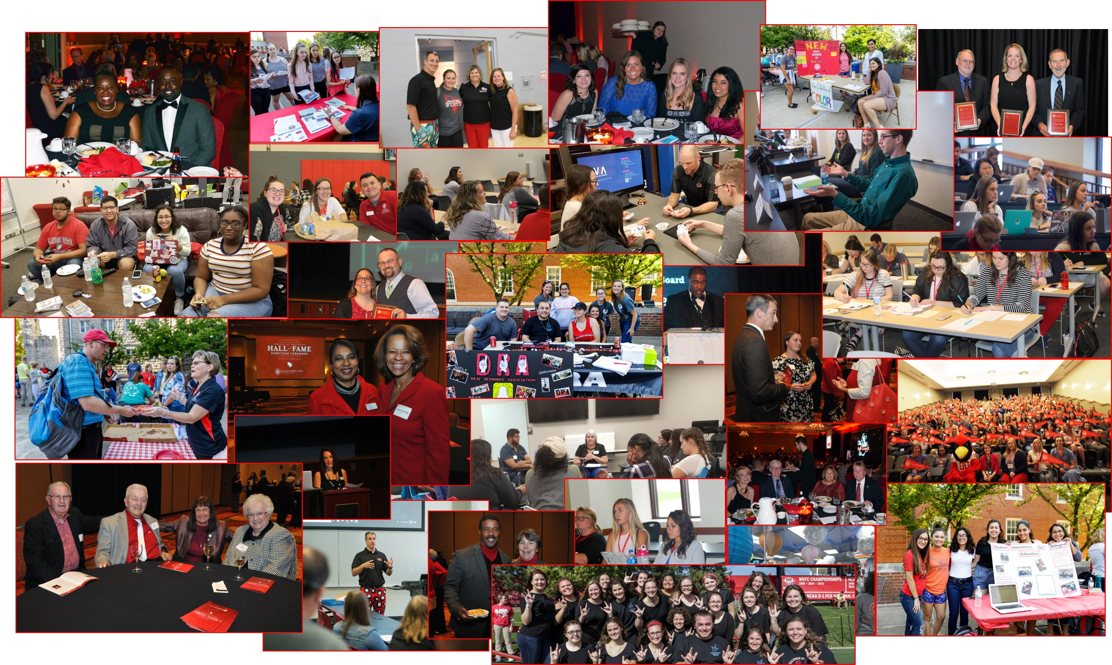
Thank You

