Slide 1
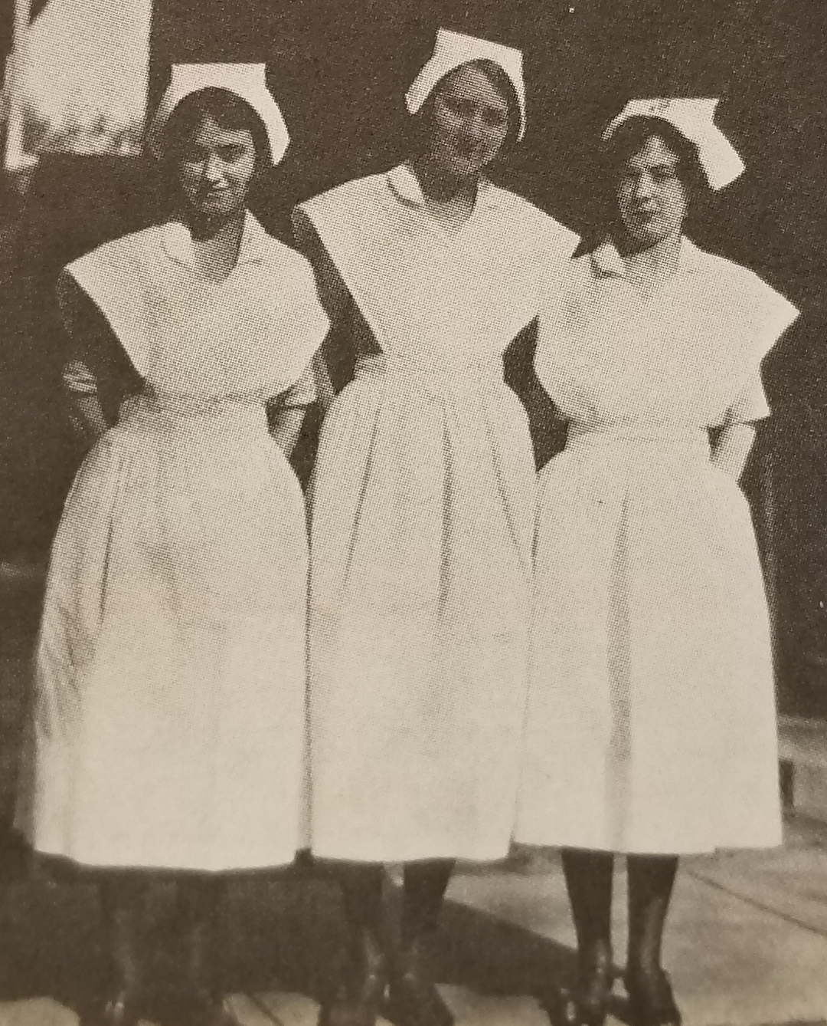
Mennonite College of Nursing
Annual Budget Report
Fiscal Year 2019
Judy Neubrander, EdD, FNP-BC

Slide 2

Special Thanks To
Janeen Mollenhauer, MS, LCPC
Associate Dean, Academic Support
Faculty, Staff, and Students
Mennonite College of Nursing

Slide 3
Applications and Enrollment
Undergraduate
Traditional BSN
Including
Direct Admits
and
Transfers

Slide 4
Applications and Enrollment
Undergraduate
Accelerated BSN

Slide 5
Applications and Enrollment
Undergraduate
RN to BSN
Notes:
Regarding the disparity between number of applicants vs. number enrolled, of the applicants for the RN to BSN program, in 2016-2017, 18 were admitted and 13 enrolled; in 2017-2018, 43 were admitted, 32 enrolled; and in 2018-2019, 53 were admitted, 37 enrolled.

Slide 6
Applications and Enrollment
Graduate
MSN
Including
FNP and NSA
Notes:
Regarding the disparity between number of applicants vs. number enrolled, of the applicants for the FNP program, in 2016-2017, 56 were qualified, 28 admitted, and 26 enrolled; in 2017-2018, 40 were qualified, 24 were admitted, and all 24 enrolled; and in 2018-2019, 56 were qualified, 25 were admitted, and all 25 enrolled.
Regarding the disparity between number of applicants vs. number enrolled, of the applicants for the NSA program, in 2016-2017, all 14 were qualified and admitted and 12 enrolled; in 2017-2018, all 20 were qualified and admitted, and 18 enrolled; and in 2018-2019, 10 were qualified and admitted, and 9 enrolled.

Slide 7
Applications and Enrollment
Doctoral
Including
PhD and DNP

Slide 8

Retention Rates
Graduate students
85%
Undergraduate students
84%
CCNE Recommendation
70%

Slide 9
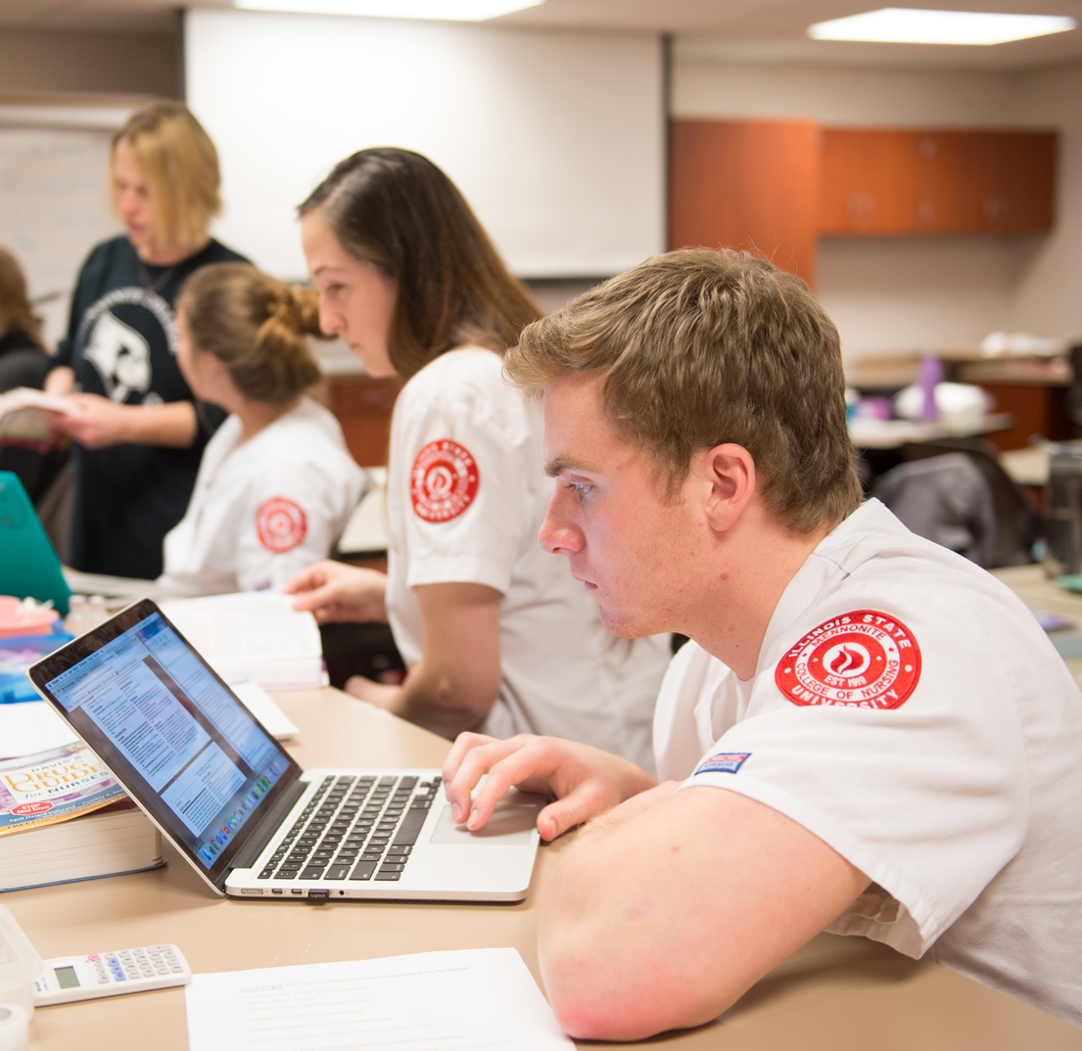
Pass Rates
National Council Licensure Examination for Registered Nurses (NCLEX)
Family Nurse Practitioner Certification
MCN
96%
MCN
100%
Illinois
88%
Nationwide
88%
Nationwide
82.9%
*2017
*2018 rates not yet available
Notes:
NCLEX 5 year average:
MCN 95%
Illinois 85.8%
Nationwide 85.4%
FNP Certification 5 year average
MCN 99.04%
Nationwide 79.6%

Slide 10
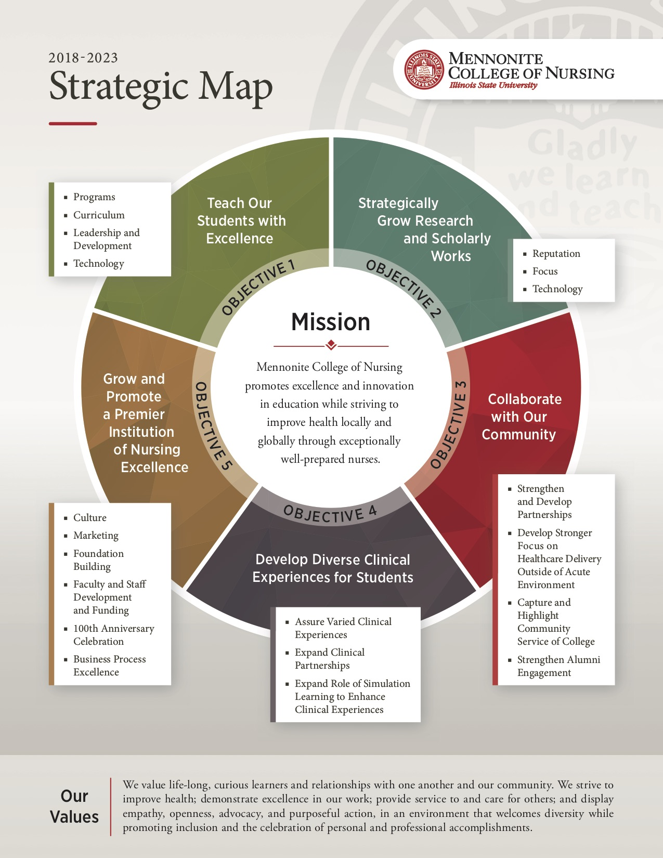
2018-2023

Slide 11





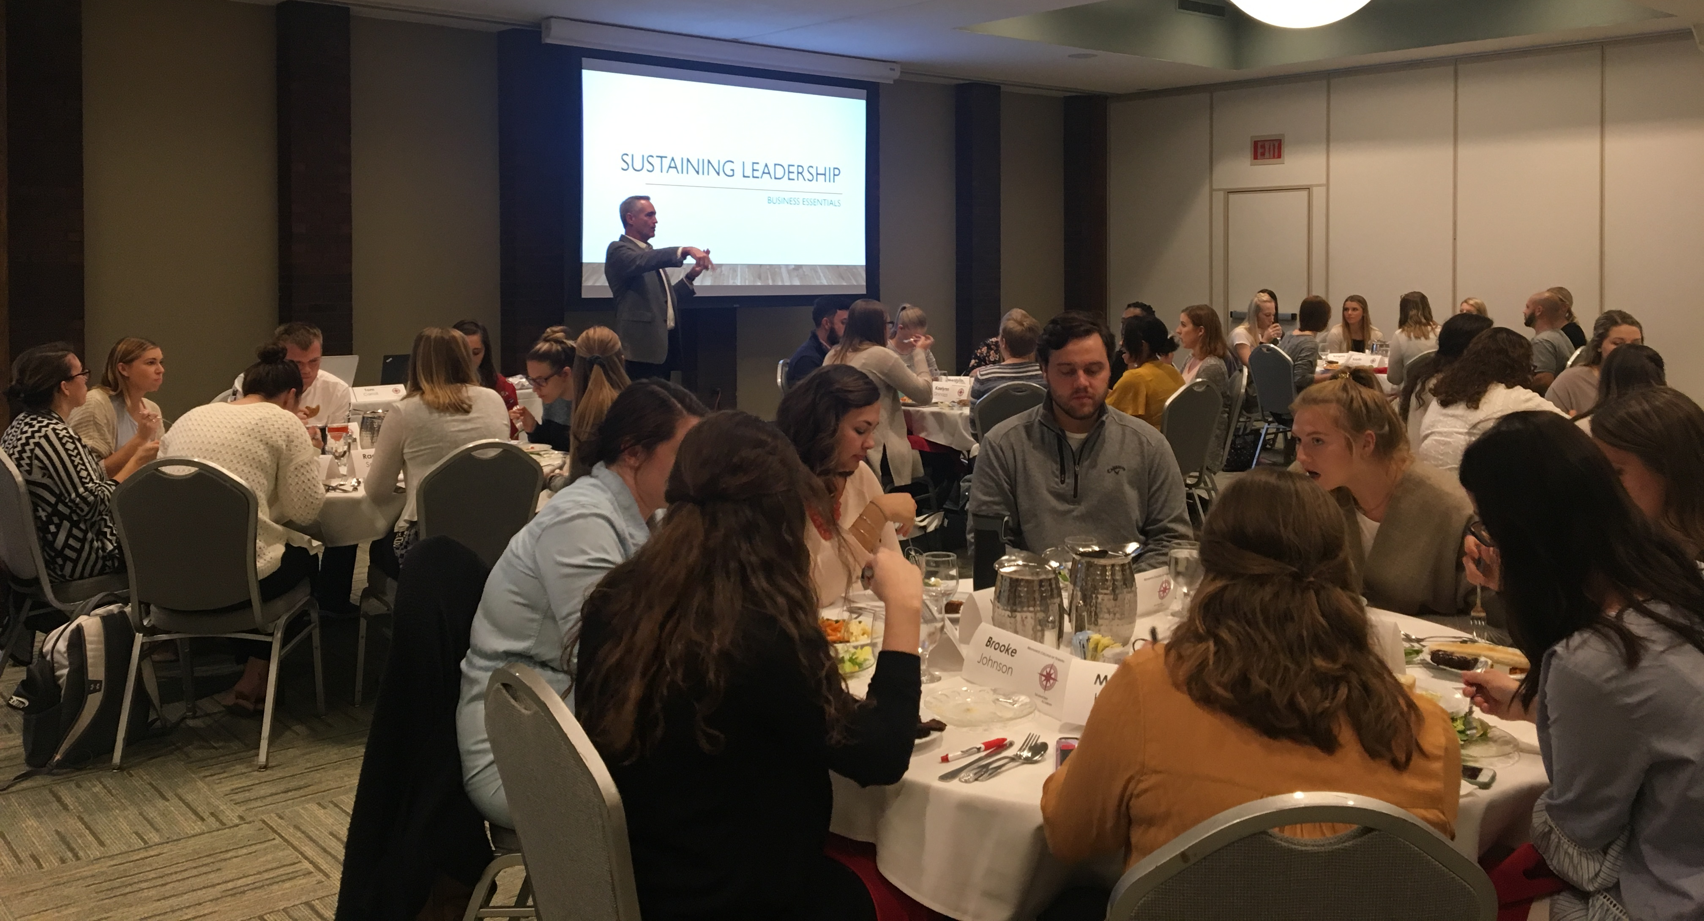





FY19 Accomplishments
New dual enrollment and dual admission partnerships
School Nurse Graduate Certificate Program
Accepting first cohort Summer 2019
255% growth
in Leadership Academy participation
Aligned testing content with NCLEX blueprint
Notes:
New partnerships for the RN to BSN program (p. 26)
In addition to the 4 initial pathway partnerships established with Heartland Community College, Illinois Central College, Illinois Valley Community College, and Parkland College in 2015, the first dual enrollment partnership with Heartland was established in January 2018. Between March 2018 and March 2019, 3 additional dual admission and 4 dual enrollment partnerships have been established with 3 new institutions, and an additional 3 are in progress.
Developed School Nurse Graduate Certificate Program (p. 28)
Granted approval by the State Educator Preparation and Licensure Board.
Leadership Academy (p. 30)
In 2017, the inaugural year, we had 18 students. In 2018, we had 64 students.

Slide 12




FY19 Accomplishments
$2M
HRSA grant
Nursing workforce diversity
(PROUD)
$1.4M
HRSA grant
Nurse practitioners in rural settings
(ANEW)
$2.8M
HRSA grant
RNs serving in primary care, focusing on the underserved (CAUSE)
Manuscripts
25 published
External grants
8 submitted; 6 funded
Internal grants
9 submitted; 8 funded

Slide 13

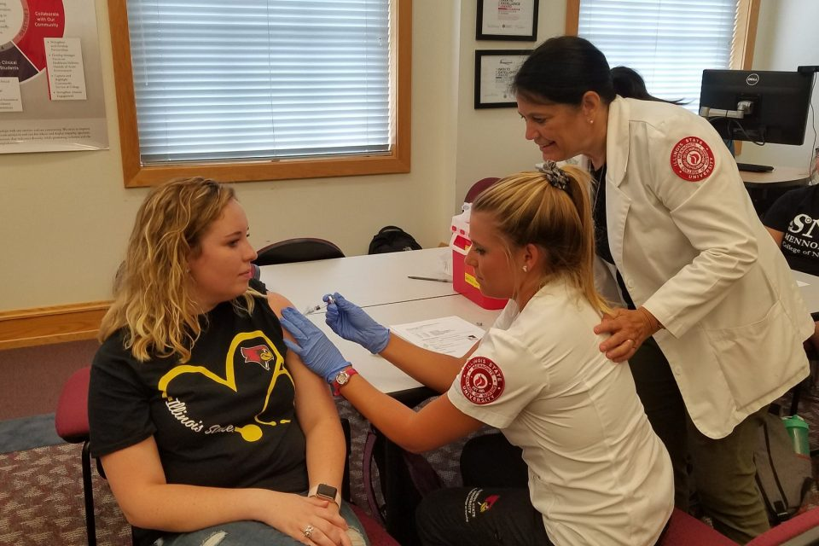




FY19 Accomplishments
Published 46 stories
Highlighting health-related
service work
Partnerships
Chestnut Family Health Center
Community Health Care Clinic
McLean County Health Department
Community workshops
Pain Management
Heart Health
Family Caregiving

Slide 14
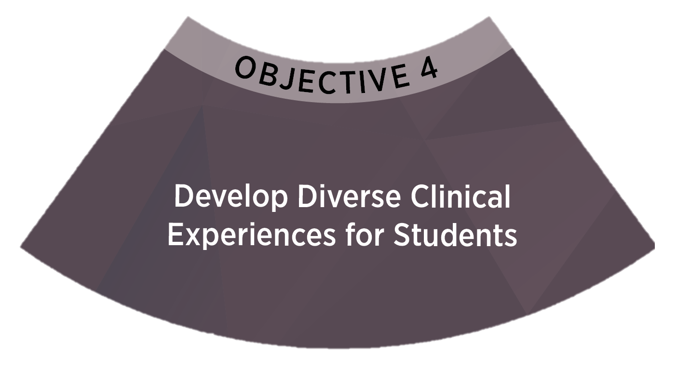
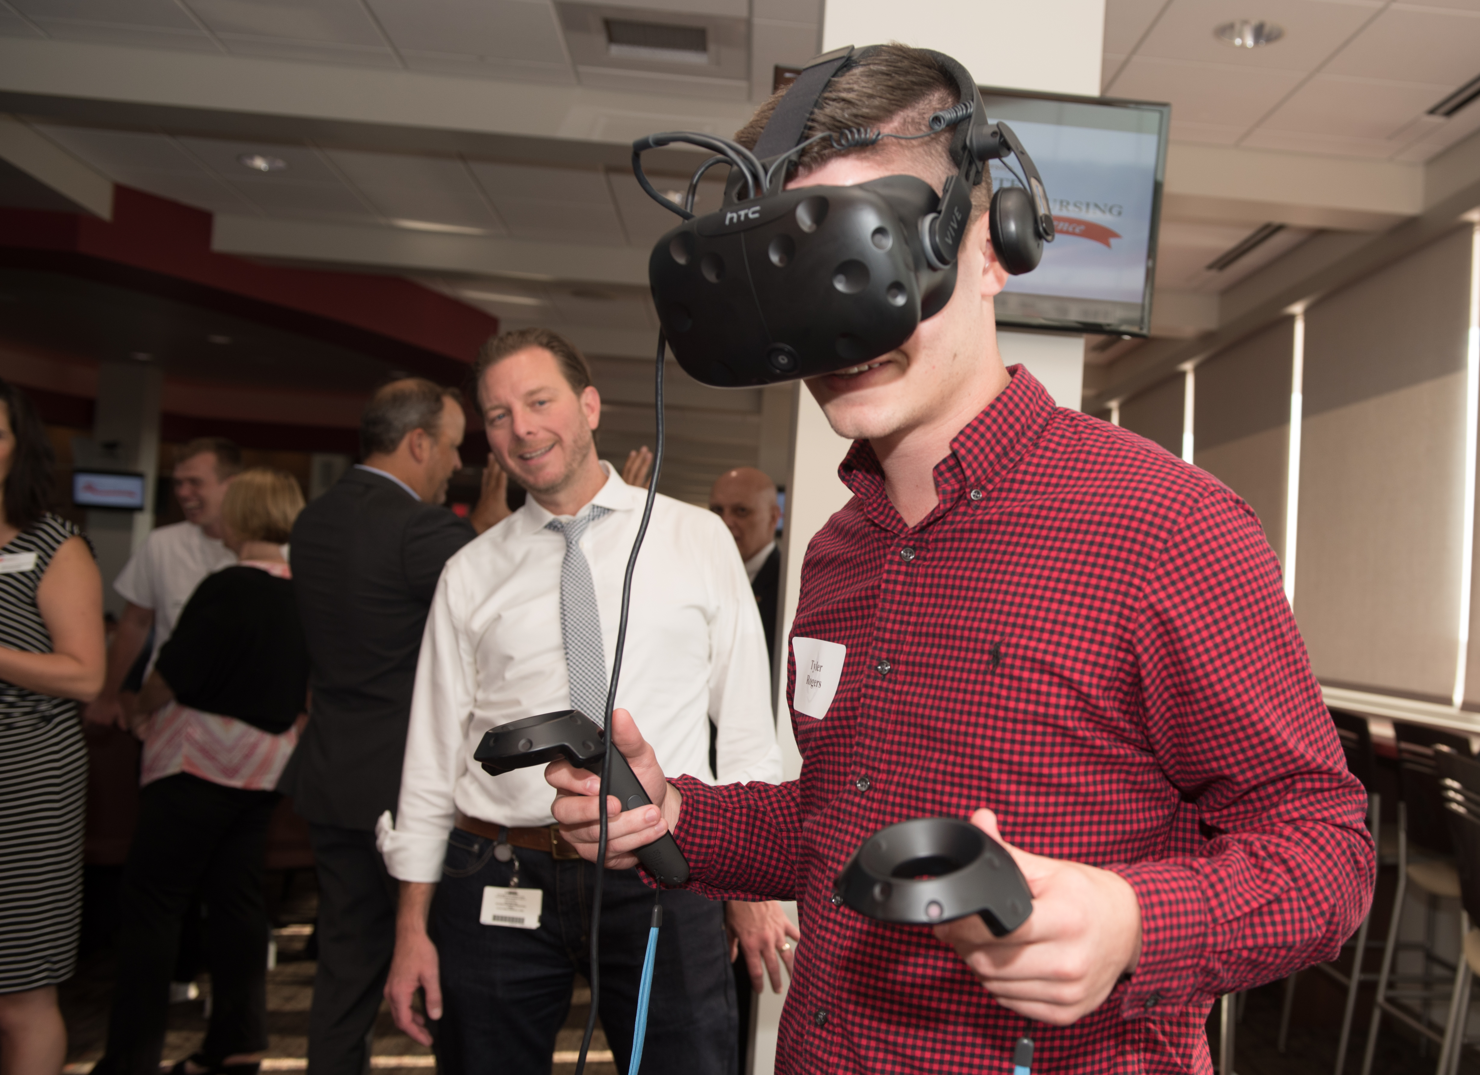

FY19 Accomplishments
New simulation experiences
Organ donation, Telehealth, Conflict, Communication
Virtual Gaming
and
Integrated
Video enhanced case studies
Interdisciplinary Simulation Scenarios

Slide 15






FY19 Accomplishments
Investment in marketing
More people seeing our ads
More people connecting with our programs
More people requesting info
Planning for future facility
Organized MCN’s 100th Anniversary Celebration
Examined
faculty/staff roles and responsibilities
Started monthly
development series
Notes:
Investment in marketing – see Emily’s notes
Organized MCN’s 100th Anniversary Celebration (p. 48-49)
Clarified faculty and staff roles and responsibilities
In Fall 2017, MCN implemented a new administrative structure with different reporting lines and responsibilities for various roles. This year, we further clarified these role functions for the various functional work teams in the college. Along with that, we are currently assessing faculty and staff to determine their satisfaction with things like interactions with colleagues, involvement in decision making, campus climate, workload, satisfaction with MCN, and satisfaction with ISU as an employer. The results of this will determine next steps.
Onboarding process was modified re: new faculty professional development
Planning for future facility

Slide 16


Campaign Update
$6.6M
raised
$7.5M
goal
88%

Slide 17
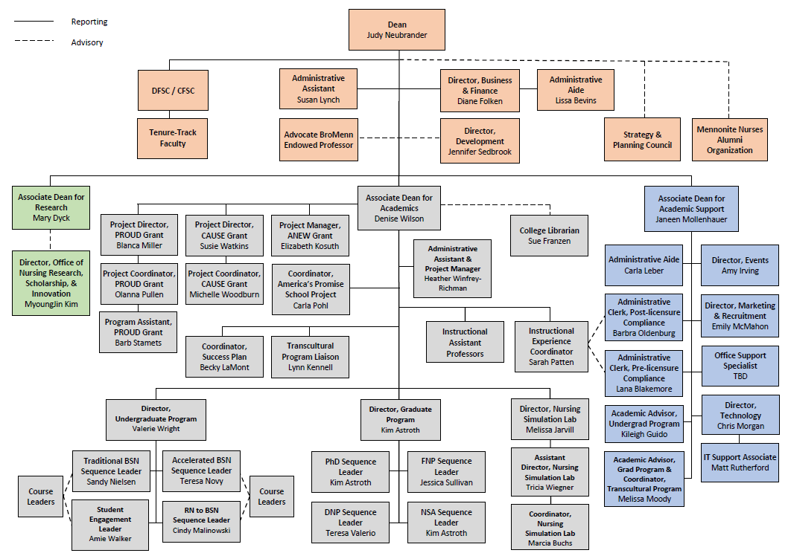
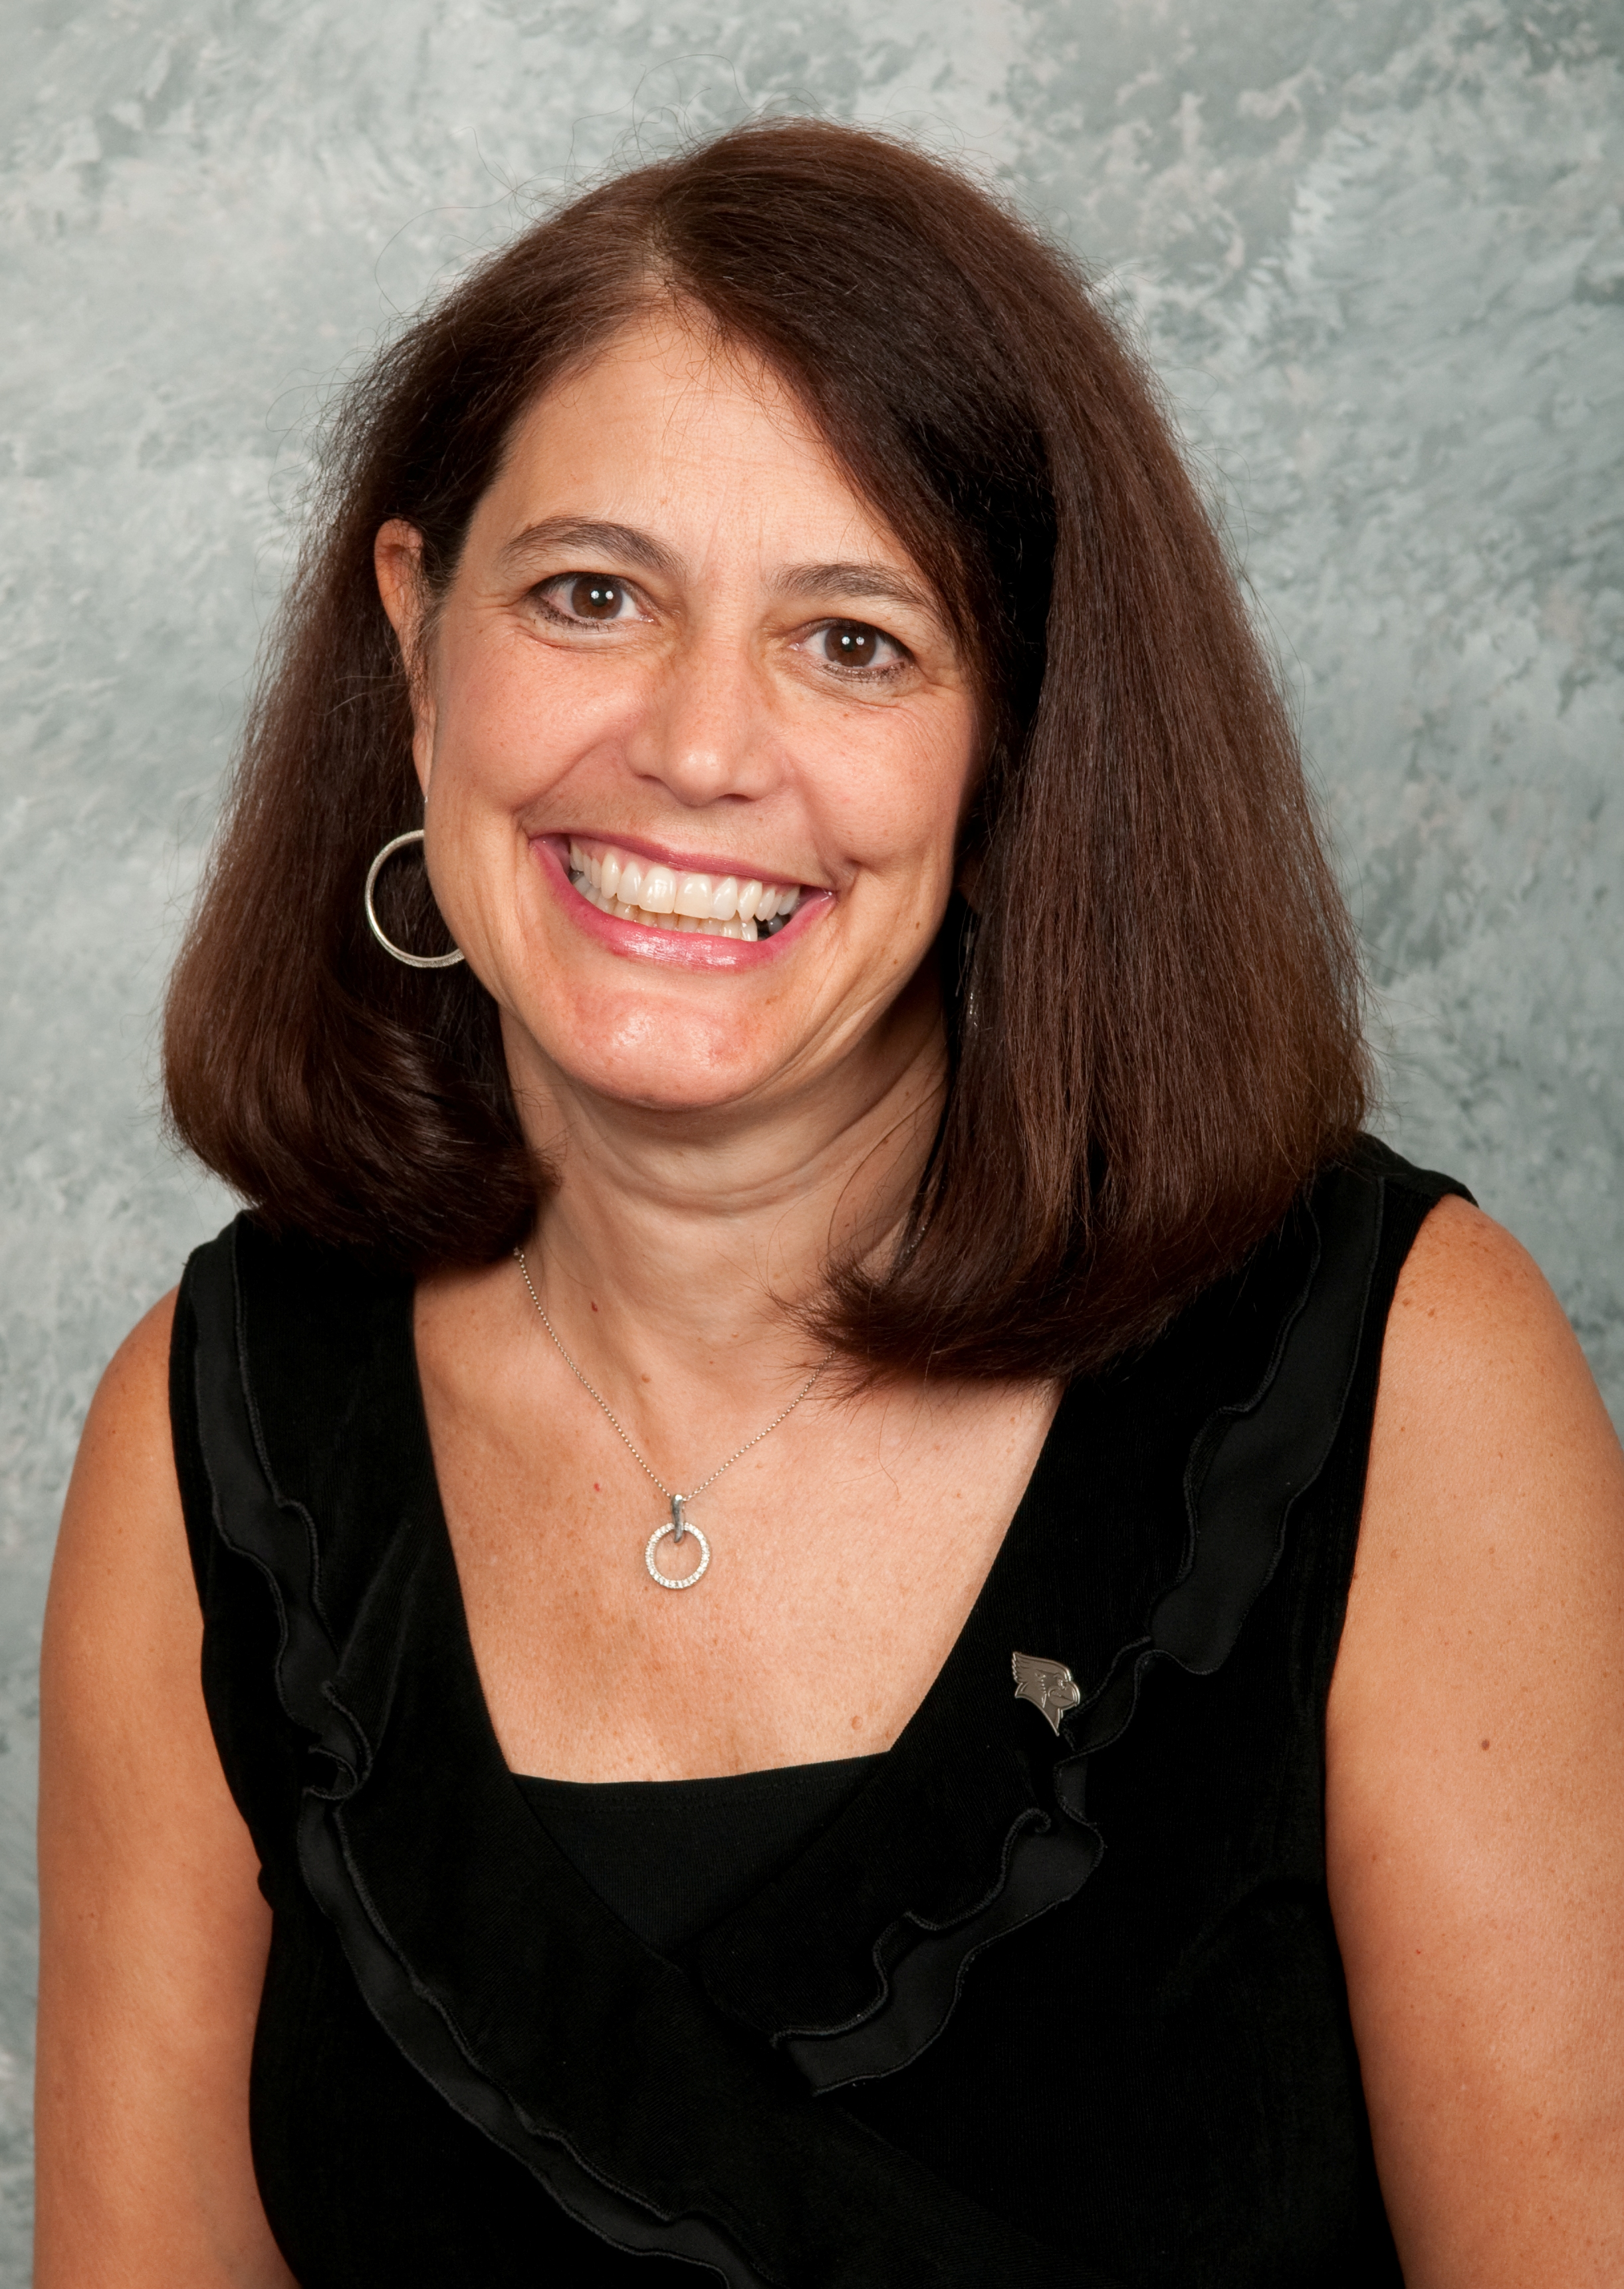
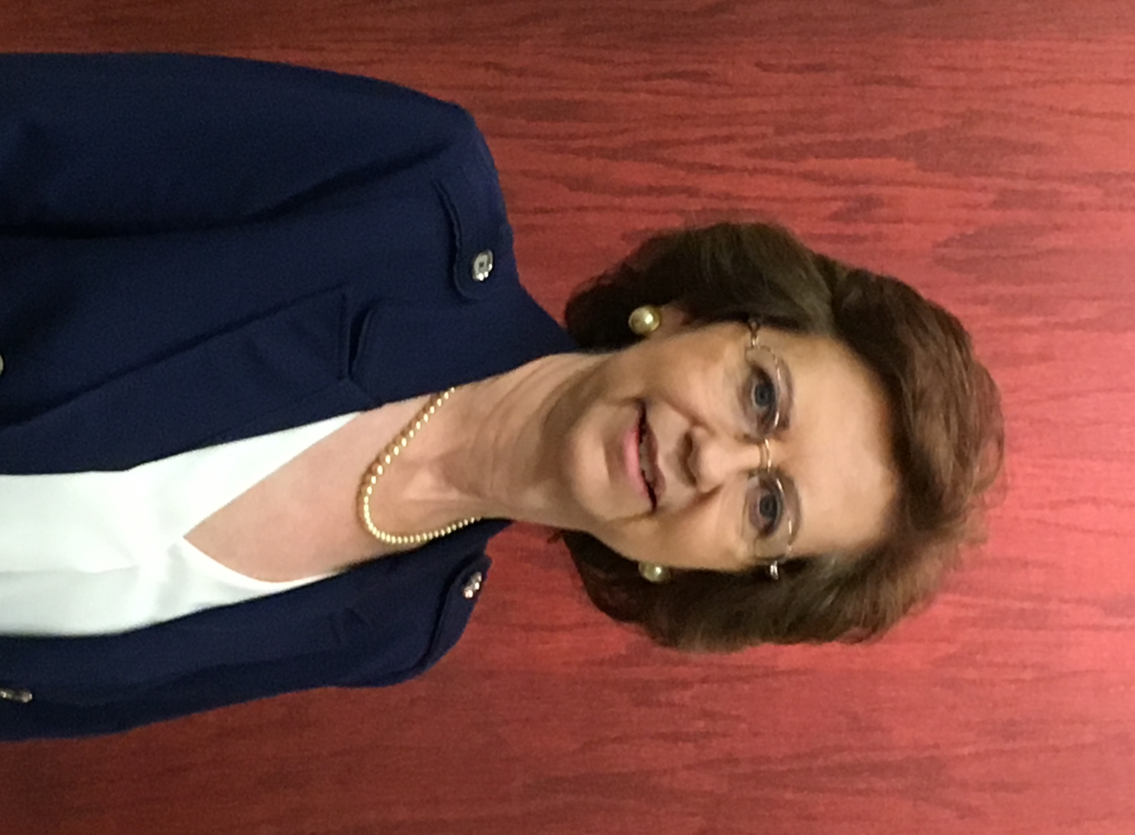
Internal Reallocations and Reorganizations

Slide 18


FY20 Objectives
Holistic review and adjustment
of undergraduate and graduate curricula
Develop digital testing platform
Notes:
Holistic review and adjustment of undergraduate and graduate curricula
Align to best practices, industry needs, licensure requirements, and accrediting agencies
Integrate holistic health, vulnerable populations, cross-disciplinary experiences, and service into clinical experiences that align with curricula.

Slide 19
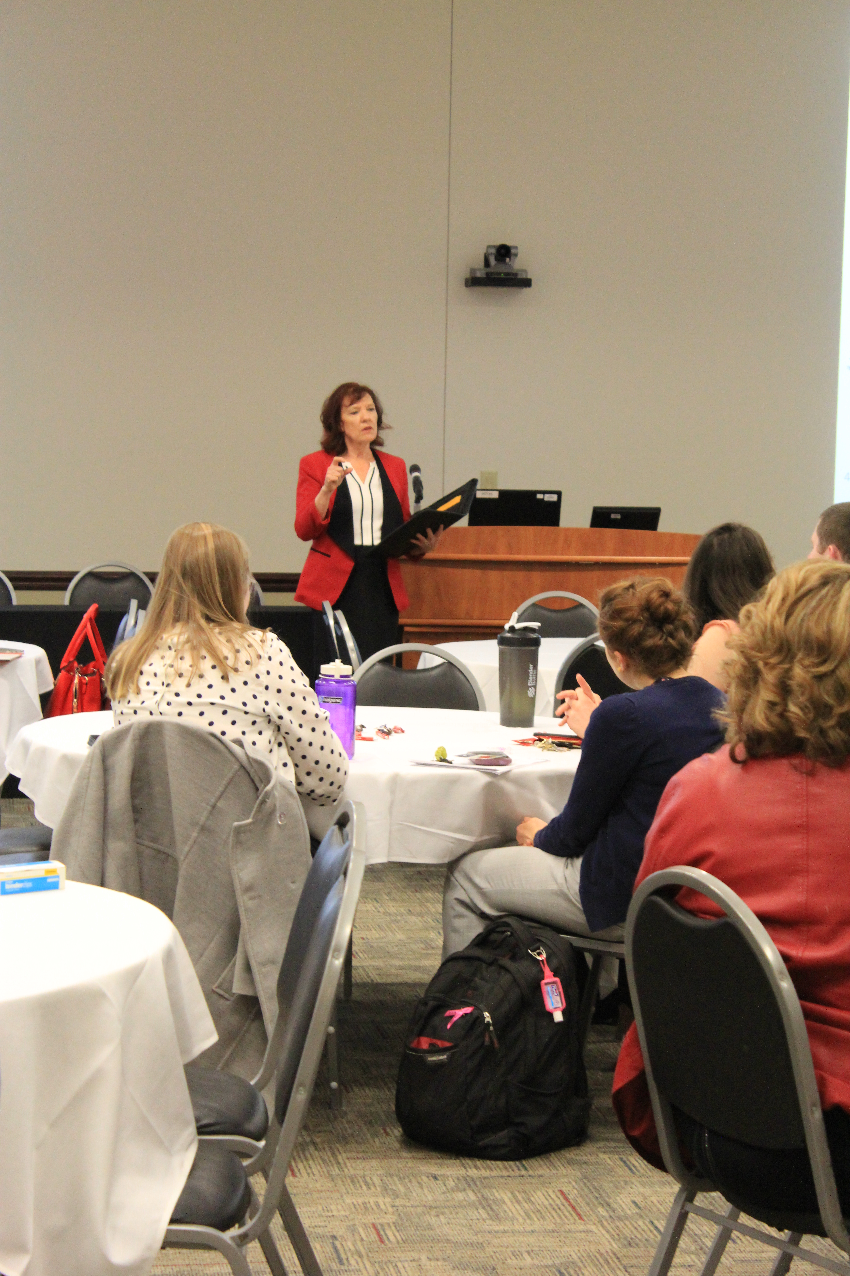
FY20 Objectives
Increase research presentations
● locally  nationally 
● internationally 
Define
Research foci and hire and sustain tenure track faculty to support it

Slide 20
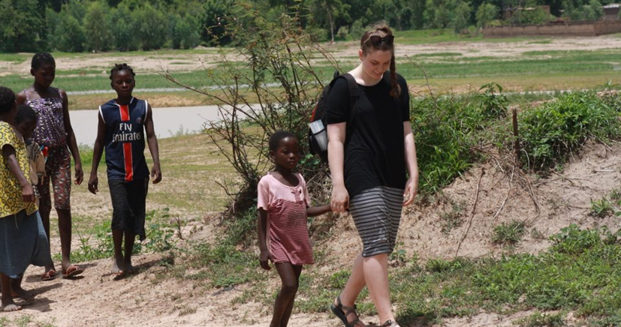
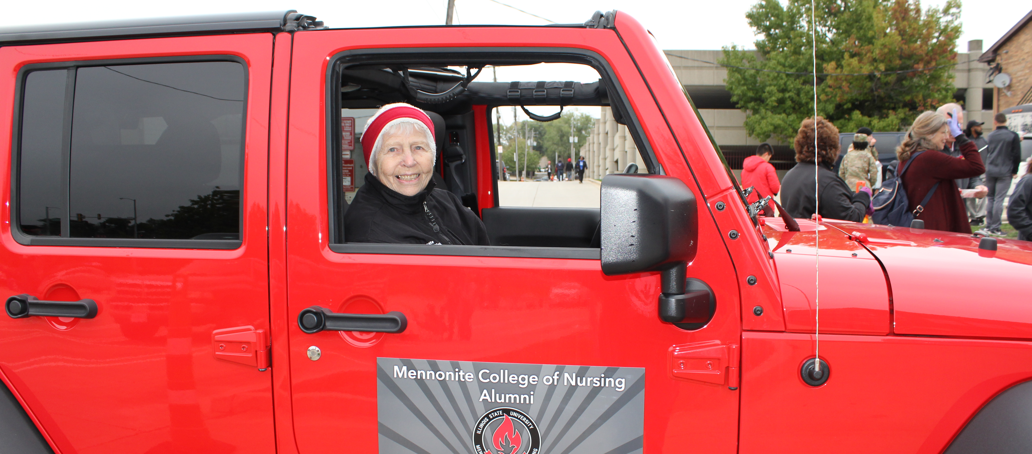
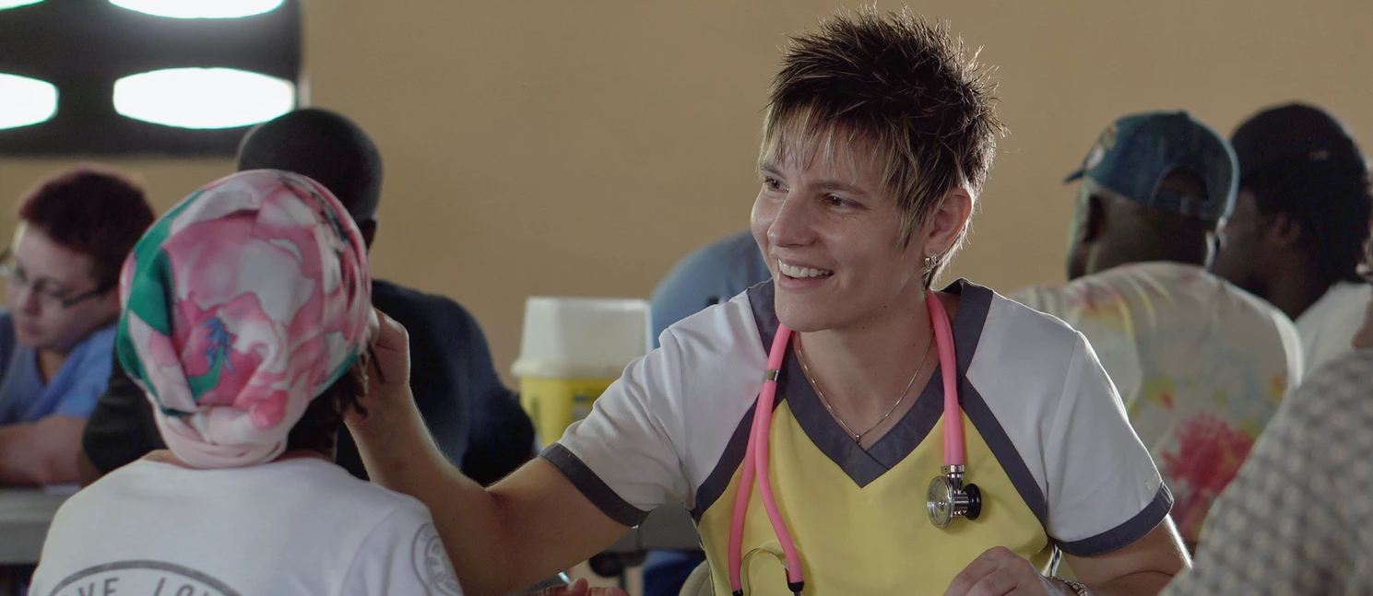
FY20 Objectives
Offer health-related service experiences
Engage Alumni
Fundraising, developing clinical sites, community service, mentoring

Slide 21
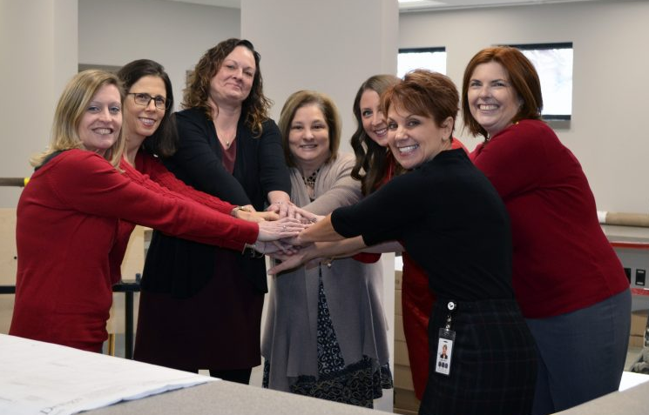
FY20 Objectives
Expand Clinical Partnerships
Beyond acute care settings
Grow faculty simulation expertise
and
broaden simulation programs

Slide 22
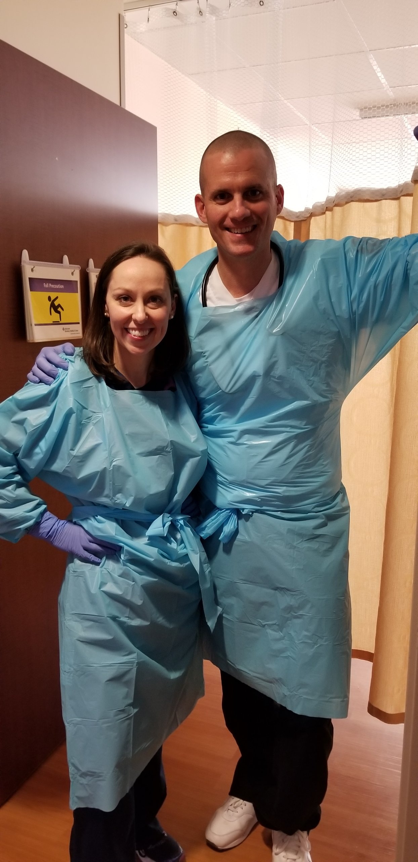


FY20 Objectives
Increase brand awareness
within Illinois and beyond
Faculty mentoring program
Succession Planning

Slide 23
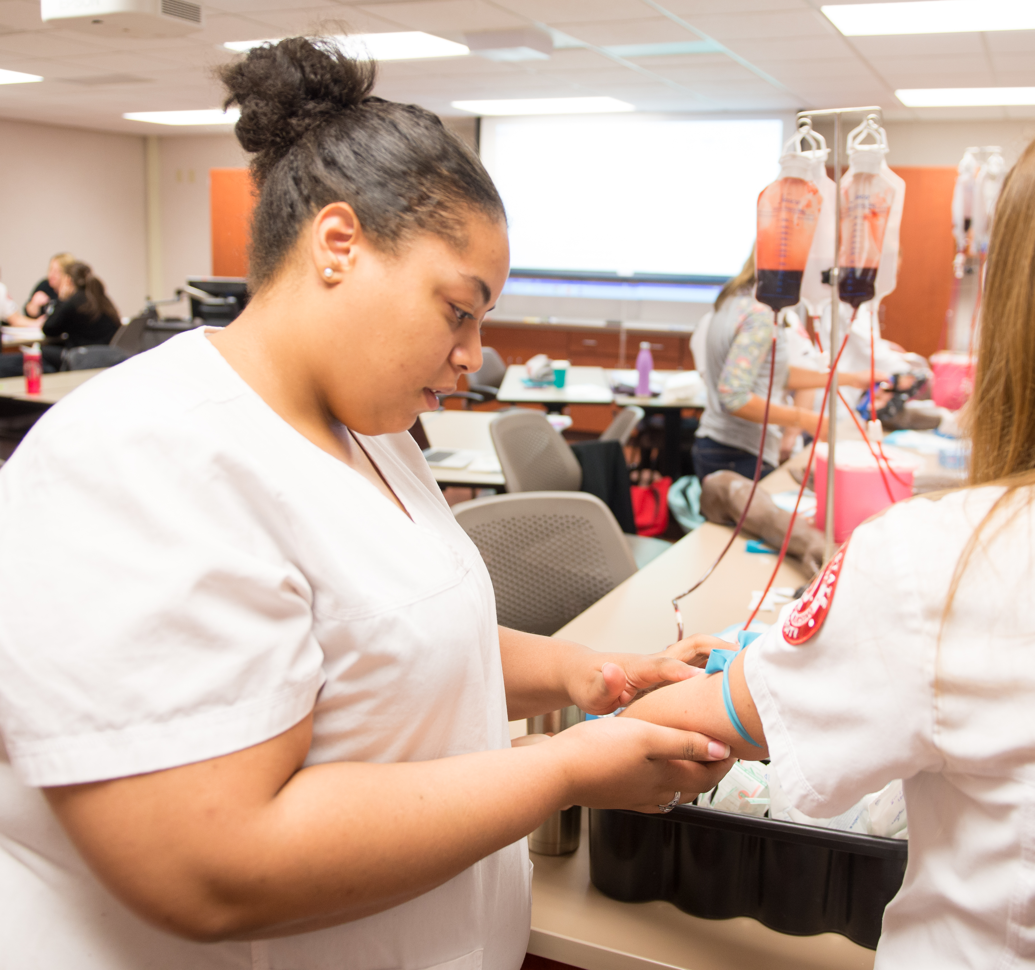
Permanent Funding Requests
Civil Service Exempt position BSN Clinical Lab Coordinator to assist with increased use of the simulation lab

Slide 24
Strategic Budget Carryover
Summer 2019 expenses paid in FY20 $155,386 | Updated computer equipment $57,255
Carpet replacement $31,990 | 100th Anniversary DVDs $5,000
Remodel of storage area to create office space $66,869 | Promotional items for scholarship banquet and other donor events $6,944
Endowed Professor startup package $15,000 | National speaker for diversity and inclusion $10,000

Slide 25
Provost Enhancement Requests
New Nursing Building Consultant $15,000 | Market Saturation in Targeted “Feeder” Geographic Areas $20,000
Digital Recruitment Funds: Under-Enrolled Sequences $31,884 | New Market Development Chicago Suburbs $15,000
Digital Brand Building $7,000 | New Channel Development Social Media Lead Generation $10,000
Design Asset Request $1,800

Slide 26
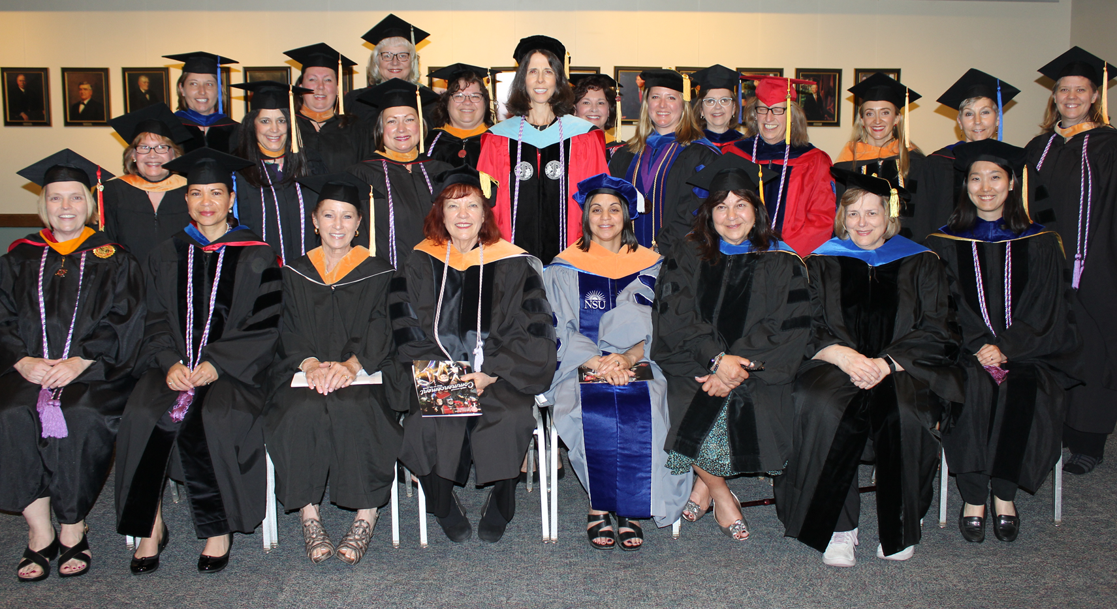
Personnel Requests
1 Tenure Track Faculty PhD and DNP prepared nurses to teach in the undergraduate and graduate programs

Slide 27
Thank you To all the Mennonite College of Nursing faculty, staff, and students for making our college such a wonderful place to learn and teach

Slide 28
Questions?

