Slide 1

Mennonite
College of Nursing
Annual Consolidated Budget Report
Judy Neubrander, EdD, FNP-BC
Dean

Slide 2
Special Thanks To…
Janeen Mollenhauer, MS, LCPC Associate Dean, Academic Support
Kim Schafer Astroth, PhD, RN Director of Graduate Programs | Emily McMahon, BA Director of Marketing and Recruitment
Mary Dyck, PhD, RN, LNHA Associate Dean for Research | Chris Morgan, MBA Director of Technology
Diane Folken, BS Director of Business and Finance | Denise Wilson, PhD, APN, CNP, CDE Associate Dean, Academics
Amy Irving, BS Director of Events | Valerie Wright, DNP, RN, CNE Director of Undergraduate Program
Melissa Jarvill, PhD, RNC-NIC, CHSE Director of Nursing Simulation | Faculty, Staff, and Students Mennonite College of Nursing

Slide 3
Applications and Enrollment
Traditional BSN including Direct Admits and Transfers
Undergraduate Applications and Enrollment

Slide 4
Applications and Enrollment
Accelerated BSN Undergraduate Applications and Enrollment

Slide 5
Applications and Enrollment
RN to BSN Undergraduate Applications and Enrollment

Slide 6
Applications and Enrollment
MSN Graduate Applications and Enrollment

Slide 7
Applications and Enrollment
PhD and DNP Graduate Applications and Enrollment

Slide 8

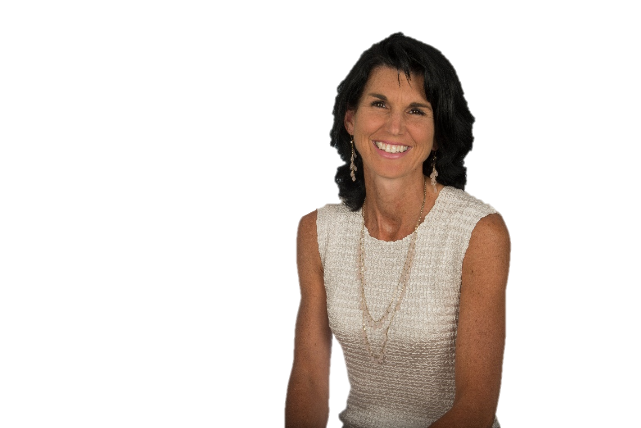
Retention Rates
Undergraduate Students
Graduate Students
84%
89%
70%
70%
CCNE Recommendation

Slide 9
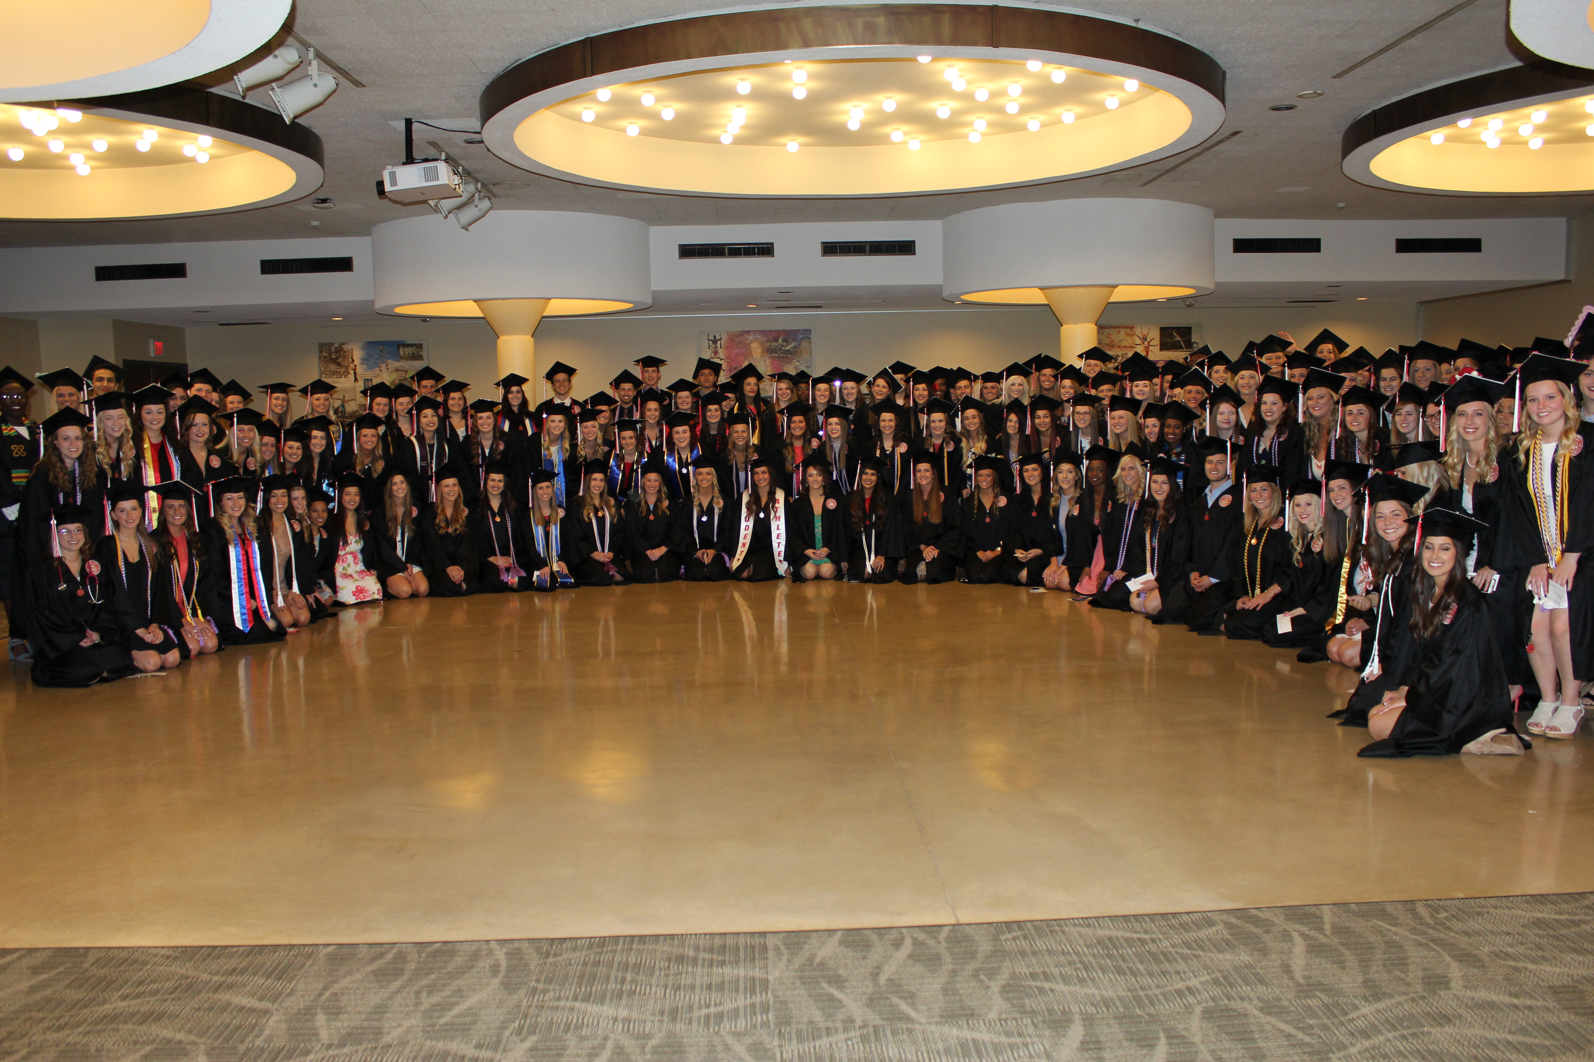
Our Graduates
Degrees by Program
 | 2016 | 2017 | 2018
BSN | 181 | 199 | 181
MSN | 33 | 27 | 56
PhD | 4 | 4 | 5
DNP | 2 | 12 | 15
Total | 220 | 242 | 257

Slide 10
Pass Rates
National Council Licensure Examination for Registered Nurses (NCLEX)
Family Nurse Practitioner Certification
MCN
95%
MCN
100%
Illinois
85%
Nationwide
81%
*2016
Nationwide
87%
5 year average
5 year average
MCN | 95.2%
Illinois | 85.2%
Nationwide | 84.4%
MCN | 99.04%
Nationwide | 78.34% *2017 rates not yet available

Slide 11
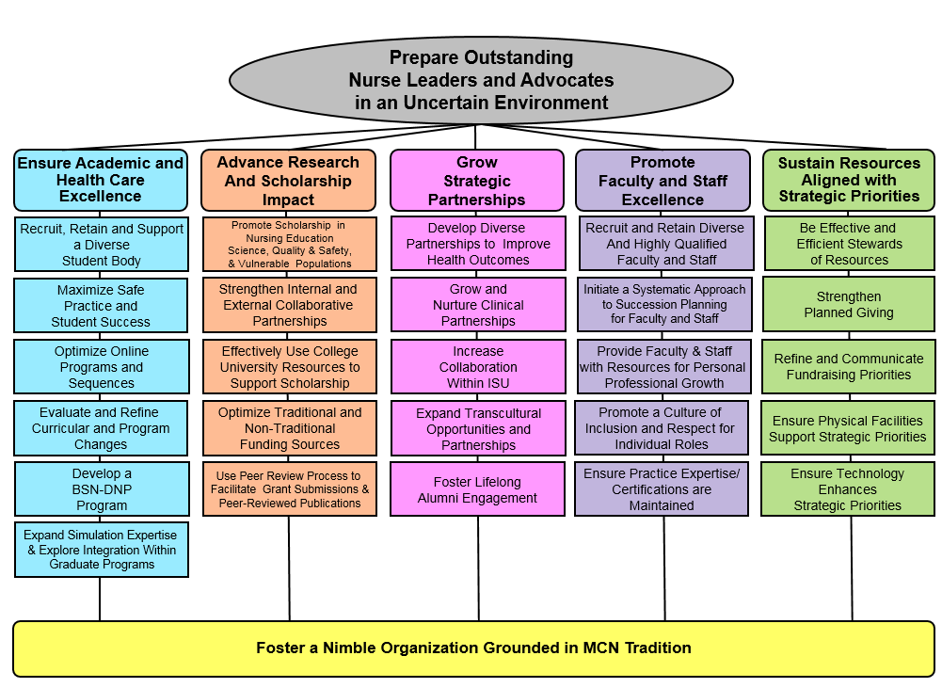
2013-2018 MCN Strategic Map

Slide 12
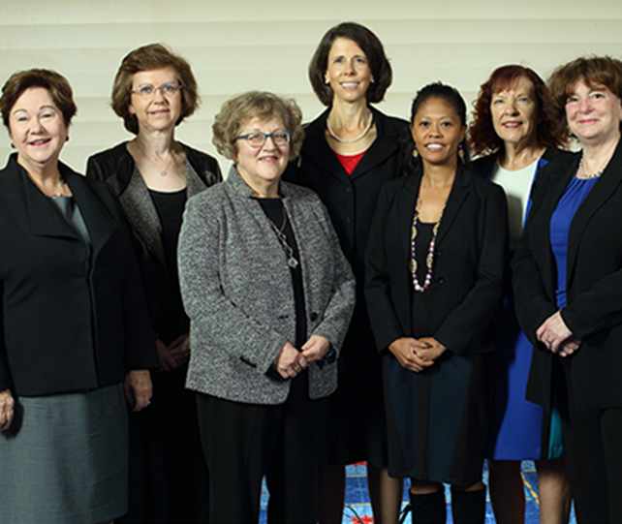

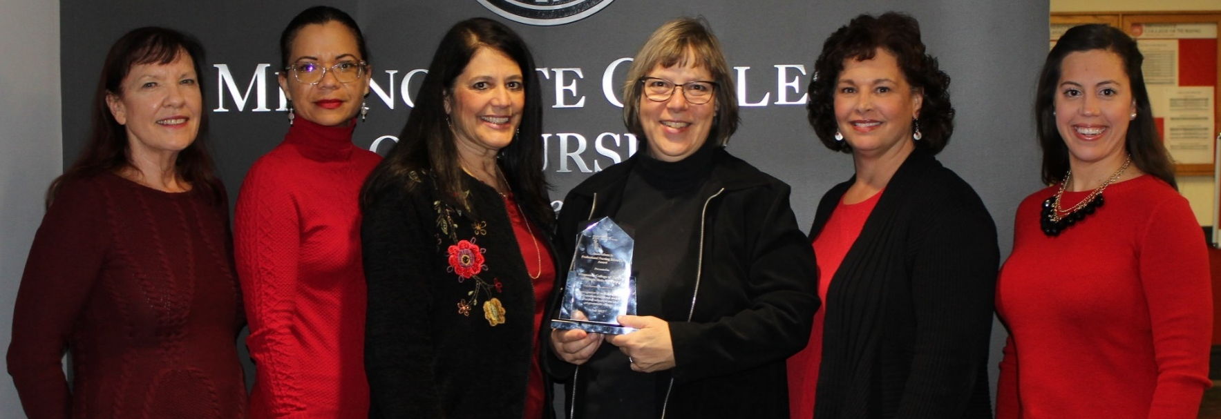
Strategic Goal 1
⇦
Ensure Academic and Healthcare Excellence
FY18 Accomplishments
Received the
2017 Innovations in Professional Nursing Education Award from the American Association of Colleges of Nursing
Granted the
maximum allowable
10 years of accreditation from CCNE
 BSN  MSN  DNP 
 Post-graduate APRN certificate 
National Recognition

Slide 13
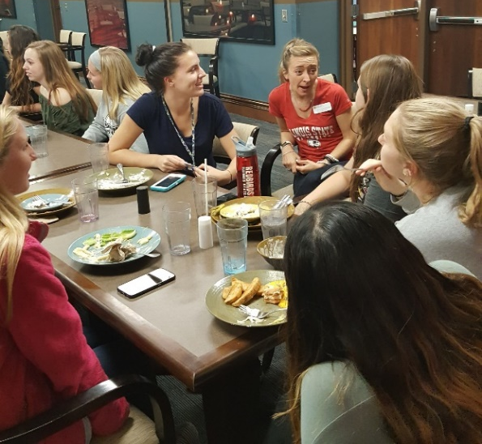

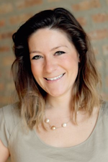

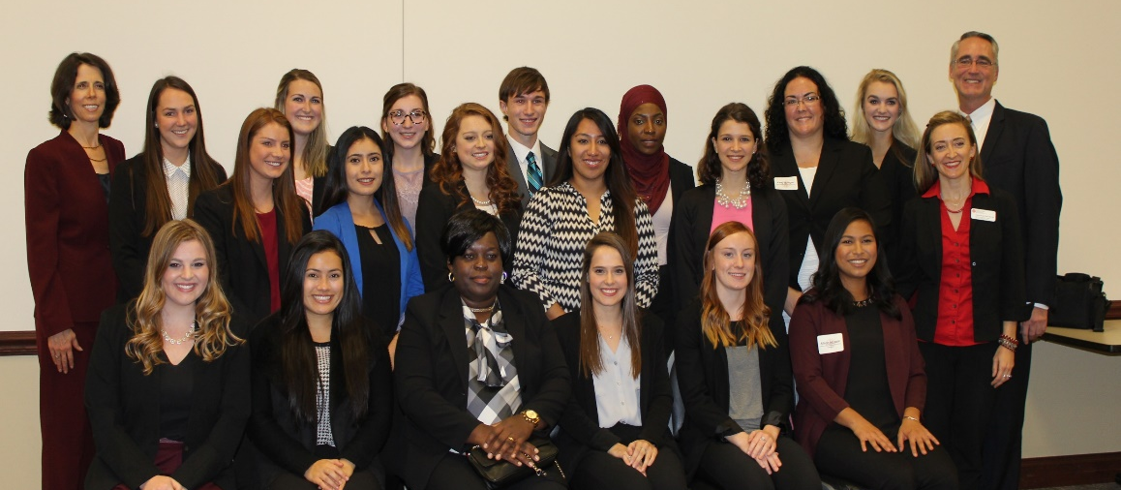
Strategic Goal 1
⇦
Ensure Academic and Healthcare Excellence
FY18 Accomplishments
Mennonite College of Nursing
Established
34-hour leadership development program for senior nursing students
Created new
Marketing and Recruitment position and hired Director
Enhanced educational and social events for nursing students living on the Themed Living Community floor
Leadership
Academy
Completed data analysis to identify competitors and tweaked website

Slide 14




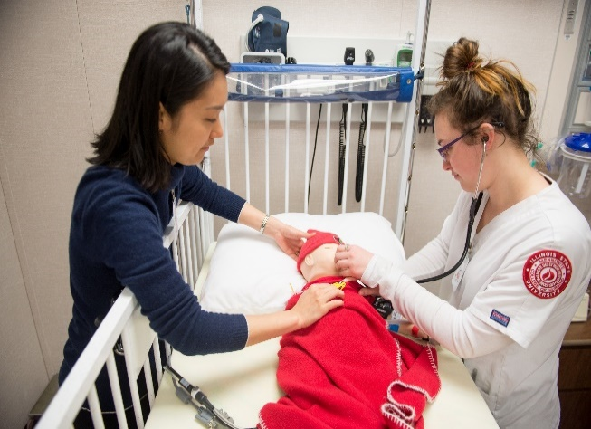
Strategic Goal 1
⇦
Ensure Academic and Healthcare Excellence
FY18 Accomplishments
Pre-entry & Retention Opportunities for Undergraduate Diversity
(PROUD) programming augmented
Expanded simulation expertise in the Nursing Simulation Lab
Enhanced the quality and consistency of online programs
Offered rolling admission for the RN to BSN program
Increased
non-traditional clinical experiences

Slide 15
Strategic Goal 2
⇦
Advance Research and Scholarship Impact
FY18 Accomplishments
66
Peer-reviewed /
refereed presentations
international, national, and
regional / local conferences
$2,000,000
HRSA grant
9
external grants
submitted
20
research
active faculty
9
funded internal grants
$10,000
IBHE grant
16
Peer-reviewed / refereed articles
$1,400,000
HRSA grant
22
manuscripts in review
with peer-reviewed / refereed journals

Slide 16
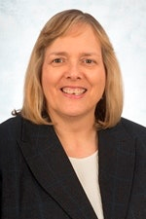
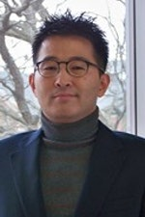
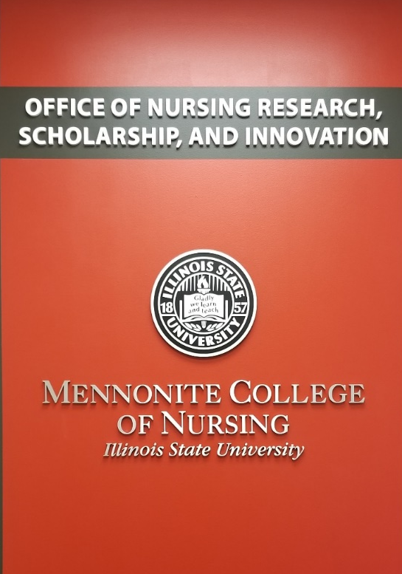



Strategic Goal 2
⇦
Advance Research and Scholarship Impact
FY18 Accomplishments
New shared learning space to facilitate teamwork on projects
Office of Nursing Research, Scholarship, and Innovation established
Monthly scholarship status dashboard created
Maitland Collaborative Project between MCN and Speech Language Pathology implemented

Slide 17
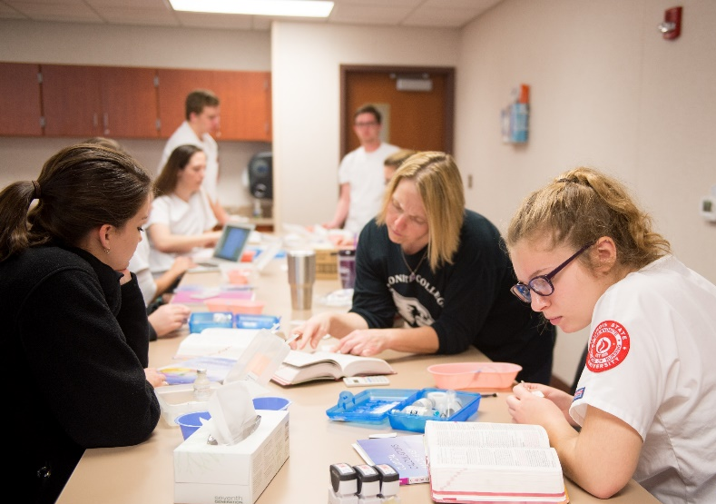
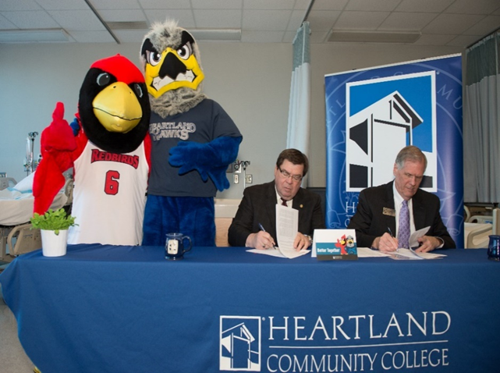
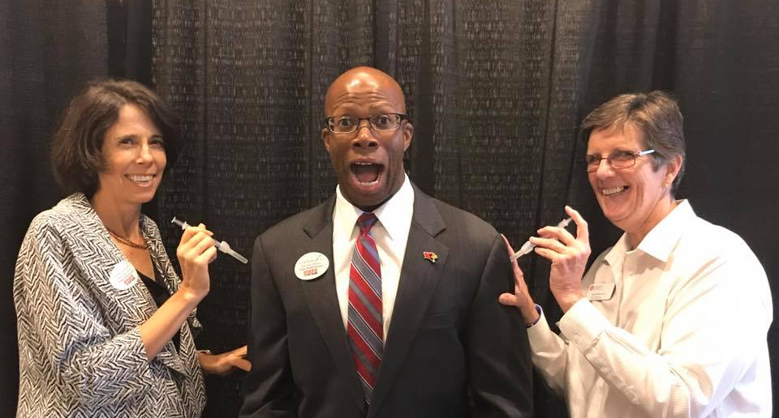

Strategic Goal 3
⇦
Grow Strategic
Partnerships
FY18 Accomplishments
Partnered with Heartland Community College to offer dual enrollment for RN to BSN program
$99,322
IBHE grant
to establish a
Dedicated Education Unit at Advocate BroMenn for
Accelerated BSN students
Collaborated with Student Health Services to offer a flu shot clinic to ISU faculty and staff
MCN selected as
1 of 4
Preferred Education Partners in IL for
Advocate Health Care

Slide 18



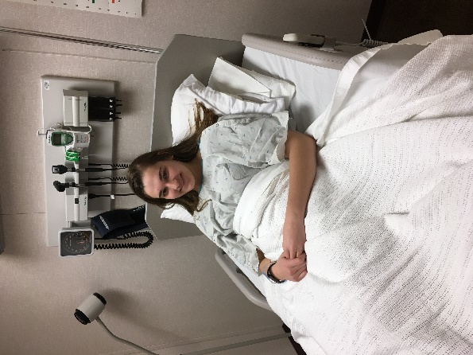
Strategic Goal 3
⇦
Grow Strategic
Partnerships
FY18 Accomplishments
Summer School Nurse Institute offered for its 6th year
204
undergraduate clinical sections
31
facilities
Leadership Brain Trust formed

Leadership Rising,
featuring Laurie Benson, Executive Director of Nurses on Boards Coalition
7
days a week
8
hours a day
Theater students employed as standardized patients
73
sections on weekends

Slide 19
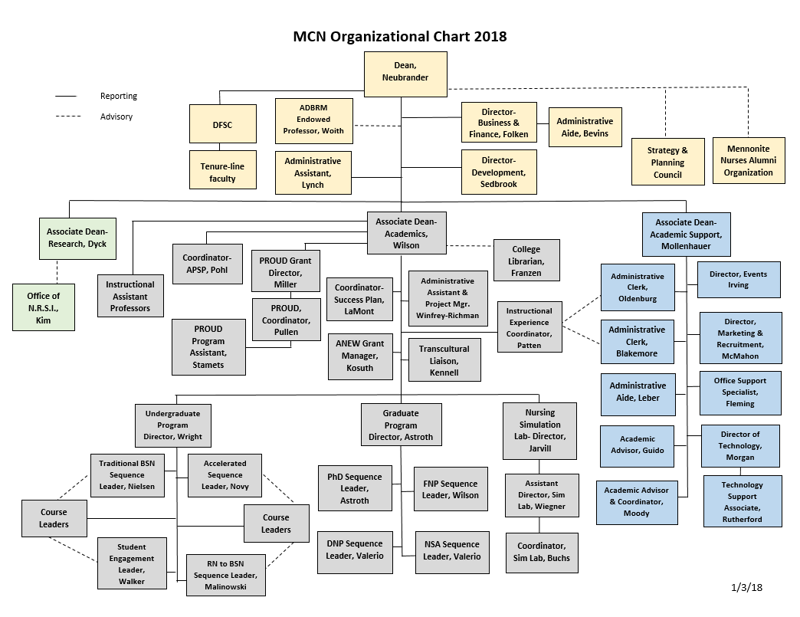
Strategic Goal 4
⇦
Promote Faculty and Staff Excellence
FY18 Accomplishments
Restructuring plan implemented

Leadership positions redefined

Associate Dean for Research
Mary Dyck

Associate Dean for Academics
Denise Wilson

Associate Dean for Academic Support
Janeen Mollenhauer
Associate Dean- Research, Dyck
Associate Dean- Academics, Wilson
Associate Dean- Academic Support, Mollenhauer

Slide 20
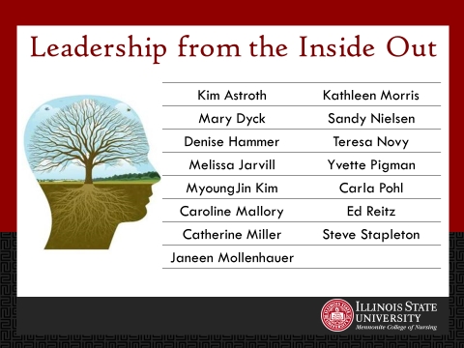


Strategic Goal 4
⇦
Promote Faculty and Staff Excellence
FY18 Accomplishments
75%
Clinical faculty
Part time
Hiring more FT faculty to decrease Part Time ratio to 55%
Collaborated with Student Health Services to implement Point and Click Software sharing project
Weekend clinicals increased from
26 to 73
All new faculty assigned a mentor

Grant-writing guidance

Slide 21
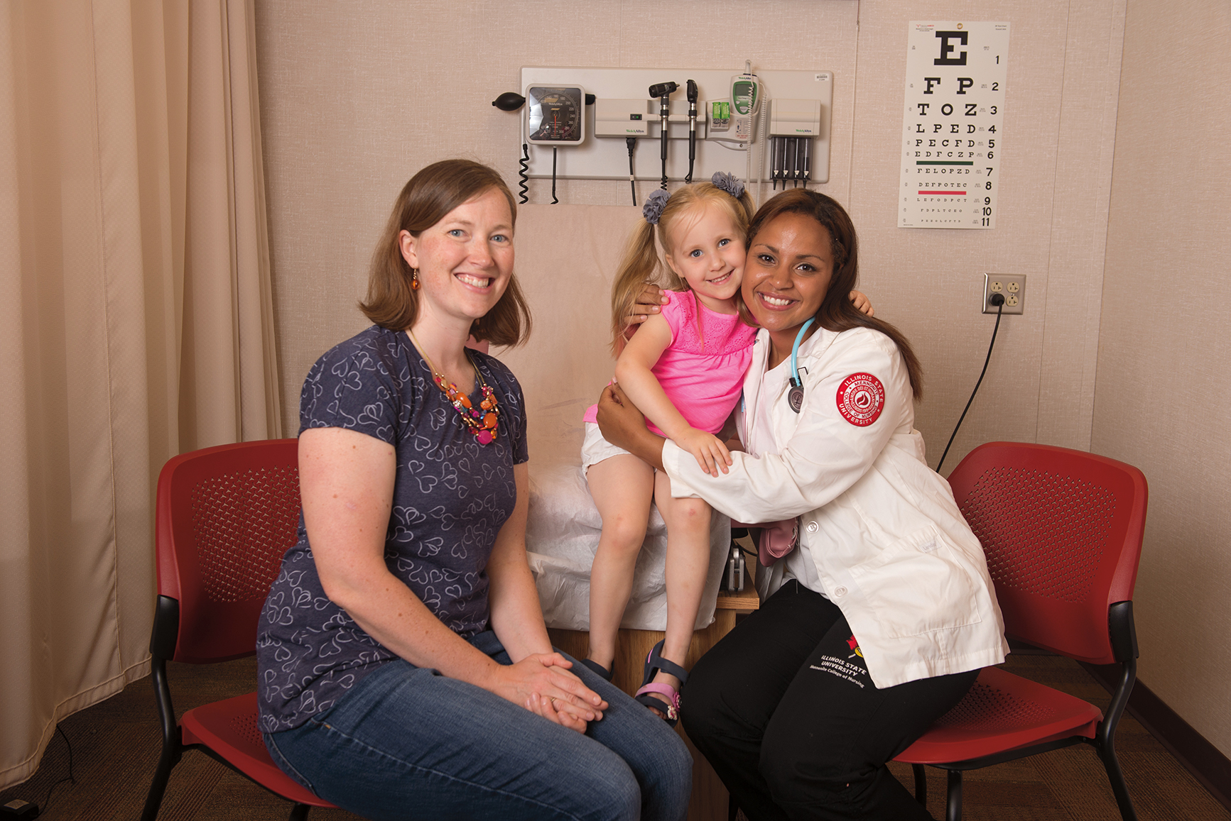
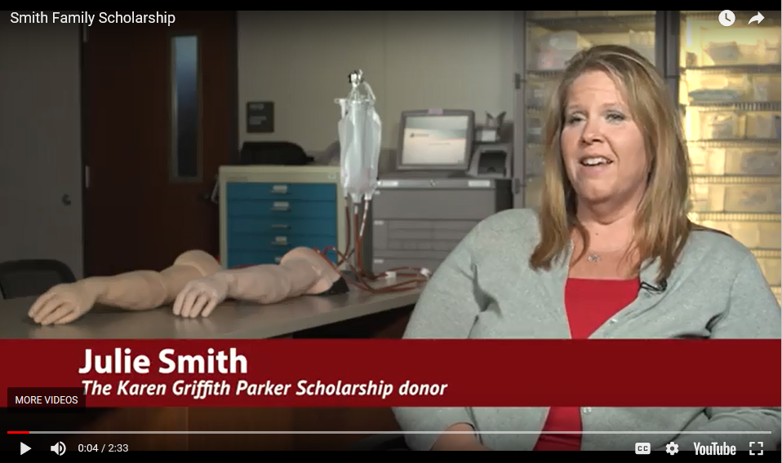
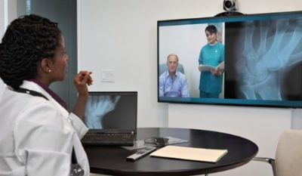
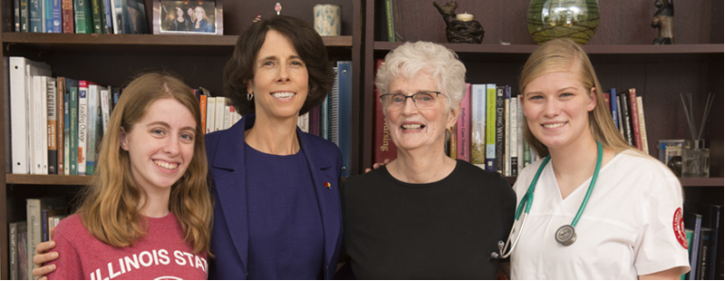
Strategic Goal 5
⇦
Sustain Resources Aligned with Strategic Priorities
FY18 Accomplishments
Communicated specific needs to donors

$26,000
for telehealth equipment for the
Sim Lab
Campaign priorities shared through personal conversations  case statements  email updates  written materials  videos
Campaign volunteers recruited to identify prospects, sponsor gatherings, and share stories about MCN

Slide 22

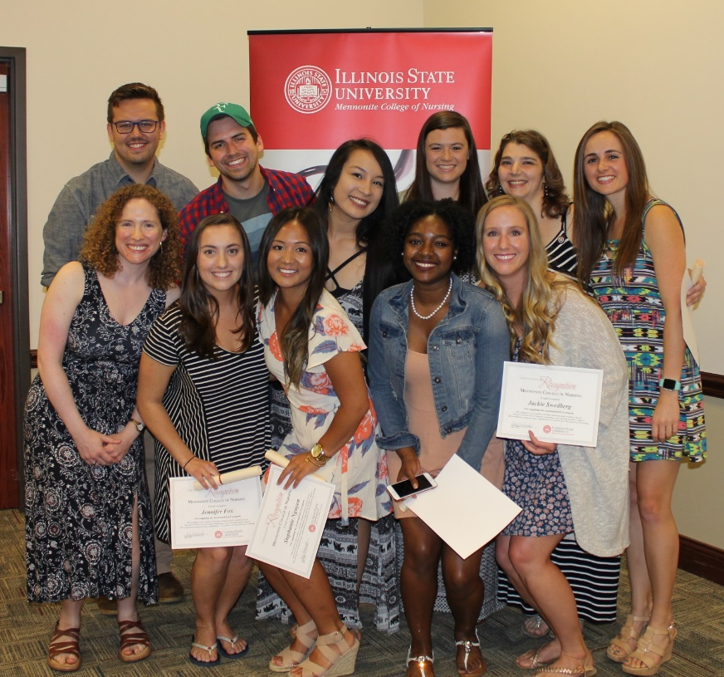

Strategic Goal 5
⇦
Sustain Resources Aligned with Strategic Priorities
FY18 Accomplishments
Campaign goal
$7.5M
Added Accelerated sequence to the on campus Full Cost Recovery model
(begins Summer 2018)
Raised to date
$5,061,895
67%
of campaign goal
Began discussions with local donors regarding an integrated health building
Rivian  OSF St. Joseph Medical Center  Chestnut Health Systems
Raised in FY18
$372,064

Slide 23
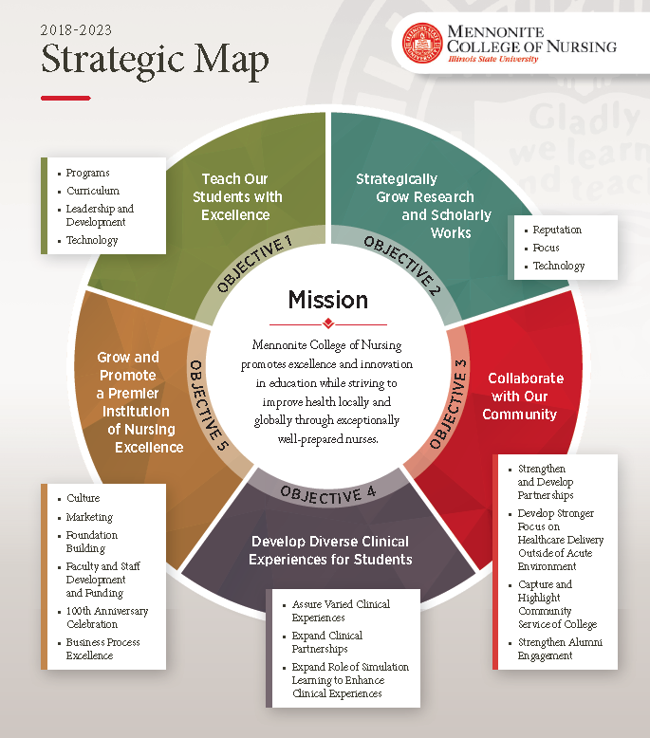
2018-2023
MCN completed an assessment of the current state of the College and set goals moving forward

Led by Tom Carroll,
former Executive Vice President and Chief Administrative Officer at RR Donnelley,
and ISU Alum

Slide 24

Strategic Goal 1
⇦
Teach our Students with Excellence
Looking Ahead – FY19
Curriculum
Holistic review and adjustment of undergraduate and graduate curricula – calibrate with best practices, industry needs, licensure requirements, and accrediting agencies

Align testing with NCLEX standards throughout undergraduate program
Leadership Development
Explore strategic campus-wide partnerships: MSN/MBA; MPH

Conduct Leadership Academy
Technology
Develop digital testing
(online testing platform)

Slide 25
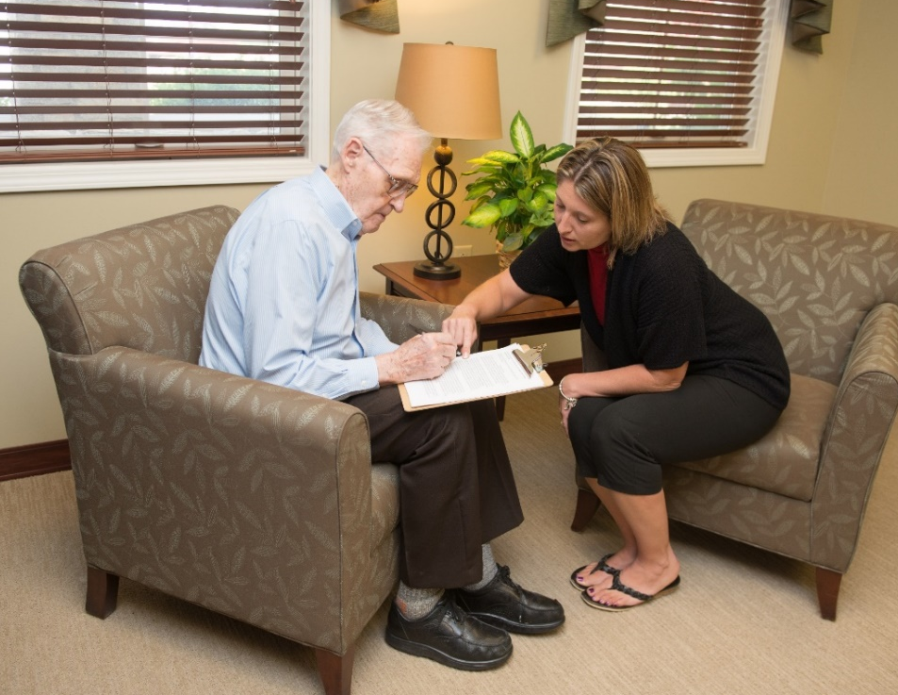
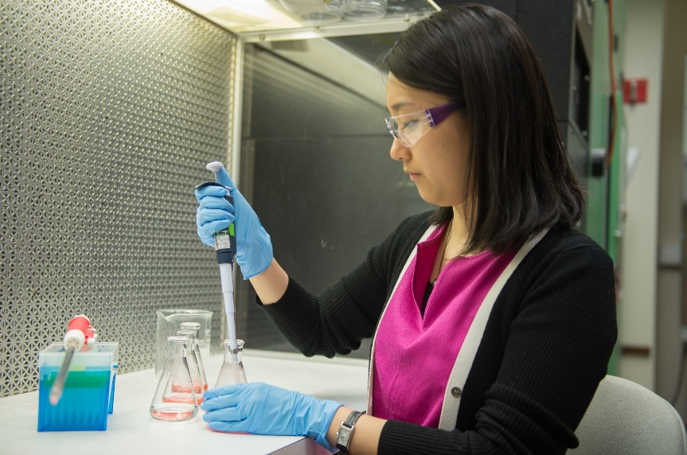
Strategic Goal 2
⇦
Strategically Grow Research and Scholarly Works
Looking Ahead – FY19
Reputation
Hire faculty with motivation for research

Assess faculty needs and impending retirements
Focus
Diverse populations  Vulnerable people  Cross discipline  Clinical practice
Leverage Technology
to enhance programs that require research
(PhD, DNP, etc.)

Develop timeline tracking system for grant and IRB protocol submissions, and research projects

Slide 26

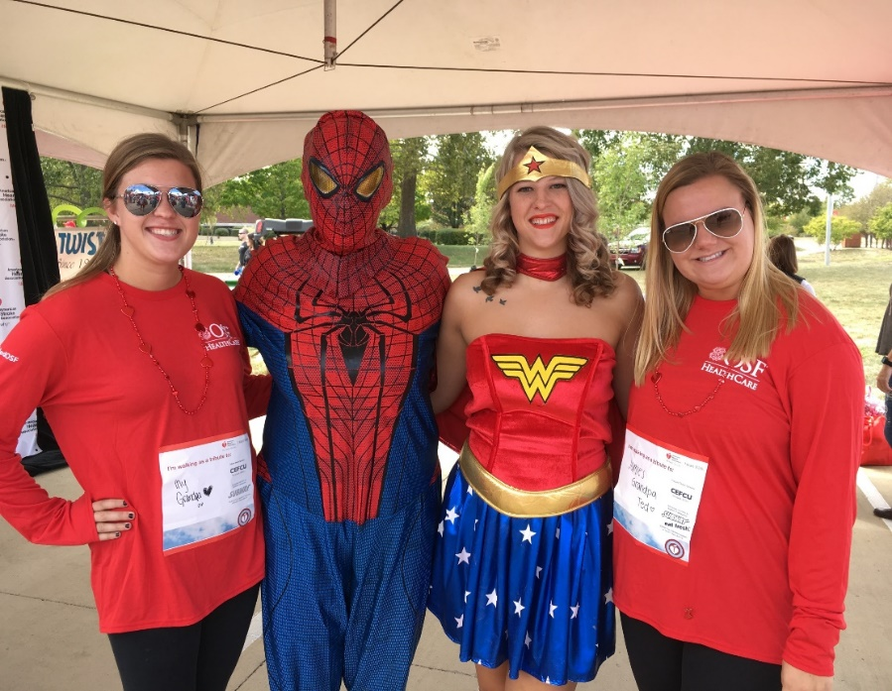
Strategic Goal 3
⇦
Collaborate with Our Community
Looking Ahead – FY19
Capture and Highlight Community Service of the college
Strengthen and Develop Partnerships
Student education that benefits the community
Feature health-related service work in branding stories about the college
Strengthen Alumni Engagement
Fundraising  Developing clinical sites  Collaborating on community service projects  Assisting in classroom or sim lab learning  Mentoring students in the clinical setting in which our alumni work

Slide 27
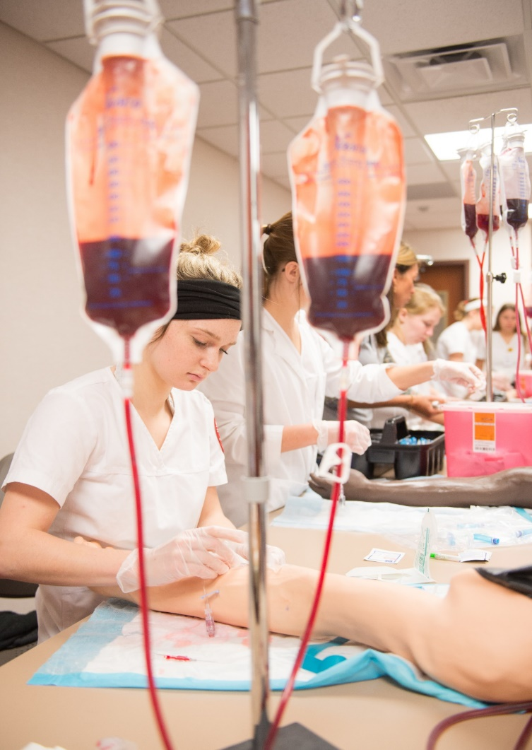
Strategic Goal 4
⇦
Develop Diverse Clinical Experiences for Students
Looking Ahead – FY19
Assure Varied Clinical Experiences
Expand Clinical Partnerships
Change Agents to the Underserved: Service Education (CAUSE)
HRSA Primary Care Grant pending
Increase Role of Simulation Learning to Enhance Clinical Experiences

Slide 28
Strategic Goal 5
⇦
Grow and Promote a Premier Institution of Nursing Excellence
Looking Ahead – FY19
Culture
Clarify job responsibilities  Assess job satisfaction
Marketing
Design and implement a recruitment plan that is
100th Anniversary Celebration
Engage community, alumni, faculty, staff, and students

Link celebration with
Redbirds Rising goals
Foundation Building
Create vision for a new building and begin planning

Inspire the community, alumni, and donors with the possibilities

Seek commitments of financial support
S | pecific
M | easurable
A | chievable
R | elevant
T | ime-bound
Faculty and Staff Development and Funding
Assess needs and deliver development to faculty and staff

Slide 29
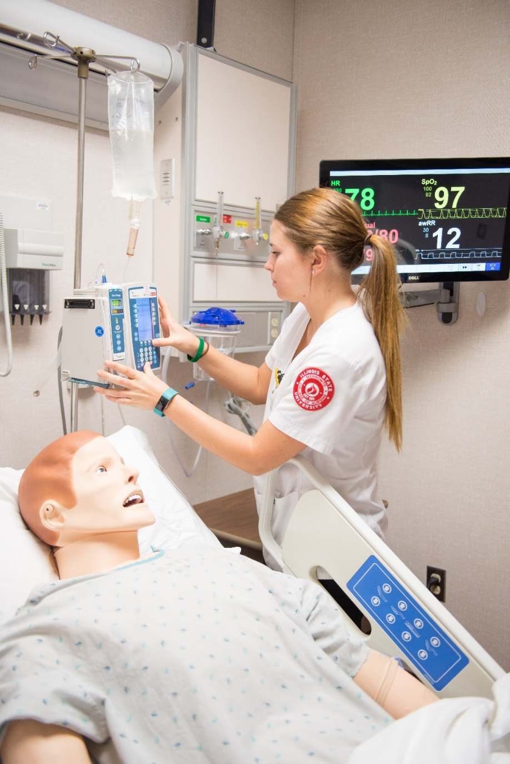
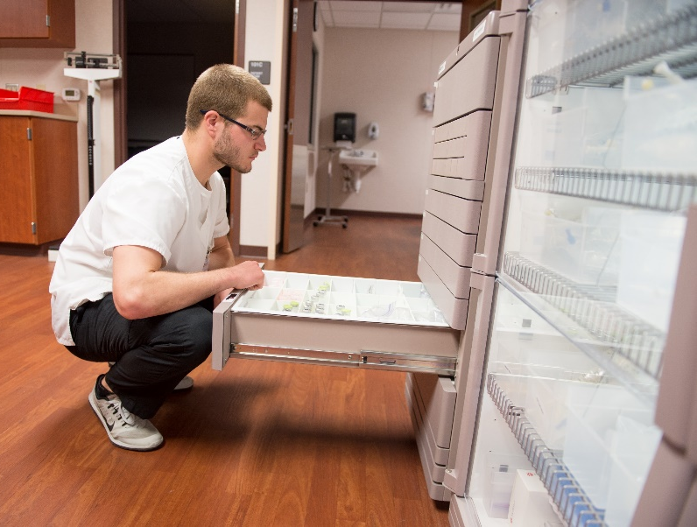
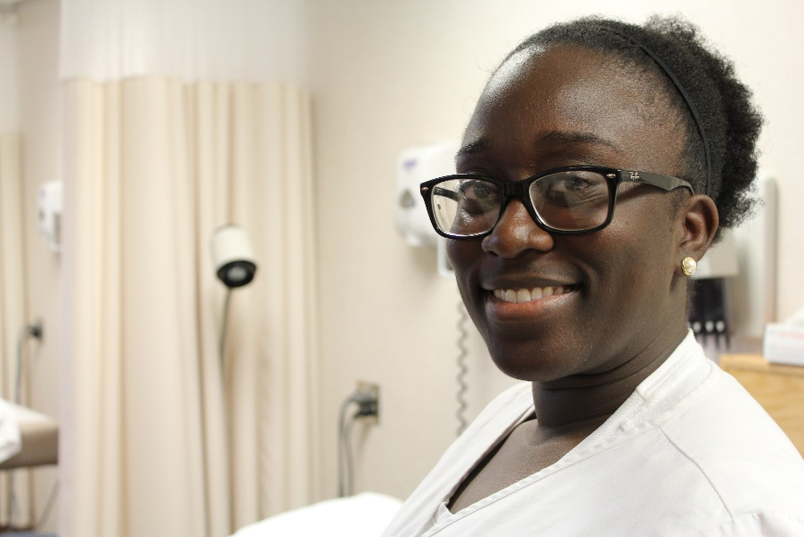
Permanent Funding Requests
Civil Service Exempt position BSN Clinical Simulation Lab Coordinator to assist with increased use of the simulation lab

Slide 30

Strategic Budget Carryover
Summer 2018 expenses paid in FY19 $137,345 | Civil Service Extra Help support $5,000
IBHE buyouts for FY19 activities $38,379 | Course release for scholarly endeavors $42,000
GA support $70,000 | Summer research faculty fellowships $20,000
Student worker support $55,000 | One Predictive, Google Adwords Audit and Consultancy $6,000

Slide 31
Provost Enhancement Requests
Feasibility study for a new building $100,000 | Facebook lead generation $24,000
Explore expanding the Nursing Simulation Lab $15,000 | Advertising $24,000
Computer Lab refresh $21,000 | Brand perception study $43,000
Digital recruitment funds $63,768 | Standing work stations $4,800

Slide 32

Personnel Requests
4 Tenure Track Faculty PhD and DNP prepared nurses to teach in the undergraduate and graduate programs

Slide 33
Thank you
To all the Mennonite College of Nursing faculty, staff, and students for making our college such a wonderful place to
learn and teach

Slide 34
Questions?

