Slide 1
Milner Library FY19 Annual Report FY20 Planning Document
Shari Zeck, Interim Dean
March 26, 2019

Slide 2
Milner Administration
Leta Janssen, Business Manager
Chad Kahl, Associate Dean
Dallas Long, Associate Dean
Colleen Rice, Communications Director
Shari Zeck, Interim Dean

Slide 3
FY19 ANNUAL REPORT

Slide 4
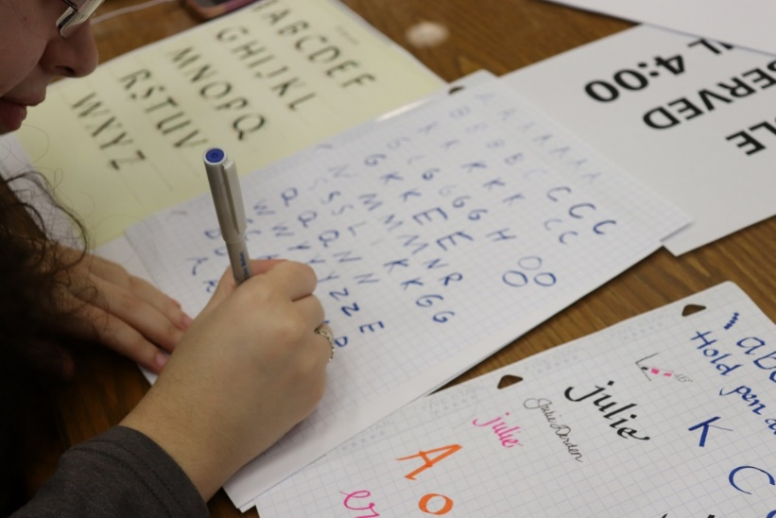
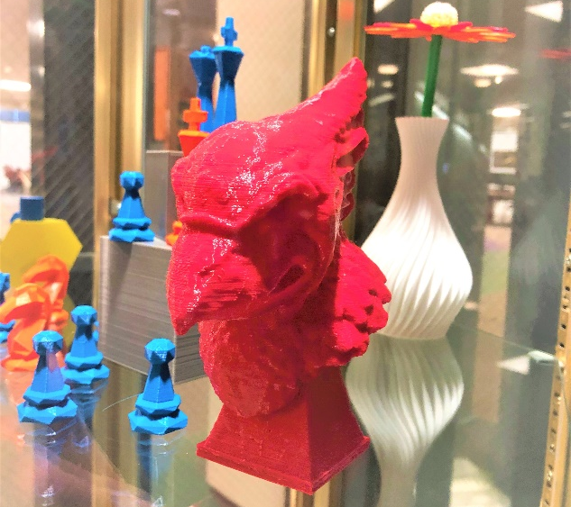
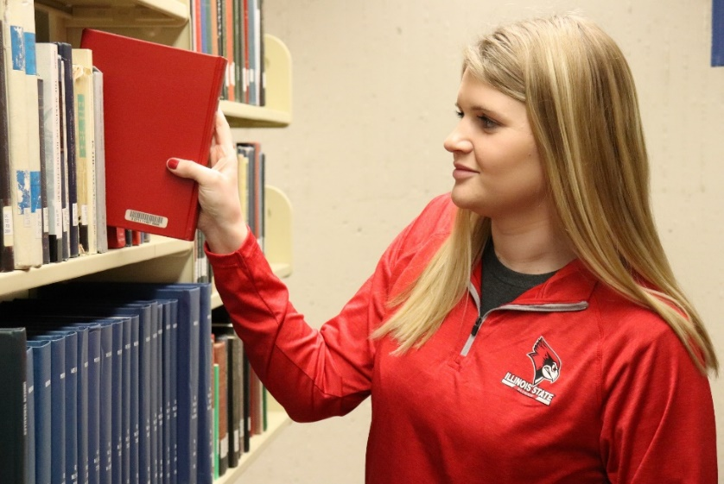
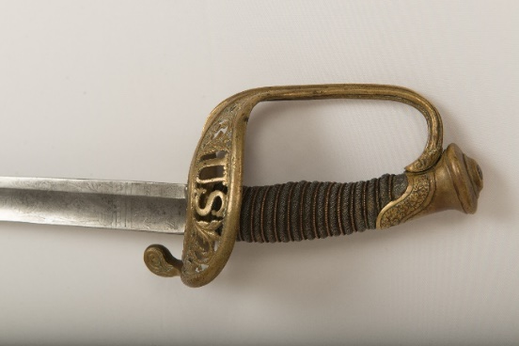
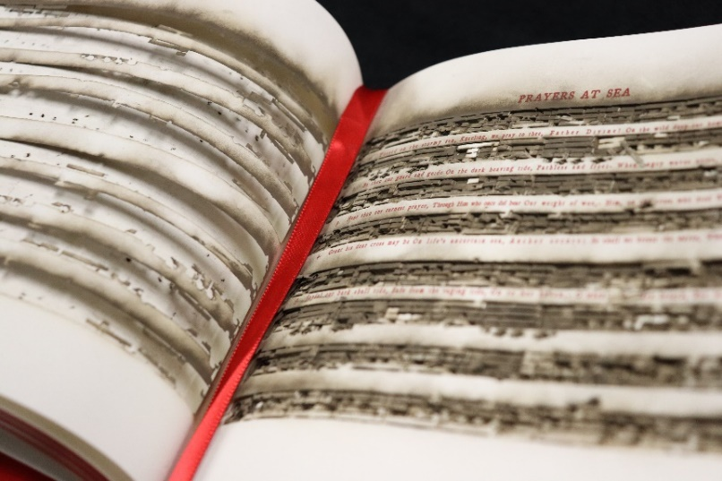
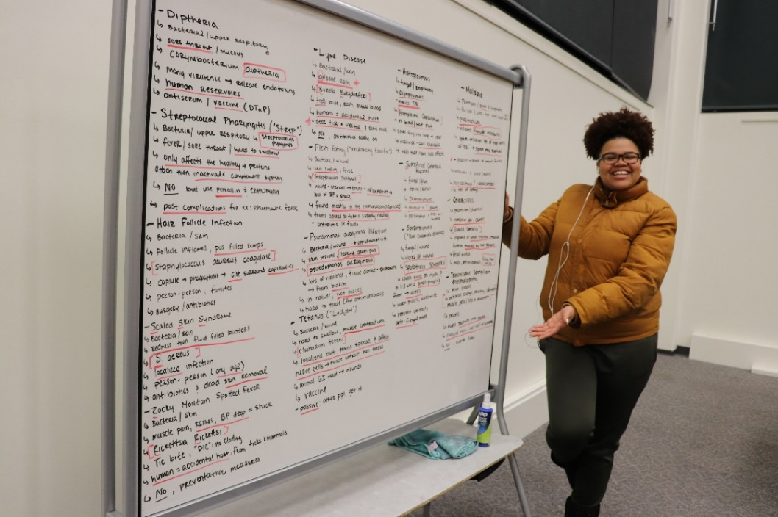
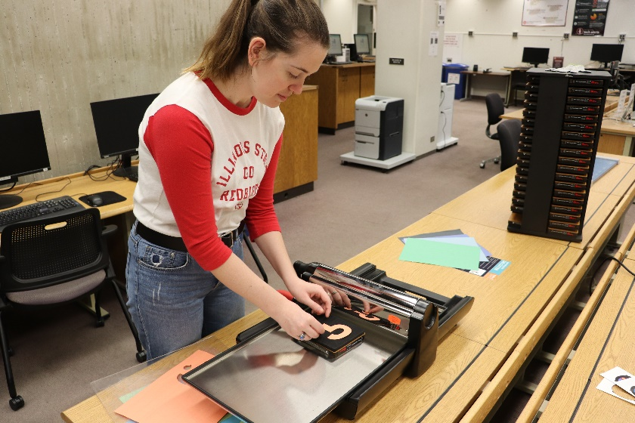
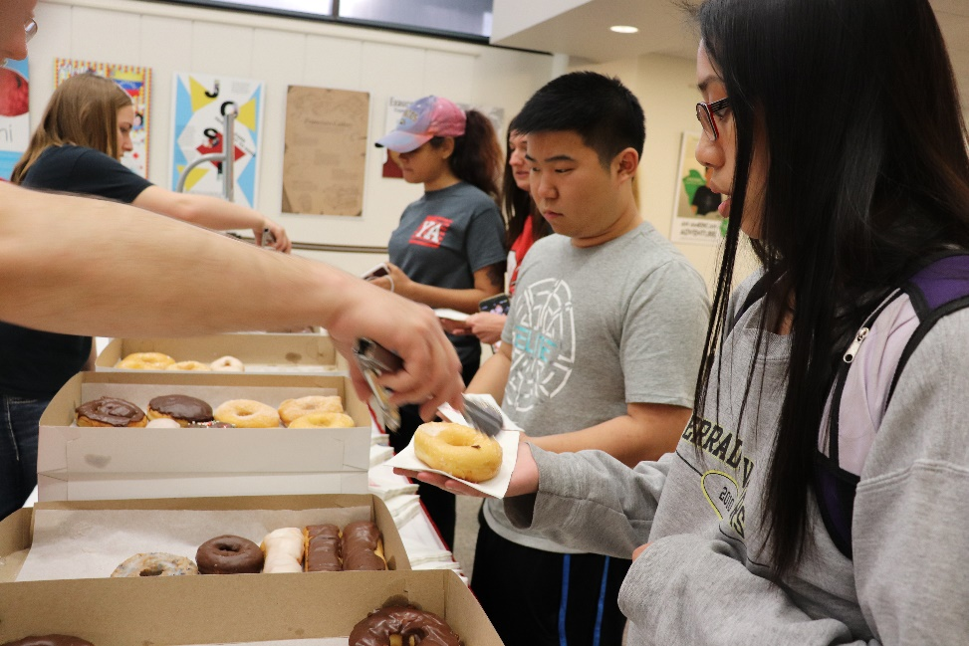

Slide 5
GOALS and ACCOMPLISHMENTS
FY19

Slide 6
Accomplishments
Begin implementing Master Plan. (after Educate. Connect. Elevate I.D.4)
Removal of low use reference materials on floor 2 has yielded a space that will accommodate additional student seating.
Worked with campus partners to develop wishlist for Student Success Center. A QBS has been issued to secure an architect to turn our wishes into a design for renovation.
Improve Milner communications, both internal and external (after ECE I.D.2 and IV.B.1)
Milner Communications Committee to develop a marketing toolkit to coordinate the messaging across Milner activities
Improved signage at entrance to Milner
Developed a brief handout for faculty regarding Milner resources
Created more engagement opportunities for students, including celebrations for National Handwriting Day, National Library Week, informational bathroom newsletters, and weekly online trivia

Slide 7
Accomplishments
Optimize our use of shared resources (after ECE IV.B.4)
Upgraded our interlibrary loan software to Tipasa
Partnered with History faculty to integrate primary sources into additional History classes.
Added Digital Object Identifiers to all library published journal articles in ISURed (made articles easier to find)
Genre headings for picture books added to over 11,000 catalog records
Faculty members Jean MacDonald and Eric Willey are collaborating with the Publications Unit to publish a serialized novel by African-American author Clarissa Minnie Thompson Allen.
“Shakespeareance,” a collaboration led by Jean MacDonald and Tara Lyons, worked with the Illinois Shakespeare Festival to hold an event celebrating all things Bard, and included speakers from around the state.
Added 3D printing capability and quickly reached our capacity to meet student requests.

Slide 8
Accomplishments
Improve fundraising prospects (after ECE I.C. 1 and 3)
Exceeded our campaign goal.
Followed monthly schedule of gift acknowledgements and contacts with donors
Sent a special solicitation letter over the summer to encourage donors within $500 of our $1000 “Ange’s Keepers” level of giving $1000 during the course of Redbirds Rising and nearly doubled our number of “Keepers”
Review resource allocation (after ECE I.D.3 and II.C.3)
Continued to add electronic backfiles for journals, providing greater ease of searching them while also recovering physical space in the library
With a flat annual budget, we must constantly consider cuts in the number and kind of purchases to meet our budget goals

Slide 9
MEASURES OF PRODUCTIVITY
FY19

Slide 10
Measures of Productivity
Over 275 individual library instruction sessions in Fall of 2018
Gate count is down nearly 20K over last year
In-library 3 hour checkouts for laptops exceeded 9,000
Approximately $60k saved via cancellation of print and journal subscriptions, whose cost per use was greater than $75
Our faculty have produced several outstanding articles, conference presentations, and workshops this year. Among the highlights are:
Two articles in a special WWI themed issue of Illinois Heritage, one by Angela Bonnell and the other by April Anderson-Zorn
Sandy Roe served as editor of Cataloging and Classification Quarterly
Chad Buckley serves as Biology subject editor for Resources for College Libraries and reviews books for Choice
Van Schwartz reviewed and revised the “Women Internationally” section of the ACRL Women and Gender Studies Section Research Agenda
Maureen Brunsdale wrote an article for Bandwagon, the official publication of the Circus Historical Society

Slide 11
INTERNAL REALLOCATIONS AND REORGANIZATIONS
FY19

Slide 12
Internal reallocations and reorganizations
Interim appointments
Acting Head of Cataloging, Acquisitions & Processing (TT Faculty)
Reclassified
University Archivist (AP to TT Faculty)
Retirements
Subject Liaison (NTT)
Government Documents Assistant (CS)
Cataloging (TT Faculty)
Distribution Clerk/Facilities Manager (CS, forthcoming in June)
Resignations
Subject Liaison/Instruction (NTT)
Continuation Specialist (CS)
Digitization Coordinator (AP)
Director of Communications and Outreach (AP, forthcoming in April)
Unix Administrator (CS)
New Positions
Head of Cataloging, Acquisitions and Processing (TT Faculty, Begins July 1)
Coordinator of Preservation (TT Faculty, unsuccessful)
Replacements
Conservator (AP, hired May 2018)
Digitization Coordinator (AP, search in progress)

Slide 13
USE OF ADDITIONAL FUNDS
FY19

Slide 14
Use of additional funds
Temporary funds from the Provost’s Office
Milner Library received $25,000 in Provost Enhancement dollars which were used to purchase a book imaging system.
Approximately $35,000 of Technology Tuition Funds were employed student assistants in the lab
External Funding
During FY19 Milner Library received $345,545 from the Library of Congress for the continuation of the Teaching with Primary Resources program.
Our $328k grant to support digitization of circus route books is in its second year

Slide 15
Use of additional funds
Foundation Funds
Foundation funds were used by Milner for book purchases, alumni events, speaker honorariums and travel
Other Variance Funds
$99,000 of SBC funds were used to purchase electronic Web of Science backfiles.
The remainder of Milner’s SBC we will ask to carry over into 2020, as the delay of the plaza repair prevented its expenditure.

Slide 16
FY20 PLANNING

Slide 17
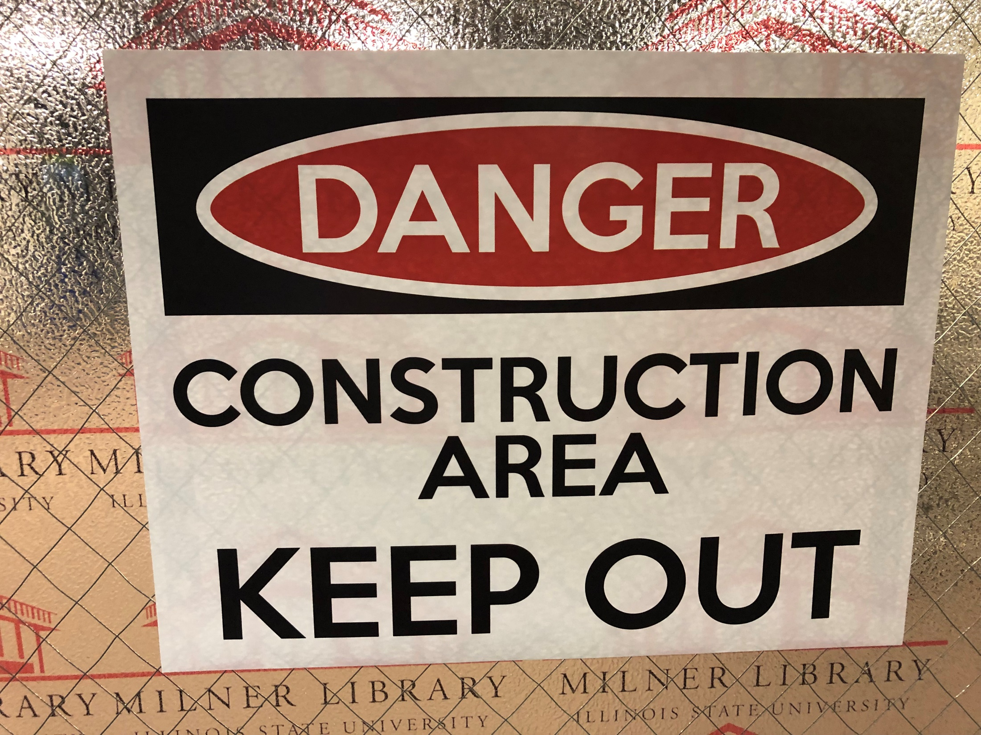

Slide 18
OBJECTIVES
FY20

Slide 19
Objectives
Refine library systems and processes (Connect)
The library information system shared among CARLI libraries is changing from “Voyager” to “Alma.” “Go live” is set for summer of 2020.
Assess and communicate needs for faculty researchers (Educate and Connect)
Complete report from Digital Humanities working group and begin implementation
Work with Office of Research and Graduate Studies to educate faculty on predatory journals, open access, and the changing landscape of academic publishing and library acquisitions.
Continue to expand and communicate the resources of Special Collections to ISU classes
Prepare digital collections short and mid term plans

Slide 20
Objectives
Promote faculty recruitment, retention, and development (Elevate)
Work with Provost to identify mid to long term strategy for increasing number of tenure track positions in Milner.
Encourage faculty research through information sessions on grants and finding the right publisher for your work.
Work with CODSULI partners to create career fair for information professionals.
Celebrate and share faculty research.

Slide 21
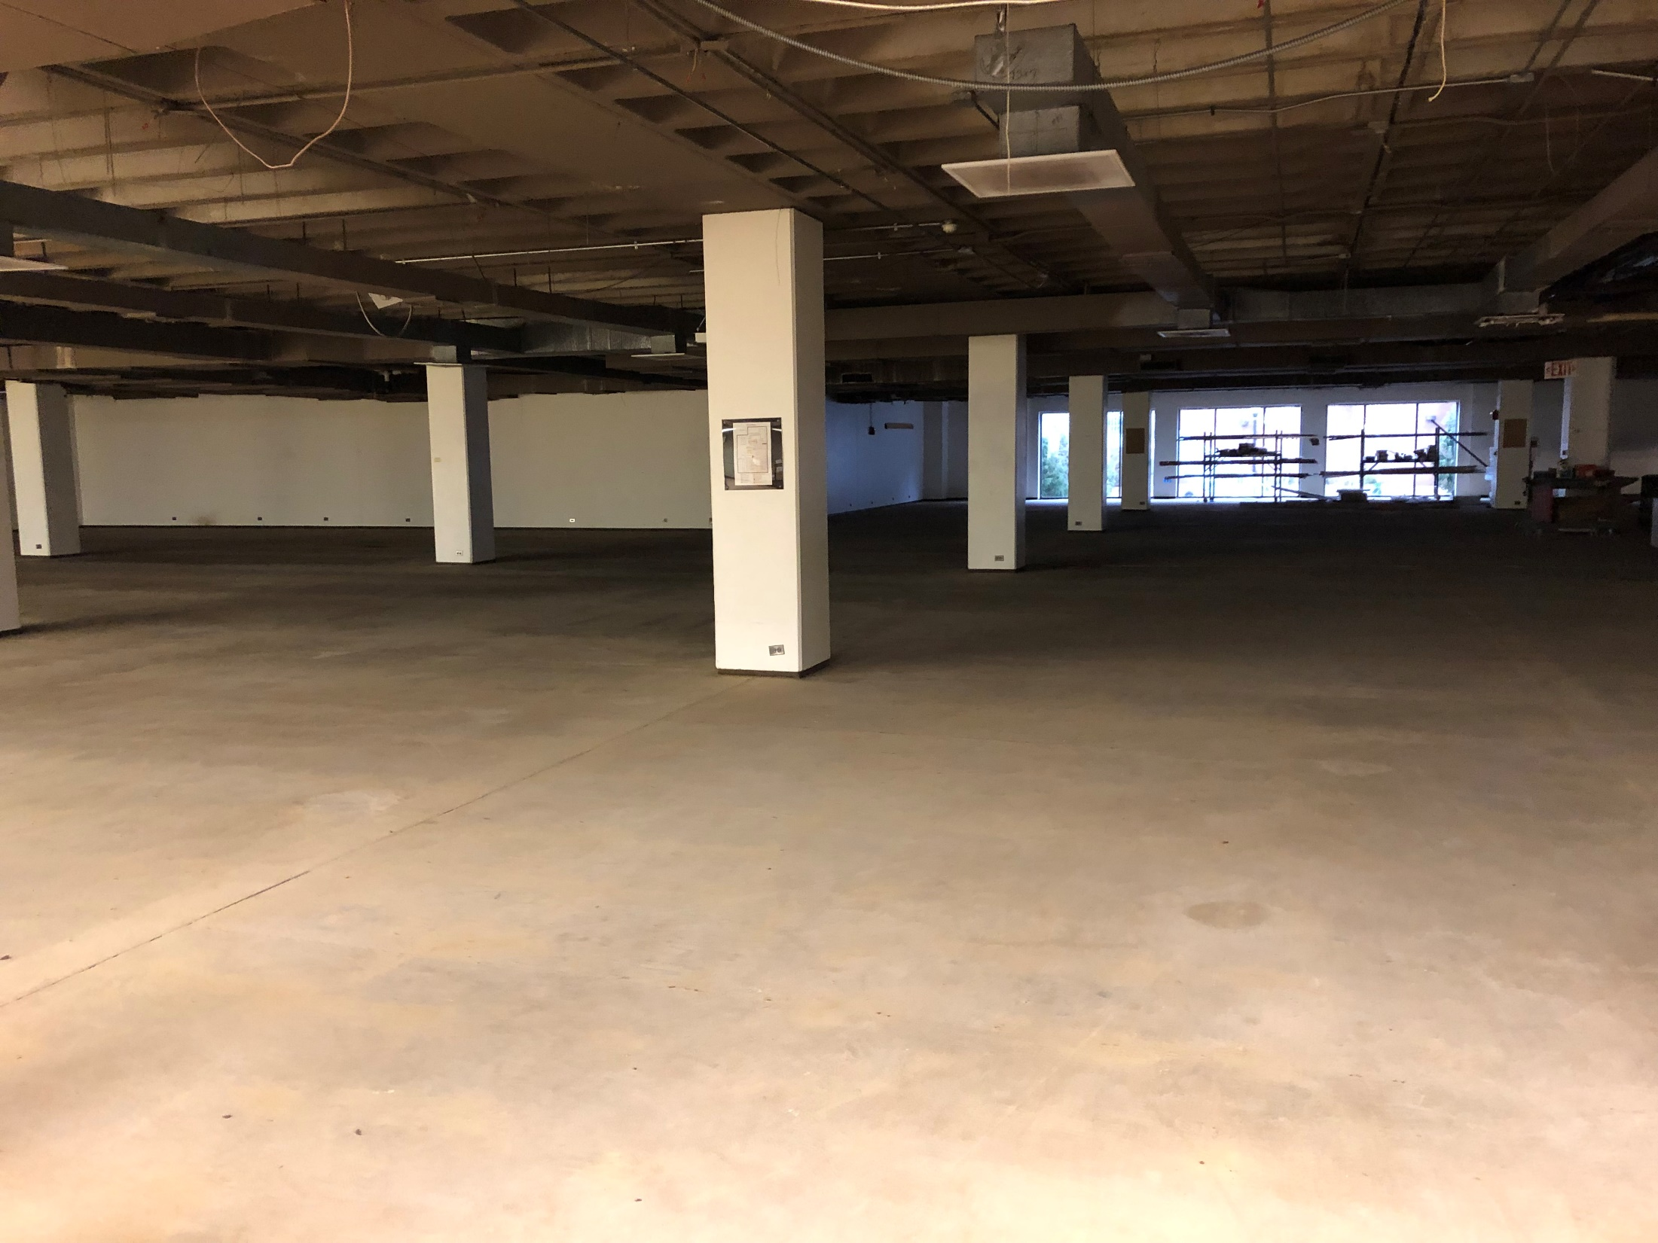

Slide 22
Objectives
Begin construction of Student Success Center (Educate)
Choose an architect, and work with them to develop a design plan as facilities completes repairs of floor one.
Begin contracting for construction as soon as possible.
Continue to work with advancements to find private dollars to support the Student Success Center into the future.
Develop plan for handling second entrance to Milner.
Work with campus partners to plan delivery of technology support in SSC
Make@Milner: a work in progress, eventually part of the SSC

Slide 23
Objectives
Continue to review resource allocation (Elevate)
Continue refinement of comprehensive collection development plan, including collection analysis associated with the programs undergoing Program Review.
Establish baselines for collection and item usage, and improve our consistency in making decisions about acquisition and deacquistion that are informed by this data.
Where financially feasible, convert existing serials to electronic backfiles
Return IRMA annex to first floor (when construction complete), as well as returning IRMA volumes stored off campus to compact first floor storage
Develop zero-based personnel plan for public services to help assess work distribution and inform future hiring; refine similar plan for cataloging and acquisitions
Integrate collection development plan in to next round of program reviews

Slide 24
REQUESTS
FY20

Slide 25
Requests
PERM - none
SBC - $2.7M, $1.4M of which is new this year
PE - none
IC - none
Supplemental IC - none
Personnel Requests: Tenure Track Faculty
Student Success Librarian (Assistant/Associate)
STEM Librarian (Assistant/Associate)
Applied Sciences Librarian (Assistant or Associate)
Data Librarian (Assistant/Associate)
Coordinator of Preservation and Unique Collections (Associate/Full)
Metadata Specialist (Assistant/Associate)

Slide 27
THANK YOU!

Slide 28
QUESTIONS?

